Slide 1
  “Septic Installation”

Slide 2
Septic Installation
This course is intended for the septic professional and will focus on understanding many of the Minnesota code requirements for septic installation along with offering a variety of methods and techniques.
A basic understanding of septic systems is required.
This is not a college type course and as such some of the contents may be simplified or generalized so that we can understand the basic concepts without getting lost in the details.

Slide 3
Introduction
With increased knowledge and experience, the Design, Installation and Maintenance of septic systems continues to improve across the state of Minnesota, and the septic industry benefits as a whole.
This training course will continue down that path by providing a variety of installation examples and solutions for you to consider that all meet MN7080 code requirements. Explanations will be given to help understand why we are required to do the things we do.
We will also share methods and ideas that others in the industry have found to be very useful.
Changes in the code are still new to many people, as such we will take some time to review many of the code requirements.
Education helps us all, and as a septic professional you should try and make an effort to spend some time doing “the other guys” job. You’ll be amazed at what you can learn when you see things from a different point of view. There is always room for improvement and quite often people don’t realize what they don’t know. The knowledge gained from doing so will allow you to improve the quality and efficiency of your own work, which in the long run saves you time and money, and ensures a more satisfied customer.

Slide 4
As a professional installer you will learn what works and what doesn’t. With experience you will begin to look at designs and occasionally notice things that just don’t make sense, and you may doubt the designer.
On the other side of the coin is the Designer who may have a reason for an unusual design.
Therefore, when you see something on a design that looks odd, or you have an idea that could improve the situation, don’t just change things on your own, call the designer and tell them about your concern or idea and offer to make a suggestion.
A difference of opinion doesn’t necessarily make something right or wrong.
Perhaps the designer was directed by the homeowner to do things a certain way that you are not aware of.
Regardless of the situation, if you can point out a mistake before it becomes a problem, the designer, inspector and homeowner will all be very grateful.
But if you change things on your own, you may end up having to re-do your work, or worse yet in need of a good lawyer!
Avoid any stress by starting with a simple phone call.

Slide 5
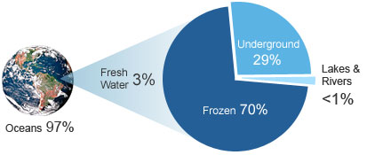
What’s the big deal?
Some people ask why we make such a big deal out of septic systems.
Water is necessary for all forms of life, and it is becoming apparent that there is only so much of it to go around.
The earth is mostly covered by water, but 97% of it is saltwater and only 3% freshwater. And of this small portion of freshwater, only a small fraction of that is available for human use!

Slide 6
Our septic tanks have what’s called “retention” time. This means the sewage that comes in the tank will be there for a certain amount of time before it gets flushed out the other end. This allows time for the treatment process to occur.
The same concept applies to all water supplies in the world, it takes nature time to replenish any given volume of water. It takes on average 10 days for water to evaporate from the earths surface then come back as rain , 200 years for Lake Superior to be flushed out, and 100’s to 1000’s of years for aquifers to be replenished.
What this means is that once we pollute this water, it’s going to take at least this long to clean it up, assuming we first stop polluting it in the first place!
This is why capping an unused well is so important, as to not allow pollutants to get direct access to a water supply.

Slide 7

So what’s the answer?
Locally in Minnesota we do not have a water shortage, and currently we may not be getting sick from our water, but that day could be coming soon if we are not careful. And that’s where our septic code comes in, and the importance of our industry. As septic professionals we play a big role in the quality of our water, the results aren’t always obvious and immediate, but they are there, and those little things do add up.
So take pride in the fact that the work you do, IS very important.

Slide 8
The purpose of this course is to brush up on our skills, to review old concepts and introduce some new ones, as well as offer suggestions of how we can improve them all.
This training course is primarily based on the 2011 MN7080 purple code book, and will only focus on ISTS (1-5000 gal/day). None the less most of the concepts will apply regardless of system size, or the code version you are using.
Our Minnesota septic code has grown very specific and quite detailed, there is not as much room for flexibility as in the past.
As such make sure you follow the design exactly. Each specification in the design must be installed as stated. These items were calculated for a reason and must be followed.
Also make sure you are building from the “permitted” design as issued from the local permitting authority. The design you initially received from the home builder, property owner or designer may not be the approved final draft. As such you could end up building the system without the latest required changes.

Slide 9
Course Contents
1 - Septic tanks 17 - Pump ON/OFF float swing
18 - Watertight risers
3 - Pump types & sizing 19 - Watertight pipe to riser
4 - Tank venting 20 - Supply pipe support & seal
5 - Tank burial depth 21 - Drainfield excavation
6 - Tank insulation 22 - Bed laterals & sandy trenches
7 - Securing riser lids 23 - Lateral cleanouts
8 - Tank watertight testing 24 - Clean out access
9 - Tank seam separation 25 - Clean out shut offs
10 - Tank buoyancy 26 - Drainback air inlet
11 - Buoyancy calculation 27 - Drainback concerns
12 - Sewer lines 28 - Cleanout enclosures
13 - Pressurized supply pipe 29 - Counting laterals
14 - Supply line access 30 - Flushing laterals
15 - Pump quick disconnects 31 - Drainfields >1’ cover
16 - Float tree 32 - Securing inspection pipes
33 – Best management practices

Slide 10
1 – Septic tanks

Slide 11
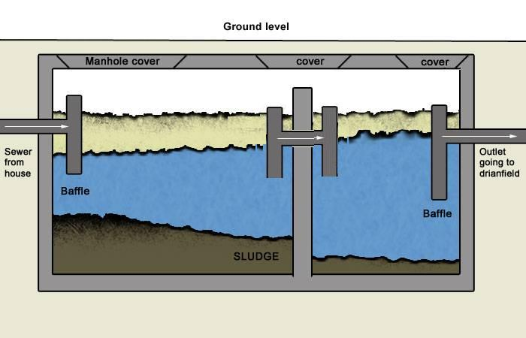
2 compartment septic with standard Baffles
(an inspection pipe or riser is req’d over the compartment wall)

Slide 12
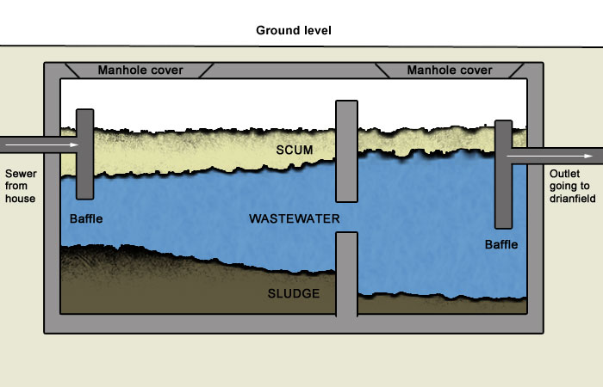
2 compartment tank with “Mole hole”
(no inspection pipe is req’d over the compartment wall)

Slide 13
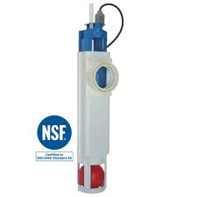
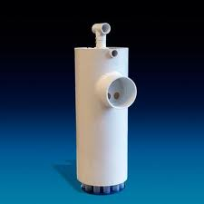
Effluent filters are NOT required on any standard septic
(The exception would be Sand filters or as specifically required by a pretreatment device.)

Slide 14
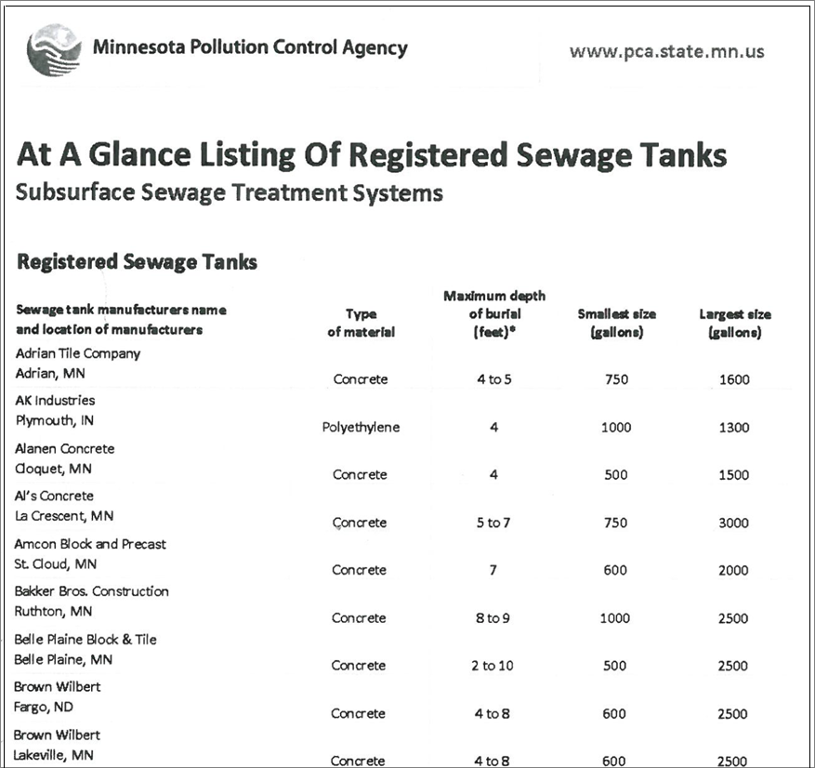
Starting with the 2013 construction season, contractors must use “registered” tanks only. Check the MPCA website at least every spring for a current list.

Slide 15
3 – Pumps: types & sizing
It may help to clarify the difference between some of the pumps available on the market.
“Grinder” pumps or “sewage ejector” pumps are typically your heavier duty pumps with metal impellers. These pumps are meant to pump liquids, solids, small toys or anything else that goes down the drain.
“Effluent” pumps are typically your lighter duty pumps that may use plastic impellers. These pumps are meant to pump liquids (effluent) only and as such are meant to be used in drainfield dose tanks or similar applications only. Do not use these pumps in a lift station where solids may still be present.
When purchasing a pump, make sure you are getting the right one for the job.

Slide 16
When determining the size of the pump to purchase, find the pump requirements as listed on the septic design worksheet.
You must then verify that your pump is adequate for this system. To do this check the “pump curve” to verify that the pump is capable of delivering the amount that is required in the design.
To simply assume a 1/2 horsepower pump will do the job is false. A large pump may be sufficient (or overkill) for most jobs, but the horsepower rating alone is meaningless and doesn’t guarantee it is adequate for the job.
Example:
The design may state a pump requirement of 40 gpm at 30’ of head.
Assuming a ½ horsepower pump will do the job is wrong, you must
check the pump curve.

Slide 17
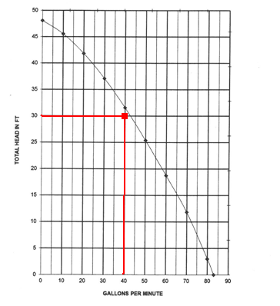
Pump curve for model XYZ
(this pump would just meet our 40 gpm @ 30’ requirement)

Slide 18
On a design it may state that the pump requirement is 40 gpm @ 30’ of head, but when you are installing the system you notice that there is only 8’ of lift from the bottom of the tank up to the drainfield laterals.
In this situation you may think there is some mistake with the design.
But the head requirement is not just the difference in elevation. Part of the head requirement is the friction loss in the pipes.
A high pump rate (40+ gpm), a long supply line (100+ feet), or a small diameter supply pipe would be the reason(s) your pump head requirement is so high, even though the elevation difference is quite small.
When in doubt have the designer recalculate the pump requirements.
But never install a pump whose pump curve shows it’s not capable of meeting the design specifications.
The following slide shows the two separate components that together make up the total pump head requirement.

Slide 19
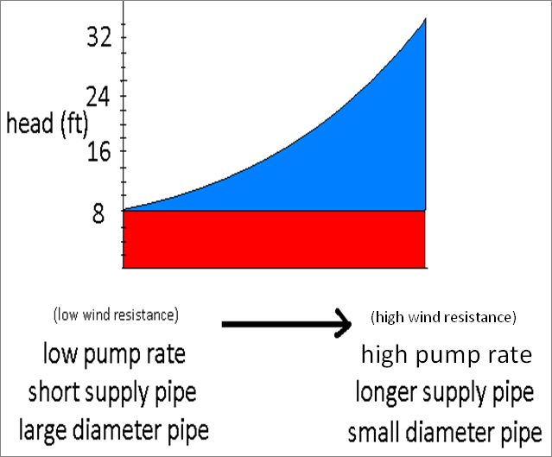
Total head = static head + dynamic head
(try and think of it as elev + wind resistance)
The head req’d for a system with 8’ of lift can range from 8 to 30+ feet of head. This chart is called a “system curve”, it’s the resistance of the septic system which varies depending on a few factors.

Slide 20
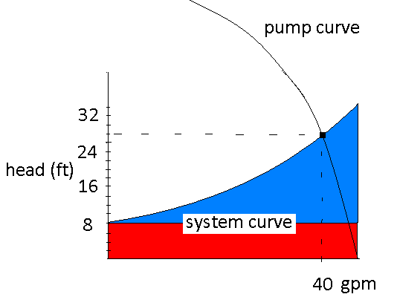
When you lay the “pump curve” over the “system curve”, the intersection is what the pump rate will actually be.

Slide 21
4 - Tank venting
All tanks must be vented to prevent a vacuum or pressure from building up inside the tank. This is normally achieved by the plumbing roof vent on the house.

Slide 22
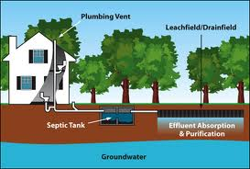
Normal venting through the roof stack

Slide 23
However if the sewage is pumped uphill to the septic tank, the pressurized line does not allow this normal path of venting. In this situation additional venting at the tank will need to be provided.
This same concern can apply when you have a pump that time doses to a pretreatment device. Most pretreatment units will provide for there own venting, but in this situation you need to verify there is venting to the down stream tanks such as the recirc tank or the pump tank.
It may be necessary to provide proper venting in these situations with an additional vent. A simple solution is 4” inspection pipe through the riser lid with a couple of 90 degree elbows to point the opening down.
To control odors a charcoal filter is often attached.

Slide 24
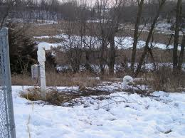
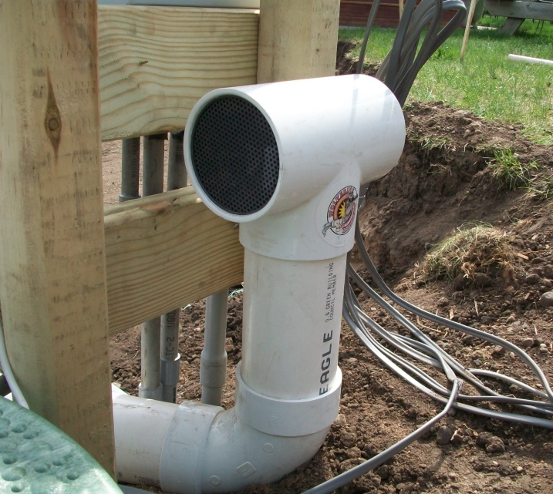
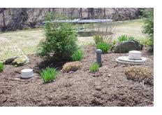

Venting at the tank
(Often includes a charcoal filter)

Slide 25
Unintended venting
On septic systems with a pump, there is a pipe containing the float & pump wires that runs from the riser to the splice box or control panel. If this pipe is not plugged it will allow venting to the control panel. These sewer gases and moisture will corrode the control panel and eventually ruin it.
The electrical components in the panel also create the possibility of a spark that could ignite any explosive gases that may be present.
As such the electrical code requires the pipe containing the sewer gases to stop short of the control panel and is to be capped or plugged with “duck seal” to stop the unintended venting to the control panel. The open wires can then continue on to the control panel.

Slide 26
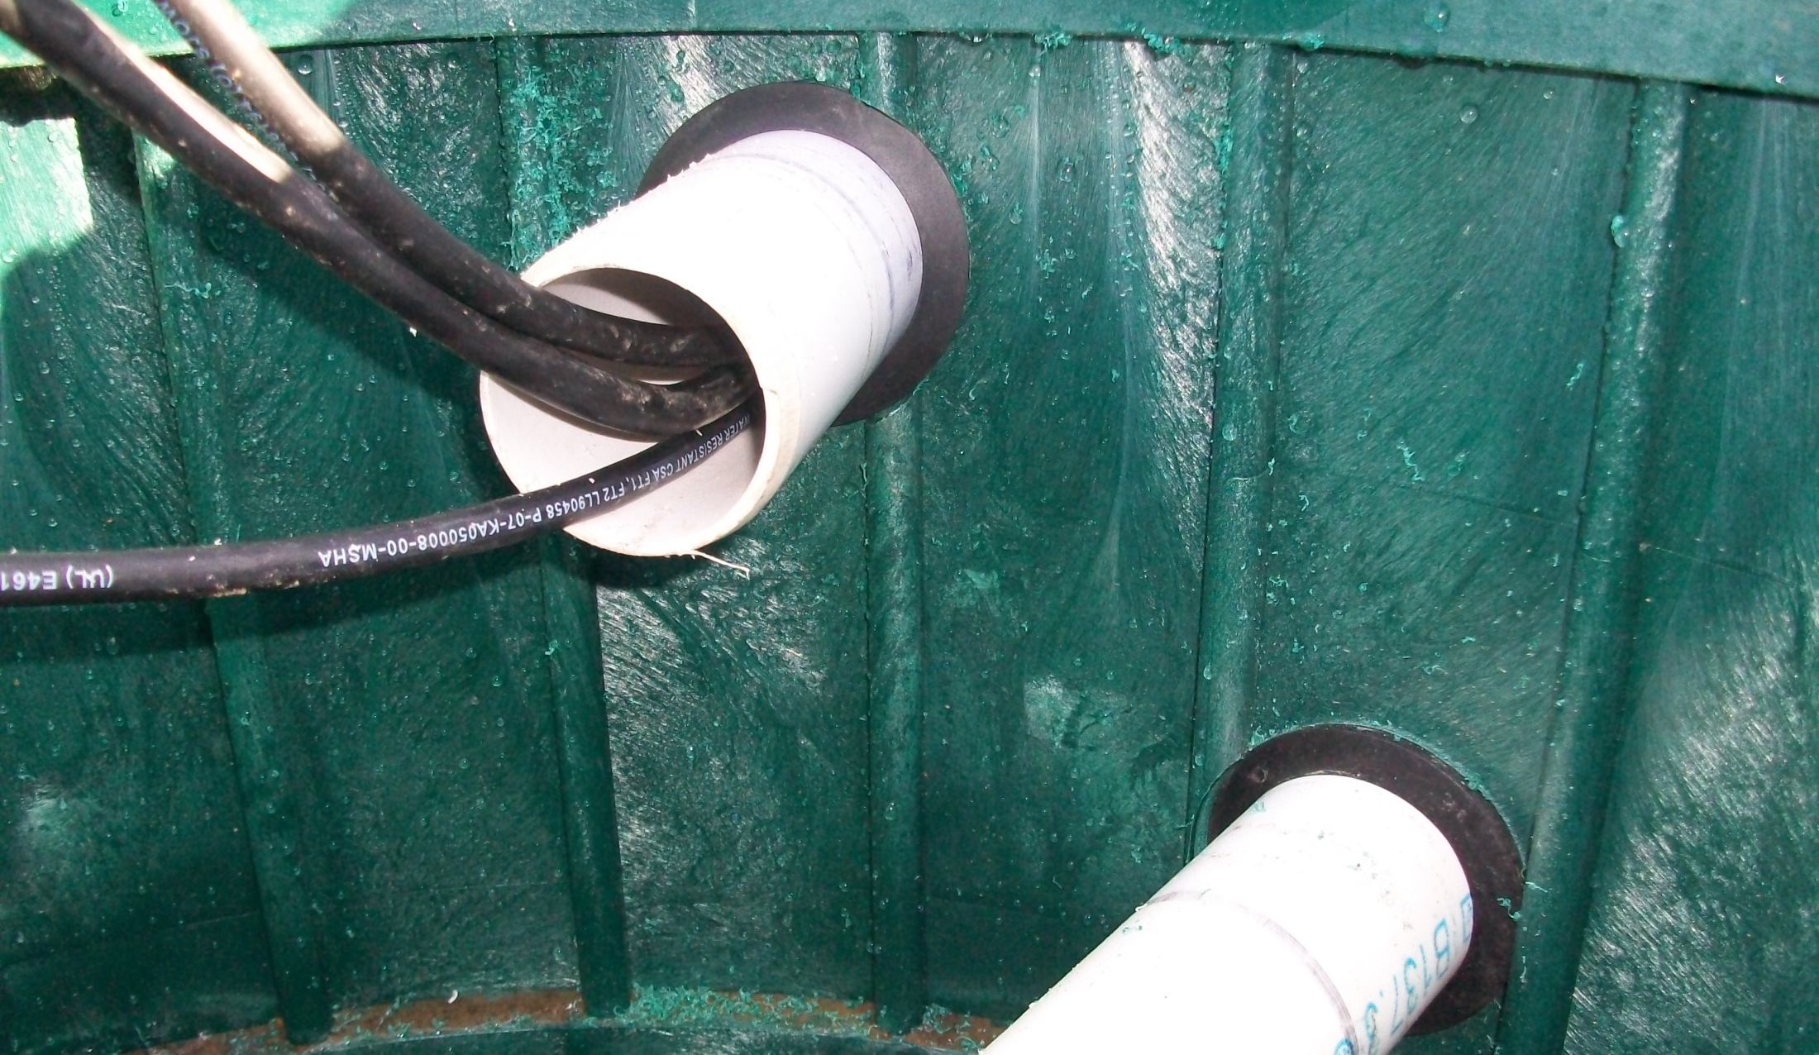
Float wires leaving the riser through a pipe

Slide 27
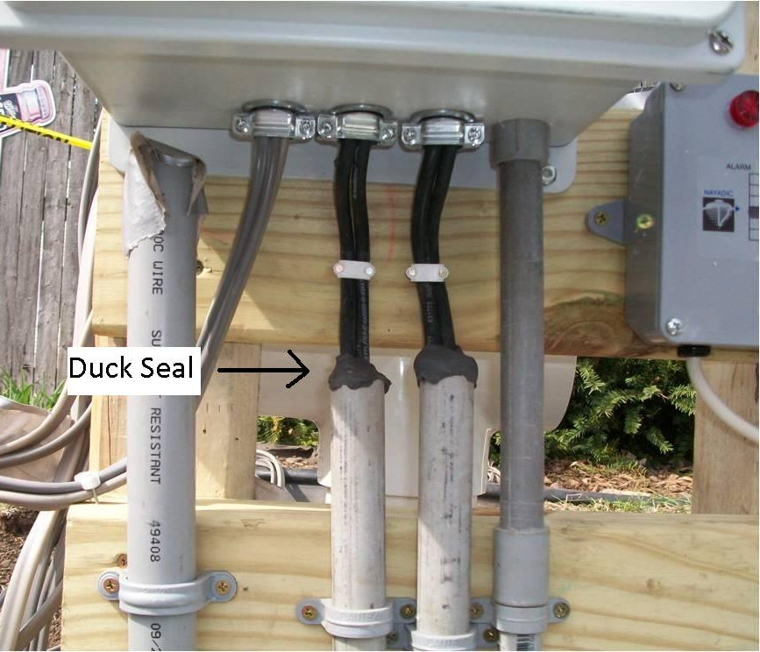
Conduit pipe from a tank must stop short and be sealed.

Slide 28
External splice boxes
On simpler systems that do not require a control panel, a splice box or waterproof outlet box is used to house the power outlet for a standard “piggyback” assembly. This housing is often attached to a 4x4 post.
Similar to the control panel set up, a pipe from the riser will bring the float & pump wires to the post but stop short of the splice box.
From here the wires alone will continue to the box with the power outlet. This method is successful in keeping the sewer gases from reaching the outlet box and similarly corroding the plug in.
Note: the pipe (conduit) containing the incoming power line is allowed to continue all the way to the enclosure box.

Slide 29
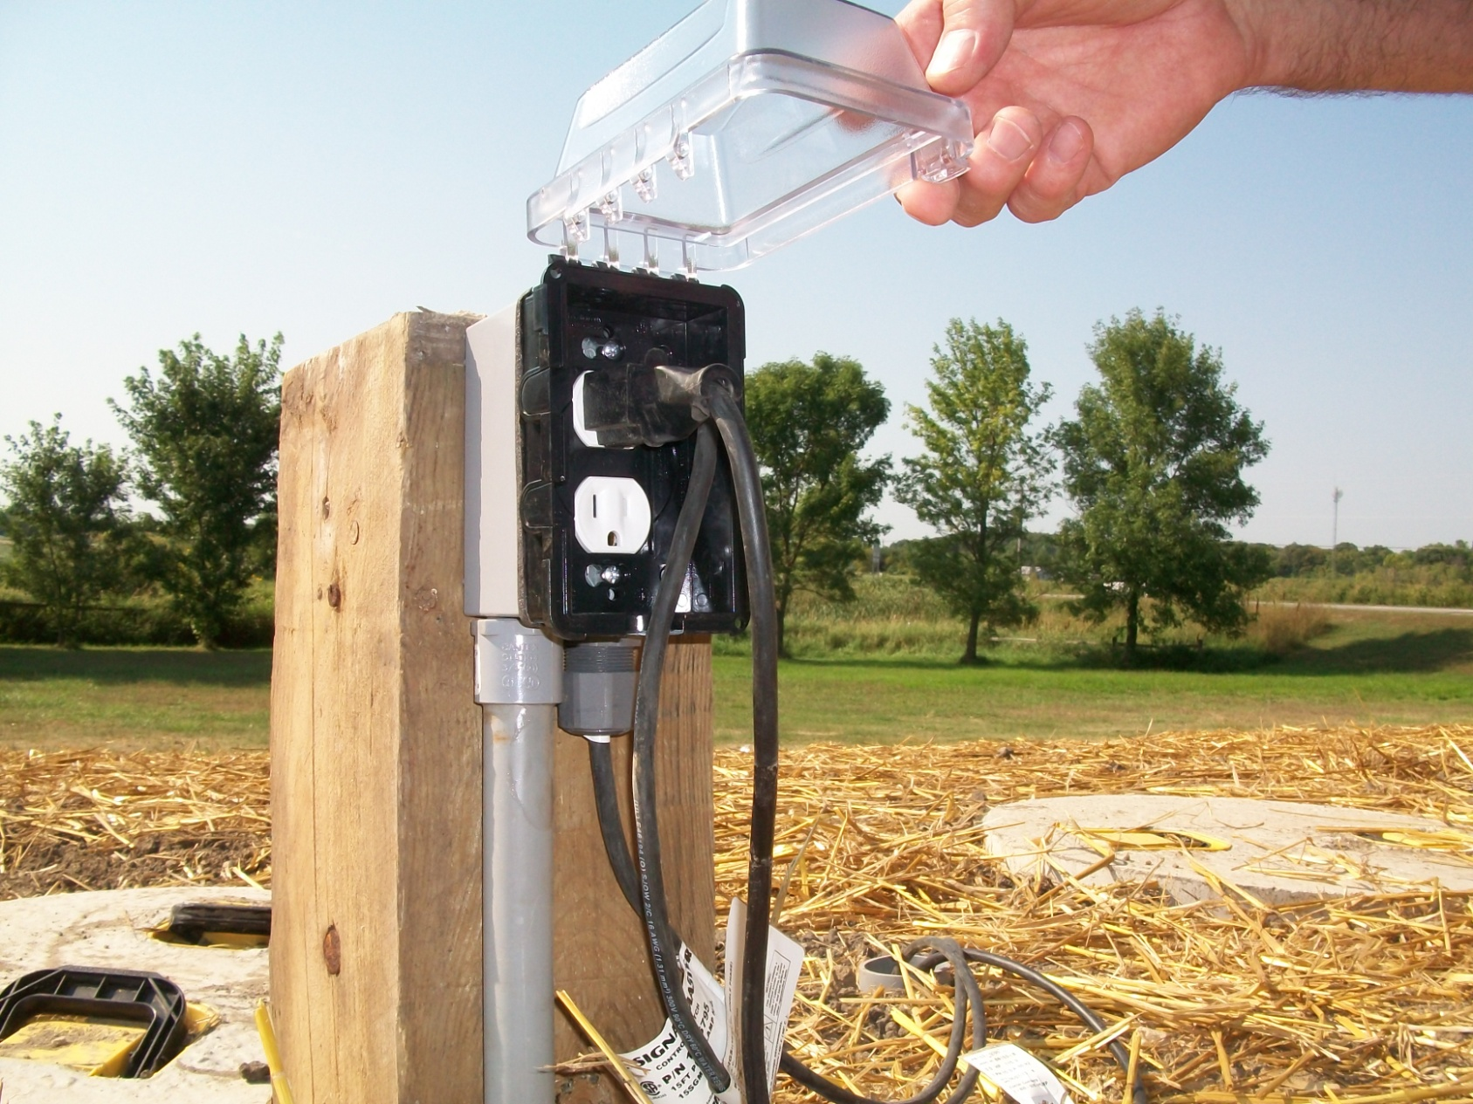
Weather proof power outlet for piggyback assembly.

Slide 30
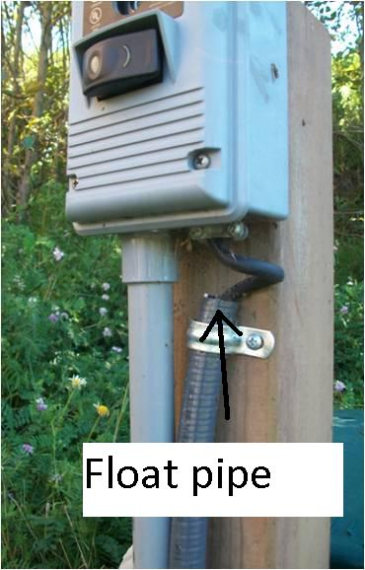
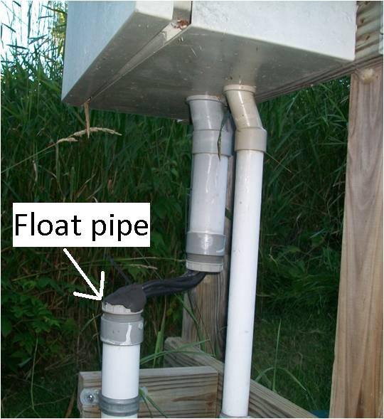
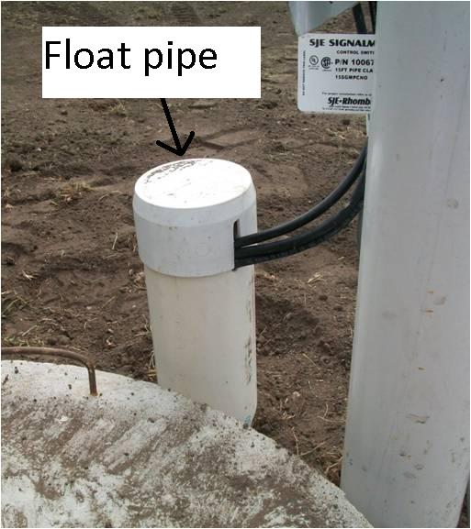
Note the pipe with the float wires stopping short of the electrical box to keep any sewer gases from entering.

Slide 31
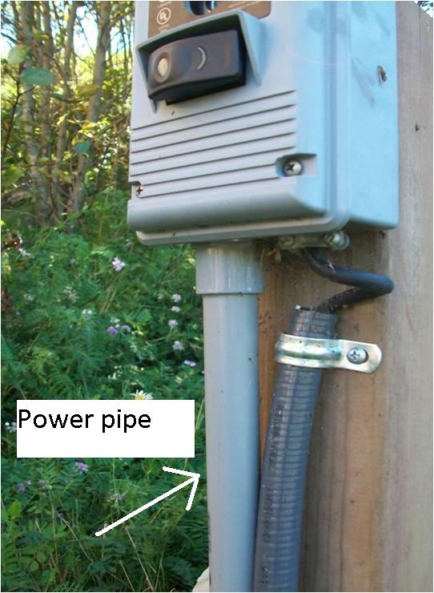
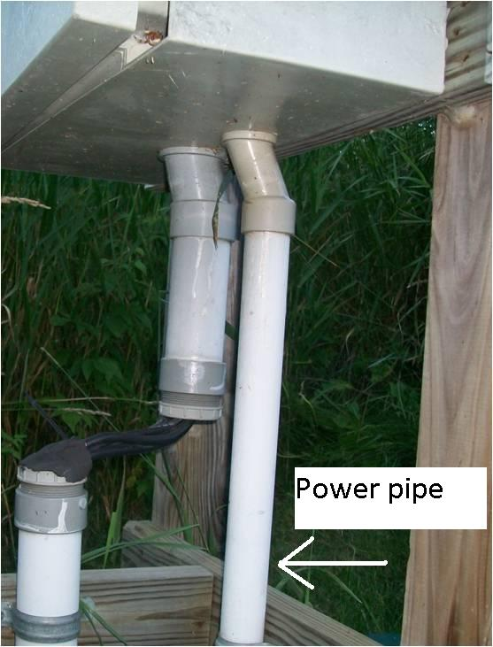
Note the conduit with the power wires (no sewer gases) continuing all the way to the electrical box.

Slide 32
Pedestal enclosures
An upgrade to the basic wood post and weatherproof outlet, is a “pedestal” enclosure. This pedestal style box combines the post and splice box into one unit. The post is hollow and typically vented to keep the sewer gases from reaching the splice box on top.
The incoming power line is fed in from the bottom of the hollow enclosure.
The pipe containing the float wires usually enters near the middle of the pedestal.

Slide 33
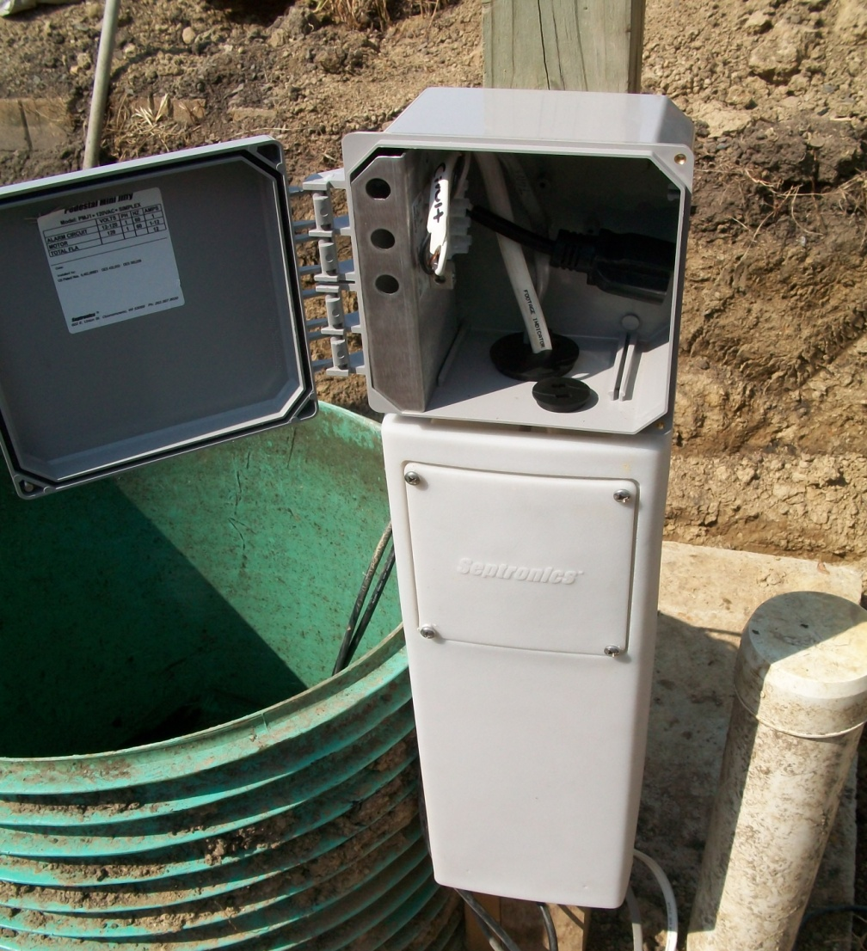
Pedestal enclosure

Slide 34
Pedestal enclosure venting
To help keep the moisture and gases from reaching the splice box at the top of the pedestal, a factory plug or duck seal is used on the pipe where the float wires leave the riser.
The hollow portion of the pedestal is then vented so any gases that did make it past the riser seal can escape.
In addition, another factory plug is used where the float wires enter the splice box portion of the pedestal.

Slide 35
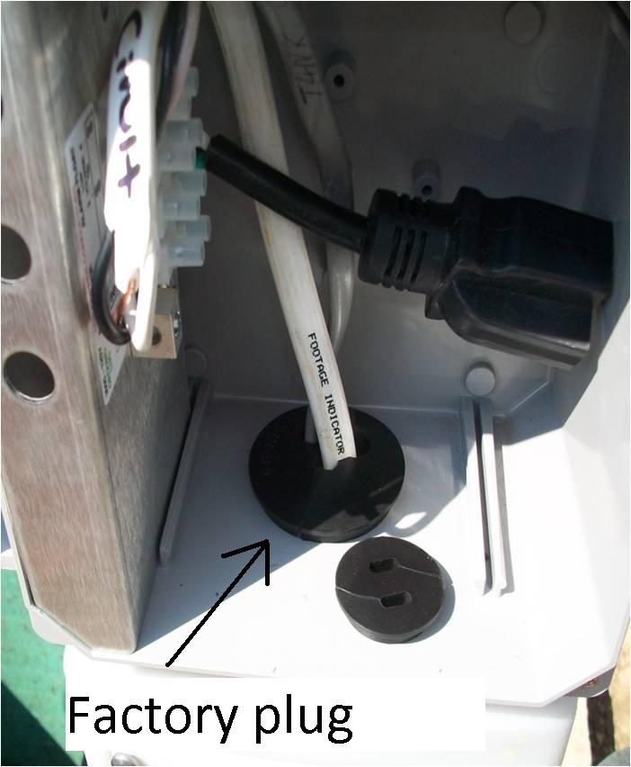
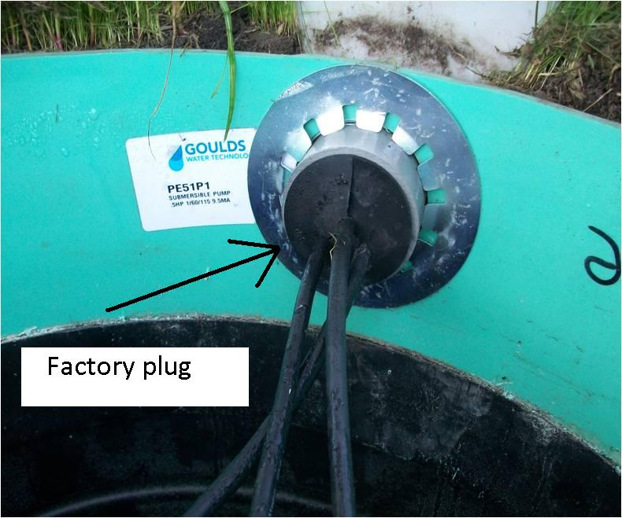
Factory plug for the Factory plug for the wires wires leaving the riser. entering the splice box.

Slide 36
Other electrical connections
On miscellaneous connections where a power outlet is not required, often wire nuts and electrical tape are used to make the connection inside the riser.
By electric code these connections (terminations) must still be housed inside a box (enclosure).
You do not want to be working in the riser where you could accidentally bump the wire nut loose and then get electrocuted.
And you don’t want to have to unwind a ball of electric tape when it comes time to troubleshoot a non-working alarm, or to replace the float.
Also, when connections are made inside the riser you must use waterproof wire nuts. Point the wire nuts up so if any moisture does accumulate it can drain out.
But when there is the option, keep the connections out of the tank/riser.

Slide 37
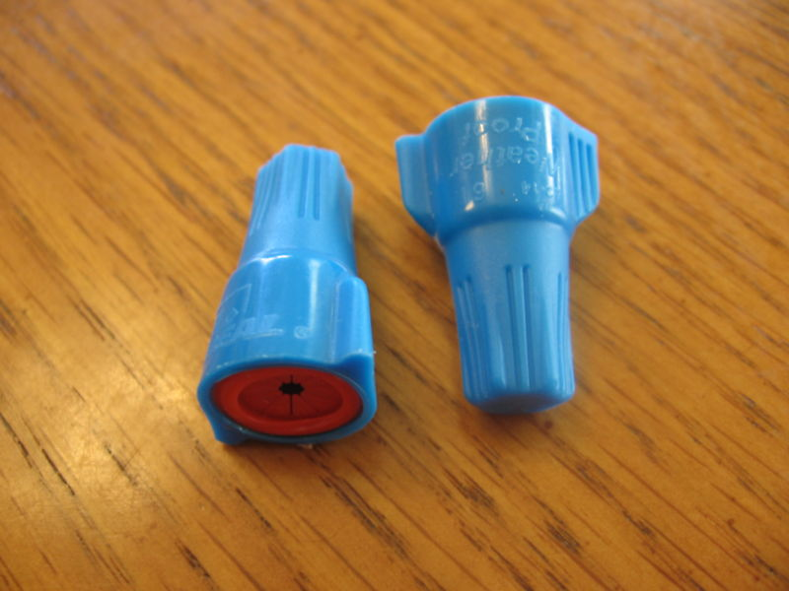
Use waterproof wire nuts when the electrical connections are inside the riser/tank or anytime there is a lot of moisture present.

Slide 38
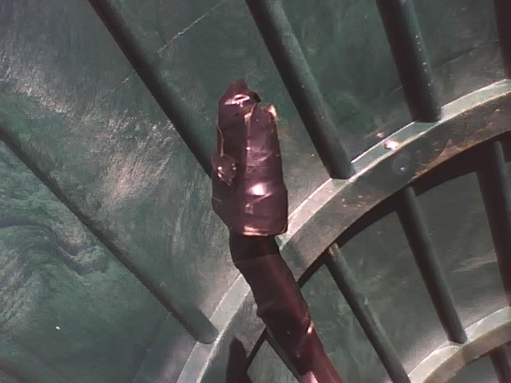
Don’t create a messy ball of tape on the connections, use a splice box instead.

Slide 39
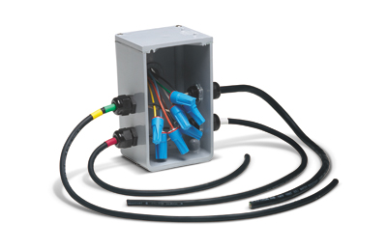
When electrical connections are inside the riser, use a splice box and fasten it to the inside of the riser .
(Note the watertight wire grips, and the watertight wire nuts)

Slide 40
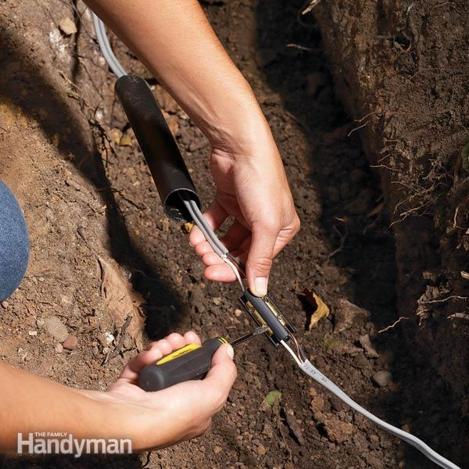
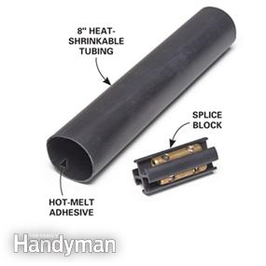
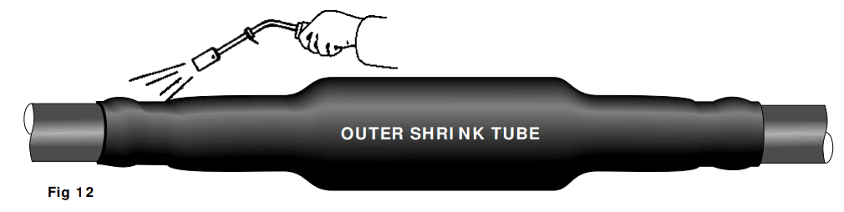
When splicing buried/underground wire, use an underground splice kit with “heat shrink”

Slide 41
5 - Tank burial depth
MN7080.2000 sec C:
The tanks on new systems must not be buried with more than 4 feet of cover, or more than 4 feet from the anticipated finished grade, unless allowed by local ordinance and the tank is rated for deeper burial by the manufacturer.
For replacement of tanks on existing systems, check with the local unit of government for maximum allowed burial depths.
In no case is the tank to be buried deeper than the manufacturers maximum rated depth (usually around 7 feet of cover maximum).
Verify the maximum burial depth with your tank manufacturer whenever you are putting more than 4 feet of cover on a tank.

Slide 42
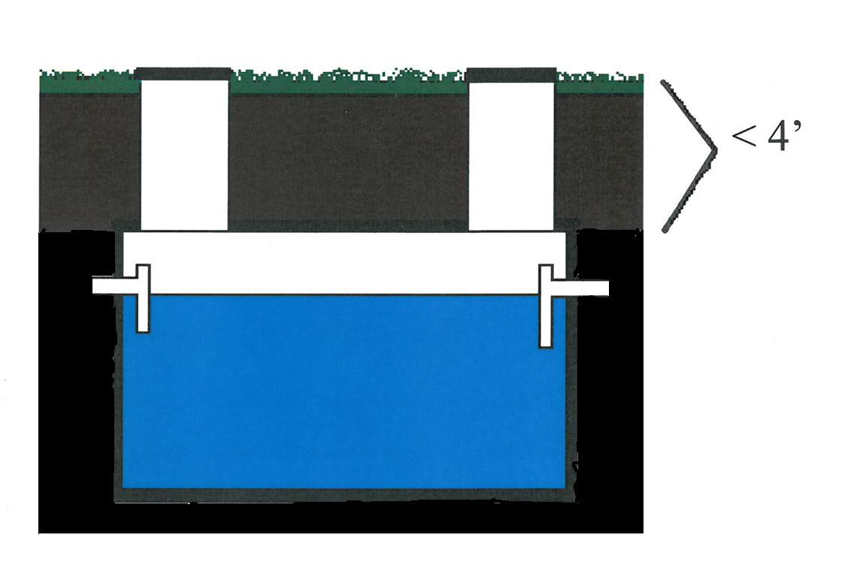
4’ of cover or less
(Unless locally approved, and rated for deeper burial by the manufacturer.)

Slide 43
Tank excavation
When digging the hole for the tank, make sure that the bottom of your hole is flat and does not have a hump in the middle. If you set your tank and it can “rock” back and forth, the floor of your excavation is not flat. Setting the tank in this condition can cause the floor to immediately crack and leak.
Do not use the backhoe to press down on the risers.
Do not use the back hoe to press down on a corner of the tank to make it level.
Both of these practices can crack the tank.

Slide 44
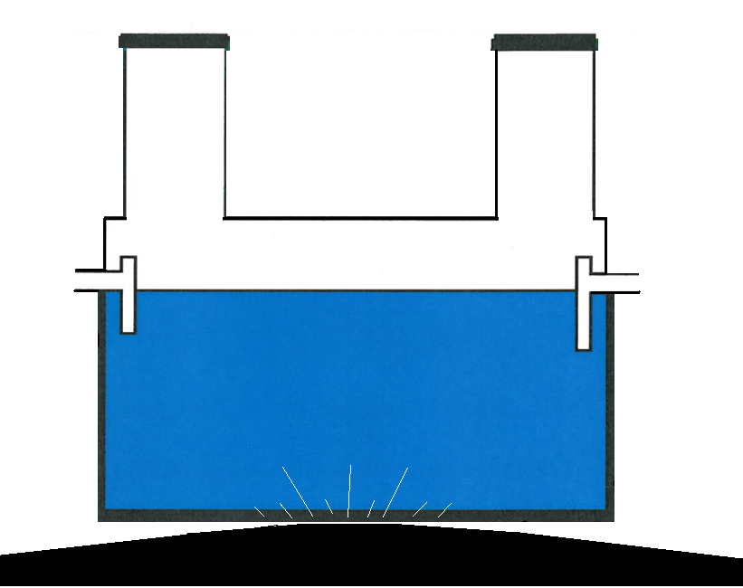
Excavated tank hole – domed bottom will crack the tank

Slide 45
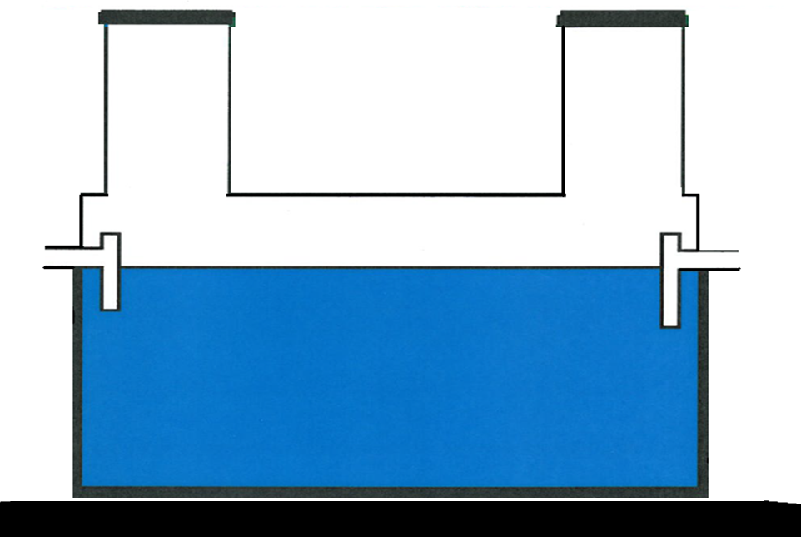
Excavated tank hole – Flat bottom is required.
When necessary bed the bottom with some sand or pea gravel.

Slide 46
For a little insurance you can “cup” out the middle of your excavated hole just an inch or so to make sure the tank is resting on the outer edges of the tank only, and not the middle of the floor.
With the weight of the tank and soil cover supported by the tank walls, there is no concern that the tank floor will buckle in, crack and leak.

Slide 47
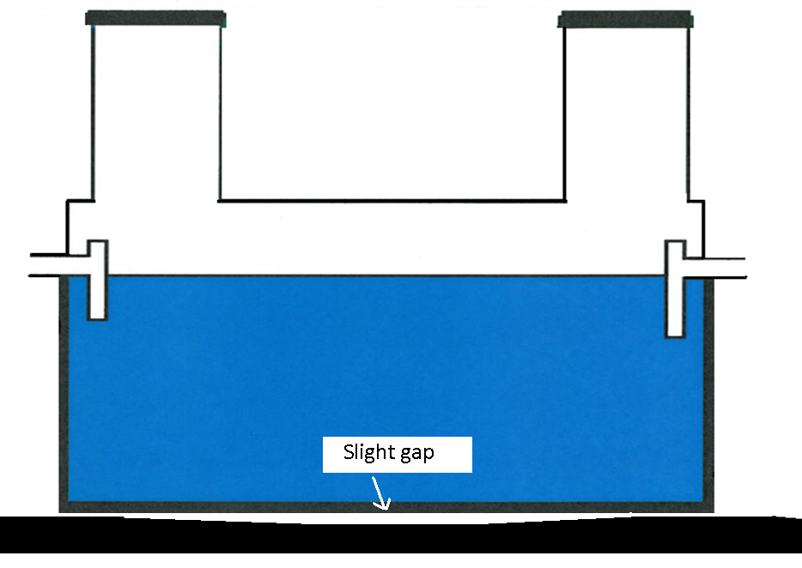
Excavated tank hole – bottom center is “cupped” out.
The tank is supported by the walls and not the floor.

Slide 48
Backfilling the tank
When setting tanks in clay soil, often the excavated walls are nearly vertical with only a foot gap or so to be backfilled around the tank.
The sewer pipe is able to bridge this gap quite easily.

Slide 49
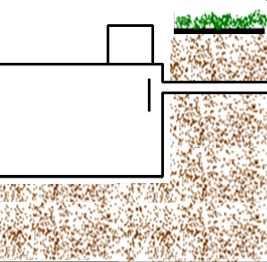
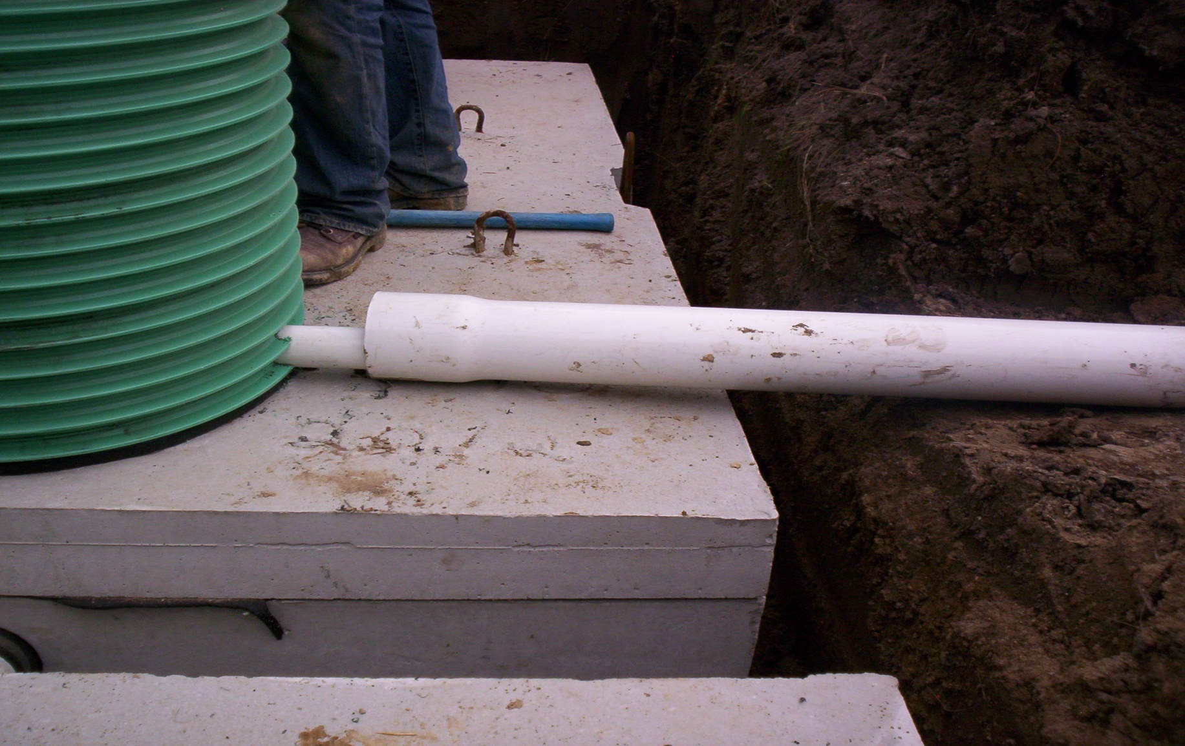
Clay soil, tight fitting tank with minimal span by the sewer pipe.

Slide 50
Backfilling the tank in sandy soils
Setting tanks in sandy soil creates additional concerns. The hole will need to be over-excavated to prevent caving in. This leaves quite a span for the sewer pipe to reach virgin soil.

Slide 51
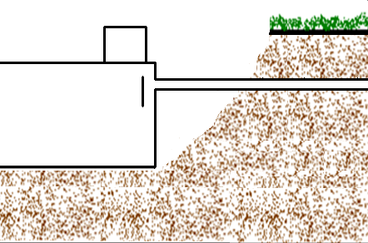
Sandy soil, loose excavation with large span by the sewer pipe
Under this scenario preventive measures will need to be taken so that the sewer pipe does not obtain a dip, lose slope, or break after the backfill settles.

Slide 52
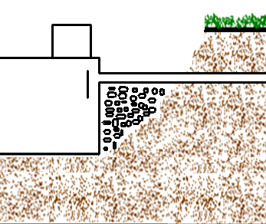
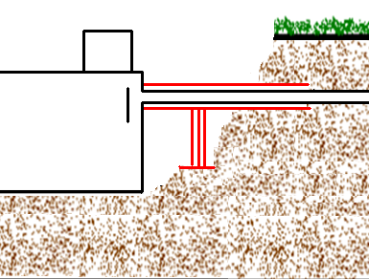
Preventive measures for settling
A few options are to:
- fill the void with rock,
- support the pipe with bracing, or sleeve it with 6” pipe,
- compact the sandy fill soil by soaking it with water,
- carefully use a jumping jack to compact the fill (for experts only!)
(be careful not to crack the sidewall of the tank)
rock fill brace and/or sleeve

Slide 53
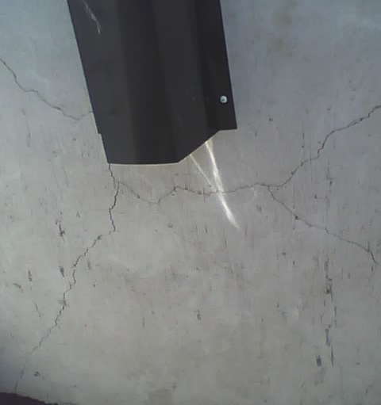
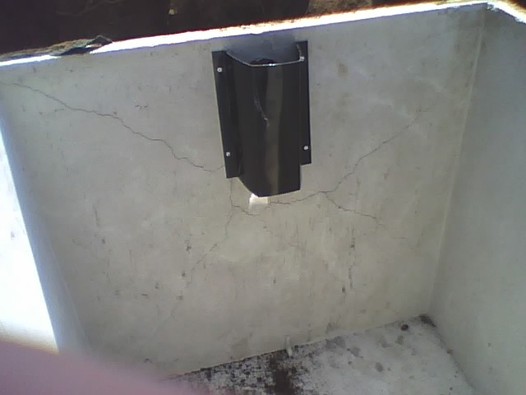
Compaction concerns
If you choose to compact the fill before laying the sewer pipe, you must be careful not to apply too much pressure or the wall of the tank WILL crack.

Slide 54
Backfilling the tank risers
When backfilling around the risers, it is best to leave the risers a couple of inches above grade to prevent water run off from being able to enter the tank and flood the tanks.

Slide 55
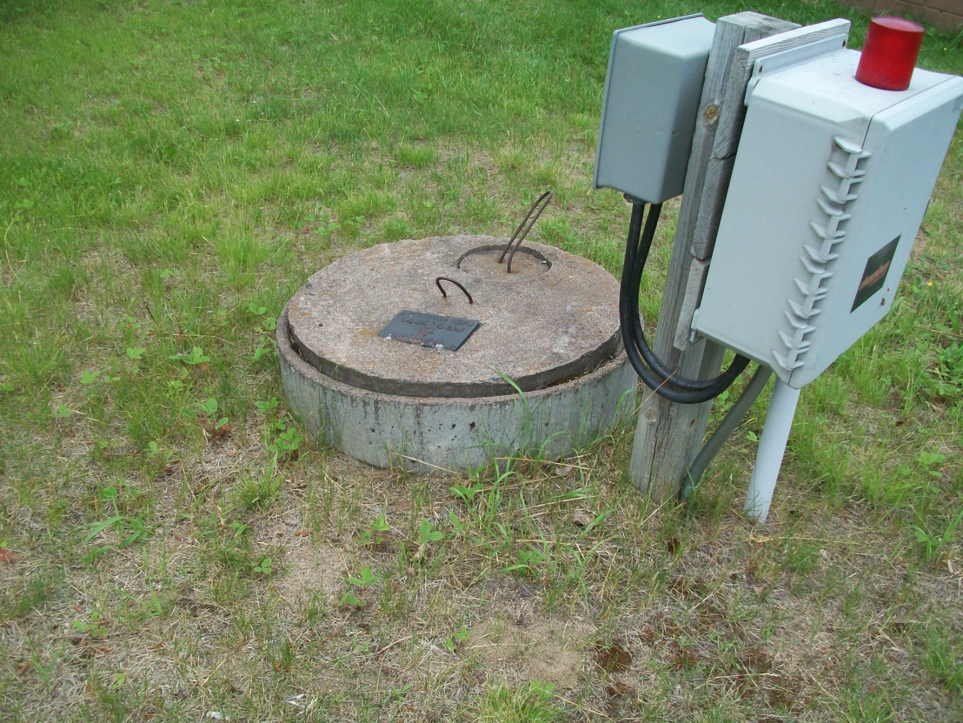
Riser left up higher to avoid infiltration

Slide 56
On sites where the homeowner has a nicely sodded yard and wants to minimize the impact of the exposed riser lids, the final riser height can be flush with the finished grade or level with the sod. This then allows the owner to run the lawnmower over it safely. But when following this method make sure the water is diverted away from the tanks.
Slope the finished grade away from the risers to encompass an area at least as big as the tank. And remember to add a little extra for settling.

Slide 57
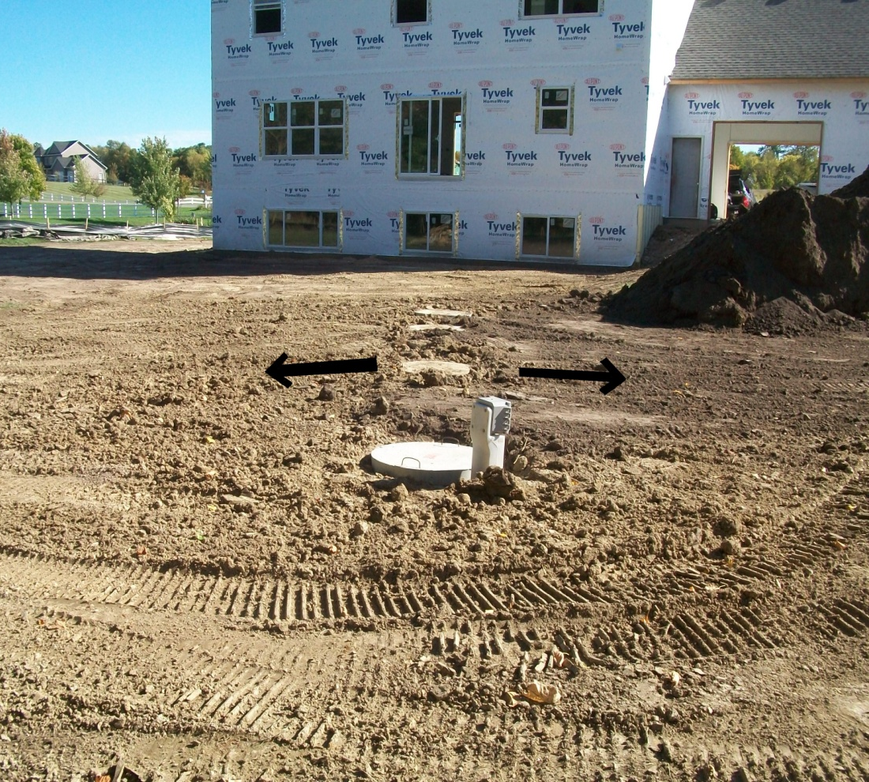
Slope the grade away from the risers on nicely finished yards

Slide 58
6 - Tank insulation
MN7080.2000 sec H:
If the tank is buried with less than 2’ of soil cover, the top must be insulated to an R value of 10, with a minimum of 6” of soil cover, and the riser lids must be insulated as well.
Extruded polystyrene (XPS) rigid foam is usually blue or pink in color and not faced with another material. The R-value is 5 per inch so a 2” thick sheet meets our septic code requirement of R-10. Double check with the manufacturer for the R value.
Sheet insulation is easy to work with and is the most common, but each crack or seam is an area for the heat to escape and defeats the purpose of insulating. It’s like wearing a winter jacket but not bothering to zip it up. For extreme cold conditions, the best method of insulating the tank is to have a specialized contractor “spray foam” the tank and risers.

Slide 59
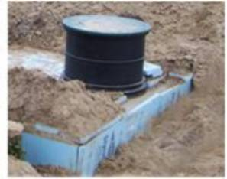
Sheet insulation

Slide 60
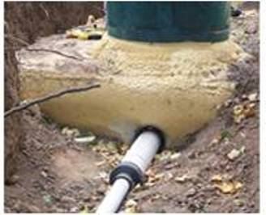
Spray foam insulation applied On or Off site

Slide 61
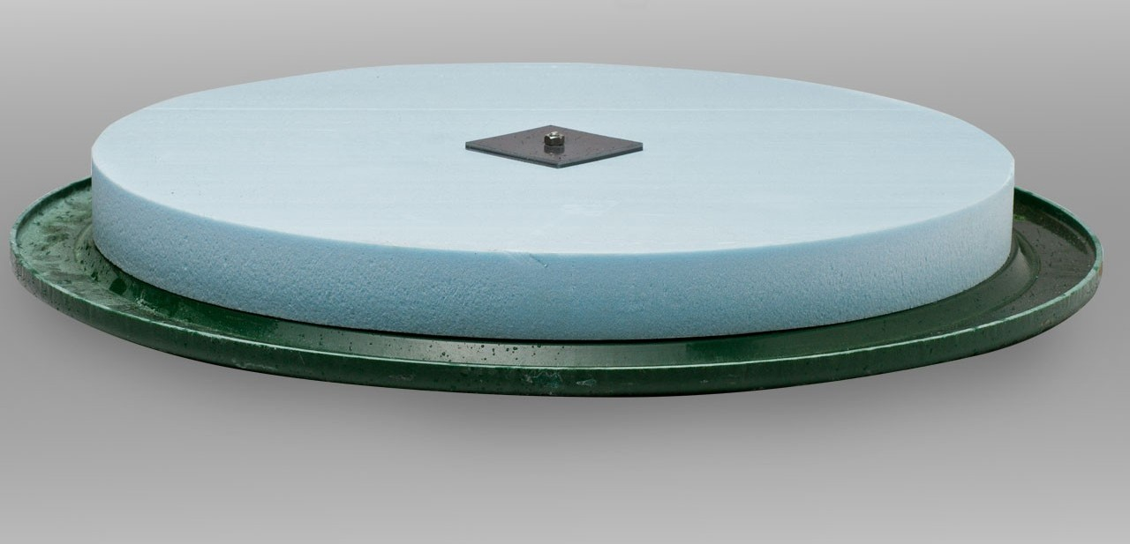
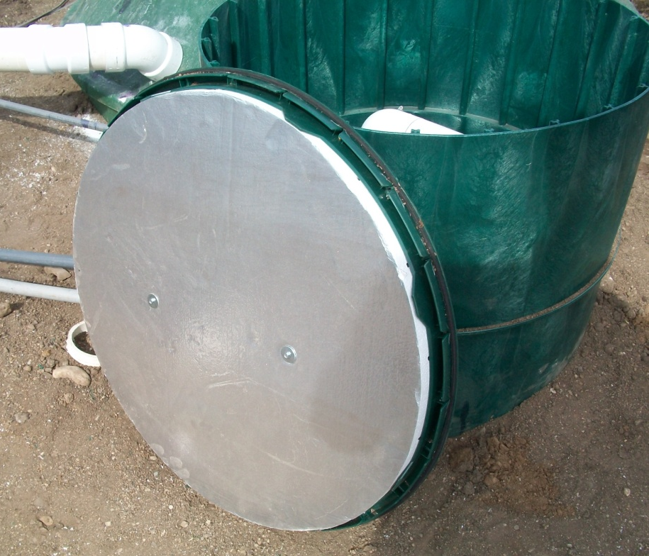
The riser lids need to be insulated to R-10 as well

Slide 62
7 – Securing riser lids
MN7080.1970 sec D:
The risers on the tanks must come to the surface and the lids be properly secured by one of the following methods:
- bolts or screws
- locked
- a lid weight of at least 95 pounds

Slide 63
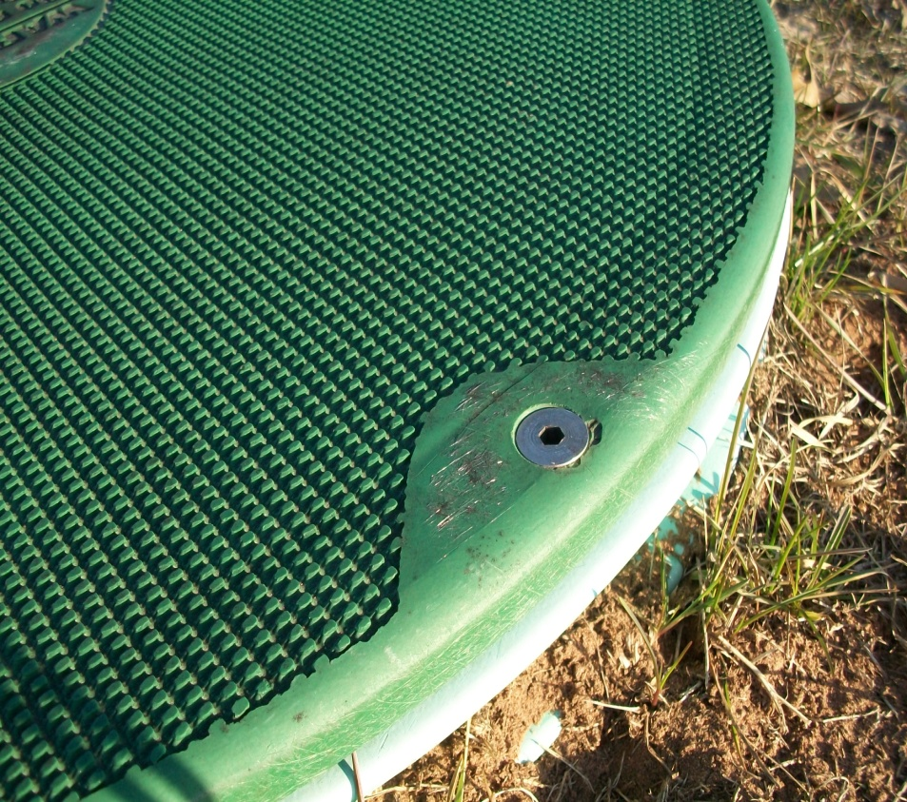
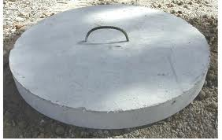
bolted lid 95# lid
Picture of bolted li

Slide 64
8 - Tank watertight testing
MN7080.2010 subp 3:
Tanks that require testing are:
- septic tanks (one per year per model)
- poured in place tanks
- holding tanks (debated?) (MN7080.2290 sec B)
Records to be retained by manufacturer for 3 years.
Testing can be performed by:
- holding a vacuum for 5 minutes @ 2 inches of mercury without loss
(all tanks)
- hold water without loss for one hour after being filled
(plastic tanks)
- hold water without loss for one hour after being filled for 24 hours
(concrete tanks)

Slide 65
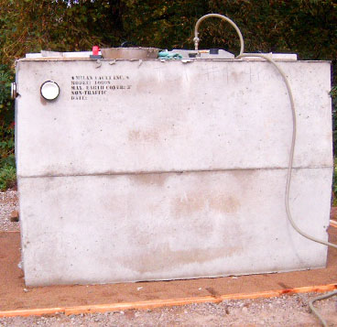

Vacuum testing for leaks
(5 minutes @ 2” of mercury without loss)

Slide 66

Water testing for leaks
(be careful not to fill the tank higher than a few inches above the top of the tank lid or the lid may rise and break the seal)

Slide 67
9 – Tank seam separation
Regardless of a “top seam” or “mid seam” tank, filling the tank to a water level above the top of the tank has the potential to separate the seam on the tank and cause it to leak.
As such, never fill the tank higher than a couple inches above the top of the tank, even when testing the tank-to-riser connection.
After the system is installed and the tank backfilled, the extra soil on the tank will help hold the seam together should the system ever “back up” and fill to the top of the riser. However, as bizarre as it may seem, under the right conditions even when backfilled this separation risk can still exist.

Slide 68


Top seam tank Mid seam tank
(box with a flat lid) (2 halves like a clam shell)

Slide 69


Tank seam separation
Lets look at why you can’t fill the tank with water up to the top of your riser.
Solids will have a force in one direction,
Fluids will give a force in all directions.
(riser with water 1’ deep)
When this “equal pressure in all directions” concept is added to the benefits of leverage, we get the basis of hydraulics.

Slide 70

So if the lid weighs less than 3120 lbs, it will want to lift up.

Slide 71


Slide 72
When you water test your tank and riser connection for leaks, it is not necessary to do a lot of math calculations.
Just remember not to fill the tank more than a few inches above the top of the tank lid.
If you need to test an upper riser connection, or a pipe leaving through the riser at a higher elevation, contact an engineer to determine how much more weight you would need to add to the top of the tank to keep the lid from lifting, or find another method for testing.

Slide 73
10 - Tank buoyancy
Consideration should be given on all sites for the possibility of the tanks floating up out of the ground under wet conditions. To properly assess the risk, it will help to understand the different “saturated” conditions.
The obvious risk is when you are setting tanks in a low elevation near the lake with a standing water level near the surface. Most likely the hole you just dug for your tank is already filling with water.
Most tank manufacturers won’t warranty their tank in this situation. Make sure to ask the manufacturer if you have concerns.

Slide 74

High standing water level
(tank floats like a fishing bobber)

Slide 75
Another situation may be when a normally high & dry soil becomes temporarily saturated due to a heavy rainfall or spring thaw.
If the tank is located in a swale, the level of soil saturation around the tank could raise significantly in a short period of time.
When you originally set the tanks the excavated hole may have been nice and dry with sandy soil and no apparent redox or other water concerns.
Then after a very heavy rainfall…

Slide 76

…The tanks pop up out of the ground.
(unusual and temporary soil saturation)

Slide 77
The next situation could be when you are at a mound site with redox near the surface.
Under this situation you must look closer at the soil profile to assess your risk.
Since you are installing a mound, you obviously have soil saturation closer to the surface. This site has conditions favorable for a perched water table.
If you have redox or heavy clay soil all the way to the bottom of your excavated hole, then you have the same high risk of your tank floating due to your tank sitting in a potential “swimming pool”.
If your final grade crates a swale towards your tank, the water will immediately flow into and around your tank area and possibly cause it to float.

Slide 78

Fresh excavation & swale creating a “pooling” area

Slide 79
However if you have a “hard pan layer” near the surface, or conditions creating a perched water table, with well draining sandy soils underneath, then the risk of your tank floating is much less.

Slide 80

This situation is similar to when the rock bed of a mound gets plugged and ponded, but the mound sand underneath it remains dry.
The tank does NOT want to float under this condition.

Slide 81
The area of “saturation” must contain the tank to create buoyancy.
A layer of saturation above or below the tank does not create buoyancy.
Evaluating the soil profile will help you assess the risk accordingly.
In turn you can take the appropriate precautions to avoid having your tank float out of the ground.

Slide 82
11 - Buoyancy calculation
The tank buoyancy worksheet at www.SepticResource.com will calculate for you the amount of soil cover needed to keep your tank from floating.
It will calculate it for two situations:
- soil saturation to the top of the tank
- soil saturation to ground surface (flood conditions)

Slide 83

Soil saturated only to the top of the tank

Slide 84

Saturation to grade, or higher.

Slide 85
Surprisingly, when the level of saturation goes above the top of the tank, the calculation changes.
Think of it like this, when you are standing in a dry pool, all your weight is pushing down on the bottom of the pool. When the pool is filled to your waist, you can bounce up and down with ½ the force on the bottom of the pool. And when the pool is filled above your head, your body has little to no weight on the bottom of the pool.
This same concept applies to the soil on top of the tank.
Once it gets saturated it gives less pressure down on the tank.
In this situation you might say, “yeah but now we have all the water pushing down on the top”. True, but the water is a liquid and will allow the tank float up, just like a fishing bobber regardless of how much water is “on top of it”.

Slide 86






A 200 pound person, and a 100 pound cubic foot of soil, giving different forces on the bottom of the pool.

Slide 87

Two possible soil cover amounts

Slide 88
12 - Sewer lines
Plumbing Code requirements:
The sewer line must not have any horizontal 90 degree fittings.
There are no burial depth requirements.
A cleanout is required within 10’ of where it exits the home, so this can technically be inside or outside the home. Regardless of a new or replacement septic, it is recommended that a cleanout always be placed just outside the home.
Additional cleanouts are required for every 100’ of pipe. This is based on the fact that the typical jetting equipment can only reach 100’.

Slide 89
Further discussion on cleanouts:
Technically the septic tank does not count as a cleanout.
To help explain why, lets say we have a deeply buried tank with 4’ of soil cover. This would make it nearly impossible for the maintainer to reach five feet down the riser and over the baffle to be able to insert the jetter into the sewer line. And this is assuming the riser is to grade (as required per the 2011 purple code).
Access to a cleanout must be from grade, or reasonably so.
Technically speaking a 101’ sewer line would require another cleanout 1’ from the tank. This is where you have to use common sense, and put yourself in the shoes of the maintainer.
Can you get away without installing this additional cleanout? Be prepared to convince the LUG doing the final inspection of your decision.

Slide 90


Cleanout just outside the home

Slide 91

Cleanout allows access for jetter/rooter

Slide 92
Sewer line comments:
Long sewer lines should be dealt with carefully. Keep the septic tank reasonably close to the home. With todays low flow plumbing fixtures, one toilet flush to a 100’ sewer line laid at 1% and little to nothing will come out the end of the pipe. A long sewer line line laid at 1% slope is just asking for trouble in regards to plugging and freezing. A design requiring the installer to lay 100’ of pipe at a perfect 1% slope is not realistic. There will be some dips and flat spots that will allow solids to accumulate and create the potential for plugging.
On longer sewer lines a 2% slope should be pursued.
And when possible, longer sewer lines should simply be avoided.

Slide 93
Other things to keep in mind to avoid sewer line problems:
- ensure the proper direction of bell end pipe
- eliminate the internal rough edge of a pipe cut
- do not perform sloppy cuts that result in an angle on the pipe end.
(make sure your cuts are at a 90 degree angle to the pipe)
- when gluing press the pipe all the way into the fitting / bell end.
These items all create edges or pockets for debris to get stuck on.
These little things make a big difference in helping to avoid future plugging of the sewer pipe.

Slide 94



Rough edges / crooked cuts Belled pipe water flow to the right→

Slide 95
13 - Pressurized Supply line
As the pressurized 1.5“ or 2” pipe leaves the pump tank it should be sleeved with 4” sch40 until it reaches undisturbed soil to prevent any settling dips in the pipe where water could pool and eventually freeze.
Per MN7080.2050 sub 2:
The pressurized supply line from the pump tank to the drainfield is required to have a minimum 1% slope for drainback purposes.
The supply pipe needs a minimum of 6” of soil cover and insulated anywhere freezing is a concern.
And “access to the supply pipe must be provided for cleanout”.
(examples of supply pipe access will be given later)

Slide 96

6” minimum cover & insulate where necessary

Slide 97
Most frozen supply lines occur just outside the tank riser where the tank backfill settles. This causes a dip in the pipe where the water pools and eventually freezes.
The solution to that problem is to sleeve the pipe where it crosses over the excavated soil to help prevent it from sagging during future settling, this would ultimately prevent a dip in the pipe from ever occurring.
Occasionally we still see the supply line freezing within the first 20’ of the pump tank, even when properly sleeved. This type of problem is typically due to the pipe being laid too flat which does not provide for drainback.
The flat supply pipe makes for a nice connection at the pump with its 90 degree angle, but it tends to not maintain the minimum 1% slope requirement for proper drainback.

Slide 98
Supply pipe is nicely sleeved, but laid too flat.
It no longer has the minimum 1% slope for drainback.

Slide 99
When installing the supply line with the minimum required slope, the 90 degree fitting connection to the pump may no longer be square. When necessary, use a piece of flex pipe or the appropriate fittings to correct the difference.
A 15 or 22.5 degree fitting on the end of the pipe can be turned until it’s lined up with the vertical pipe from the pump.
Or a 90 fitting and a “street” 90 can be put together and spun until you are in proper alignment with the vertical pipe from the pump.

Slide 100

Flex pipe
(whirlpool tub style pipe)

Slide 101

15 degree fitting turned until level again

Slide 102


A “street” fitting does not require a piece of pipe between two fittings. (this simplifies the connection) regular 90’s street 90

Slide 103


The “street” 90 and the regular 90 fitting can now be spun to return to a vertical pipe connection.

Slide 104
14 - Supply line access
MN 7080.2050 sub 2, item D states:
“Access to the supply pipe must be provided for cleanout. The access point must be accessible from final grade“.
This requirement for access to the supply line has the same purpose as the access point at the end of the laterals, or a cleanout on a sewer line.
The simplest way to achieve this is to use a cam lock quick disconnect between the pump and the supply line.
Once you have gained this access, you must also make sure there are no “hard 90’s” in the way for the jetter to get through.
This is the same requirement as with the lateral cleanouts.
The following examples show how this can be accomplished.
Notes:
Answer: At the pump disconnect

Slide 105


Notes:
Access the supply line from the pump disconnect, → no hard 90’s

Slide 106

“J-hook” configuration with cam lock and long sweep 90 provides easy supply line access at the cam lock connection.
Notes:
Example of a perfect set up. Note elec tape hassle, just put 1 restraint at top.

Slide 107

“Up and 90 out” configuration allows easy jetter access at the cam lock connection.

Slide 108
Supply line “access”.
If you recall, the code stated that access must be “reachable from grade”.
As this is rather vague some LUG’s have specifically stated in their ordinance that this distance can be no greater than 24” to 30” from the top of the riser.
Comments have been made that the average person can reach a lot further and thus the 24 to 30 inch requirement is excessive.
However, that depends on how long your arms are, and realizing that you can reach further into the riser when you are building the system, than when it is finished.

Slide 109

Lots of reach when you are standing on the tank and bending at the waist.
Picture of summer built reach into riser
Notes:
Accessing pump disconnect. During summer construction, easy to bend over and reach WAY into the riser

Slide 110
Bending at the waist is NOT how you reach into a riser after the system is finished with final grade.
At this point you typically lay on your stomach and reach into the riser. As such you can not put both your arms in the riser or you will likely be going for a swim. This is especially true in the winter while laying on the slippery snow. You will need your other arm to brace yourself to keep from sliding in.
Under these circumstances a 24” reach with one arm is a reasonable expectation.

Slide 111

Less reach after the system is finished

Slide 112
When the supply pipe is too deep, a “J” hook assembly is necessary to bring the pipe and quick disconnect within reach.
Don’t forget to drill a weep hole in the bottom of the supply pipe so it can drain.
If you assemble the pipes after drilling , make sure your pipe glue does not drip down and plug the weep hole!

Slide 113

Make sure weep hole does not get plugged with pipe glue.

Slide 114
15 – pump quick disconnects
With only one hand to reach into the riser to disconnect the pump, it becomes difficult to use any tools such as a channel lock, nut driver, or a sawzall (on a shaking pipe).
note: fernco’s are NOT allowed as they are not a pressure rated fitting.

Slide 115

No Fernco’s
(and notice how difficult it would be getting a jetter past the 90)

Slide 116
Union type fittings are quite large, and can be difficult to get a grip on especially when they are wet. In most cases it is nearly impossible to loosen a union fitting with two hands, let alone one hand.
If the fitting is so tight you need a channel lock to break it loose, you will also need to use a second pair to neutralize the torque on the pipe. Sometimes this takes two people, and usually results in a dropped pair of channel locks, and an addition to your vocabulary of four letter words.
Then when it comes time to try and reassemble the connection, it often takes two hands to get the pipe lined up, while you struggle to spin the threaded coupling on without cross fitting the threads. Once again the assembly may be simple during the install process when you are gluing the pieces together, but is just about impossible at maintenance time.
As such, DO NOT use a union style fitting.

Slide 117

2” union fitting
Notes:
Union

Slide 118

A 2” union fitting is a handful
Notes:
Unions are big, & basically impossible to loosen with one hand, need tool or two hands.

Slide 119
The best option, and the only practical choice for a pump disconnect, is to use a cam lock.
With a cam lock the pump can be removed with one hand in a matter of seconds, and reassembled just as quickly and easily.
Notes:
Hassle to get the threads lined up. 2 arms in the riser –> falling in.

Slide 120


Threaded fitting Slip fitting
Notes:
Cam lock

Slide 121

“J- hook” and “90 out” pump assemblies both with cam lock quick disconnects.
Notes:
Example of a perfect set up. Note elec tape hassle, just put 1 restraint at top.

Slide 122
There are two other points to note on the previous slide:
The float wires were attached to the pump pipe with electrical tape in a “candy cane” wrapping fashion all the way down to the pump.
When it comes time to replace the pump or adjust any floats, the maintainer will have to spend time unwrapping all this tape to get enough slack in the wires to pull the pump out.
A better method would have been to secure it with just one fastener near the top that is reachable from grade.
The location of the cam lock on the J-hook assembly is perfect. If the pump needs to be checked the maintainer can disconnect the assembly and turn the pump on. The water will spray down into the tank, not at the side of the riser splashing on you or the ground surface, and not straight up creating a geyser and a big mess.
And with no hard 90’s in the way, a jetter can be inserted without any difficulty.

Slide 123
Do not “candy cane” wrap the wires.
Note the perfect cam lock location on this “J” hook assembly.
Notes:
Example of a perfect set up. Note elec tape hassle, just put 1 restraint at top.

Slide 124
With this setup, a maintainer can disconnect the pump, then turn the pump on to verify if it’s working or not. The water will be pumped down, back into the tank. Without creating any mess.
Notes:
Example of a perfect set up. Note elec tape hassle, just put 1 restraint at top.

Slide 125
16 – Float tree
Another method to simplify the removal of the pump or adjustment of the floats would be to use a separate float tree.
In this manner the pump can be removed without messing with the floats, and vice versa.

Slide 126

Separate float tree with factory riser bracket

Slide 127


You can also use an orifice shield as a float tree bracket. This method really simplifies float adjustment or pump replacement.
Notes:
Side note; A perforation shield can also doubles as a float tree bracket.

Slide 128
17 – Pump ON/OFF float swing
To achieve the proper dose amount our design sheets calculate the amount of float swing quite accurately, usually down to one or two decimal places (6.2 or 7.56 inches of swing).
Yet the accuracy of the actual float setting is at best a ballpark guess with a degree of accuracy around plus or minus 2 inches.
To set the float swing, most installers will manually lift the float by hand from start to finish listening for the float to click ON and OFF, followed by a boastful statement of “it’s right on the money” as the apprentice watches with complete astonishment!

Slide 129

Measuring float swing

Slide 130
There are many things that affect the ability to do this accurately.
1) the float will activate differently depending on how you are holding it.
2) typically the installer is “eyeballing” the amount of drop without any actual measurement.
3) often the float wire is held by hand at an angle that is different than when it’s finally fastened.
4) some say “for the last 20 years we have set all 4 bedroom systems at 6” of tether”. But not all 4 bedrooms are dosed the same.
5) the design tank gallons per inch is different than the installed tank gallons per inch.

Slide 131
There are different types and manufacturers of floats.
You could have a pump rated float (120 volts) or a signal rated float (24 volts).
6” of tether on one float could be 8” of dose volume.
6” of tether on another float could be 12” of dose volume.
A difference of 50%!

Slide 132


In order for the float to swing properly, When you tape or zip tie the wire to it must be fastened properly. The wire is to the pipe in a vertical (up/down) be in a horizontal position (left / right). position, the swing amount will change.

Slide 133
Typical dose amounts.
A 500 gallon pump tank will typically have residential dose volumes in the
6” - 15” range.
A 1000 gallon pump tank will typically have residential dose volumes in the
3” - 8” range.
So our industry typically has residential demand dose swings in the range of
3” - 15”.
Yet the shortest swing you can get from a demand float is about 5”.
In reality this does not allow us to dose the smaller 3”-5” range out of the 1000 gallon tank using demand dosing.
Counties that require a minimum 1000 gallon pump tank end up with individual doses to the drainfield on smaller 2 bedroom systems exceeding the maximum dose amount (25% of design flow).
The point here is to show that our designs and ordinance requirements can sometimes exceed reality. In these cases we just do the best we can, and if necessary educate the inspector who may incorrectly want to fail your work.

Slide 134
Take your time and do your best at setting the float swing accurately.
Use the charts available to determine the approximate tether length to give a certain amount of ON/OFF swing.
The tether amount is measured from the float to the fastener.
Have a tape measure handy and manually verify the amount of ON/OFF swing.

Slide 135

Tether length measurement
(4” of tether length, from the fastener to the float)

Slide 136

Tether length chart (approximate settings)

Slide 137
If you don’t have a chart handy, another way to approximate the needed
tether length is to “add 2 then divide by 2”.
example:
If you need 10” of dose float swing,
add 2 then divide by 2
  10” + 2 = 12
  12 / 2 = 6”
  6” of tether to get your 10” of dose volume.
  The final setting will be confirmed by the manual swing method
  measuring the difference in heights of the ON/OFF clicking positions.
  This method is also a great way for inspectors to quickly verify the float setting is reasonably accurate when looking down into the riser.

Slide 138
And don’t forget to verify the pump tank “gallons per inch”.
While the design assumed a tank with 22 gal/inch, the tank manufacturer you chose may be at 28 gal/inch.
The design with 7” of swing may now require 5” of swing to obtain the proper dose amount.
When setting the floats, verify the gal/inch of the tank you installed is the same as the design. If it’s different, recalculate the swing amount.
Example:
If the design stated 7” of swing with a 22 gal/inch tank,
then the system is dosing 7” * 22 gal/inch = 154 gallons.
If the installed tank is at 28 gal/inch,
then the 154 gallon dose divided by the new 28 gal/inch = 5.5” of new
float swing (not the 7” as initially shown on the design).

Slide 139
While we are talking about setting floats accurately, what happens if the homeowner messes with the system, or the float fastener breaks?
How do you know what to set the swing at?
An idea that is very helpful for anyone in the future who may be working on the system is to write down the pump & float setting requirements somewhere very obvious.
This could be:
on the inside of the riser,
on the inside of the splice box,
or on the pump pipe itself.

Slide 140

Pump & dose req’s on the inside of the riser
Notes:
Side note: Nice for the maintainer to have pump req’s when replacing the pump.

Slide 141

Pump & dose req’s listed on the splice box

Slide 142

Pump req’s listed on the pump pipe.

Slide 143
18 - Watertight tank to riser connections

Slide 144
When using concrete risers the mastic tape (tar rope) is used to seal the connection between the tank and the riser sections.
The proper placement of the mastic tape is for it to be on the angled
(45 degree) section of the riser, not the flat section.

Slide 145


Yes No

Slide 146
When using something other than concrete risers, such as the ultra rib (green), dual wall (black) , or Polylok style riser, you must use a “tank to riser” adapter ring.
You can not just set these risers into the tapered section that was meant for a concrete riser.
The proper method is to use a two part epoxy and glue the riser to the adapter ring, then seal it with a bead of silicone on the inside.

Slide 147

The proper method is to use a two-part epoxy and glue the riser to the adapter ring.

Slide 148

Then apply a bead of epoxy or silicone to seal the riser to the adapter ring

Slide 149
Another method not quite as good is to apply a layer of the mastic tape (tar rope) at the base of the adapter ring similar to the concrete riser application.

Slide 150

Tank mastic being applied around the base of the adapter ring
Picture of mastic on tank/adapter ring.
Notes:
If your not using concrete risers, you must get the adapter ring cast into the tank. You can then put a layer of mastic, and/or some epoxy adhesive.

Slide 151

At this point you can simply set the riser on the tank
Picture setting riser on mastic.

Slide 152
Regardless of method chosen, it is best to finish the installation with a bead of silicone on the inside of the riser. This will help to give a water tight seal.

Slide 153
Apply a bead of silicone to seal the riser to the adapter ring

Slide 154
Another method is to apply a layer of roofing tar to the outside of the riser/tank connection, along with a layer on the inside at the riser/adapter ring connection.

Slide 155

Layer of roofing tar at the riser/adapter ring connection

Slide 156
Please be aware that not all “tank to riser adapter rings” are created equal. Some are 3/8” thick and very durable, others are 1/8” thin and very flimsy.
The ultra-rib and dual-wall risers also have a slightly different inside diameter.
Green ultra-rib inside diameter = 23 1/2”
Black dual wall inside diameter = 24”
As such you must plan accordingly to get a good watertight connection.

Slide 157

Tight fitting riser connection

Slide 158

½” gap between riser and adapter ring

Slide 159


Some rings form a 90 degree angle to the top of the tank, and others form a 70 degree or tapered angle.
90 degree - best angled – difficult for adhesion

Slide 160
With the tapered adapter ring it becomes difficult if not impossible to “secure” the riser to the tank.
This type of adapter ring often does not come in contact with the riser itself. Without any surface area to adhere to, this riser is just sitting there as if there were no adapter ring at all. Under this scenario as soon as the first bucket of backfill hits the riser you run the risk of it getting bounced around. A rock or some soil may get underneath the bottom of the riser and now you have lost your water tight seal.

Slide 161

Be careful when backfilling to not move or shift the riser.

Slide 162
The riser shifting during backfill concern will apply to all riser applications.
This situation becomes more risky when use a lower quality approach to “securing” the riser to the adapter ring.
The risk continues to increase when using the tapered ring style, or when there is a gap between the riser and the adapter ring. Once again under this scenario the riser is able to move around more freely which can break the seal and create a leak.
When using the tapered adapter ring, or when there is a gap, many installers will often fill this void with a roofing tar or other similar material to form a watertight seal and provide as much adhesion as possible.

Slide 163


High quality adapter ring

Slide 164


Medium quality adapter ring

Slide 165


Low quality adapter ring

Slide 166
The standard tank to riser adapter ring can be used for both the green ultra-rib and black dual wall riser material.
However the Polylok style must be paired with its own matching adapter ring.
All of these adapter rings can be cast into the tank, or retrofit after the fact by fastening with concrete anchor bolts (tapcon style bolt).
For retrofit applications don’t forget to apply a sealant between the tank and the adapter ring.

Slide 167


Retro-fit adapter ring fastened with concrete anchor bolts
(don’t forget the sealant between the tank and adapter ring)

Slide 168

Note:
When backfilling the Polylok style riser, make sure the lid is on and secure.
If not the riser can bow or become oblong during the backfilling and the lid will not fit properly anymore. And you will NOT be able to bend it back into proper position without removing the backfill first.

Slide 169
Another style of adapter ring is for the tank manufacturer to form a “concrete” ring as part of the tank itself.
The same concerns and methods for sealing and securing apply here as they did with the previous styles.
You will want to obtain a good watertight seal and secure the riser to the tank as best possible.

Slide 170


Concrete adapter ring tight fit using mastic as sealant

Slide 171
The end result is that we want a watertight connection between the tank and the riser. The installer must take the appropriate steps to ensure a water tight seal which will be dependent upon the type and quality of materials chosen.
Some feedback from the industry has included concerns that the ribs on the outside of the ultra-rib and dual wall will be pulled on by frost heave and break the seal between the riser and the tank.
This is a valid concern, and may occur. However, we have not had reports of this actually happening on systems built using the proper techniques.
The following slide shows the connection between a tank and an ultra-rib riser. The original installer used a 2 part epoxy with a high quality riser adapter ring. After 12 years of Minnesota winters there is no evidence that frost heave has ever broken the seal.

Slide 172

12 year old connection still intact

Slide 173
The one method you DO NOT want to use is basic spray foam found at a local hardware store. This product is NOT a sealant, and it is NOT an adhesive. It is simply a gap filler.

Slide 174

Basic spray foam filler

Slide 175

Nothing says quality quite like spray foam
Notes:
Nothing says quality like spray foam! It’s not a sealant, or adhesive, it’s just a filler.

Slide 176

When in a bind, spray foam can help to repair existing systems. But it should be avoided on new construction.

Slide 177

Notes:
On existing systems it’s better than nothing, but not for new installations

Slide 178
If you are insistent upon using a spray foam, find a product that is actually made for such an application.
One that works as a sealant and an adhesive.
Notes:
Pictures of various tank to riser adapter rings.

Slide 179
19 - Watertight pipe to Riser connections
Any pipes leaving through a concrete riser should be through a “cast in place” boot or pipe coupling.

Slide 180


Cast in place boot
Notes:
If using concrete, must use cast in place boots

Slide 181

Cast in place coupling

Slide 182
When using green ultra-rib, black dual wall, or Polylok style risers, there are a few options for sealing pipes leaving through the riser.
One option is to use a fernco style “no hub” grommet that can be found at any Menards or Home depot in the fernco section.
This type of grommet is meant to seal the gap between the pipe and the riser.
Drill a hole in the riser, apply some silicone to the inside and outside of the grommet, then insert into the riser and pound the pipe through for a water tight fit.

Slide 183

Fernco “No hub” style grommet
Notes:
Grommet from menards/home depot in the fernco section. Put a little silicone inside and outside

Slide 184

“No hub” style grommet

Slide 185

Pipe inserted in grommet and sealed to riser.

Slide 186
If you are working during warmer temperatures, another method is to wrap the mastic tape around the pipe at the proper distance from the end of the pipe, and insert through the hole in the riser.

Slide 187

Mastic at the proper distance from the end of the pipe
Picture of mastic around 4” prior to insertion into riser.

Slide 188

Warm mastic conforms to the surface contours
Notes:
Warm pliable mastic conforming to contour

Slide 189

Warm mastic will slide through and fill the gaps
Picture of mastic on the inside of the riser being squished in.

Slide 190

The tar rope mastic can be pressed in around the pipe afterwards to form a seal, but this method is more prone to leak.

Slide 191
Another method is to drill a hole in the riser giving a tight fit on the pipe. After inserting the pipe, simply apply a bead of silicone around the pipe, both on the inside and outside of the riser.

Slide 192

Apply a bead of silicone around the pipe.
Picture of pipe and caulk through riser
Notes:
Bead of silicone around the pipe note cam lock

Slide 193

Or use tar around the pipe where it comes through the riser

Slide 194
On the stackable “Polylok” style riser, using a grommet typically works best.
Applying a layer of silicon helps for any gaps that may occur around a riser rib.

Slide 195
Add a little silicone if the grommet bulges over a rib

Slide 196
20 - Supply pipe support & seal

Slide 197
After the supply pipe leaves the riser, we must make sure the pipe does not sag or dip and create a location for water to pool which could potentially freeze during the winter.
Typically a 4” piece of PVC is used to create a support sleeve for the supply pipe.
There are two ways to build this support:
- with an open end sleeve, or
- with a closed end sleeve.
With an open ended sleeve, we do not need to make the ends of the 4” watertight, as shown on the following slide.

Slide 198

No need to seal the 4” pipe ends when using this method
Picture of 2” into riser and block holding up 4”
Notes:
2 3/8” hole saw for 2” pipe. No need to seal the 4” ends on this installation.

Slide 199


When coming out higher on the riser, use some type of block to hold up the 4” sleeve.
(Still no need to seal the ends of the 4”)

Slide 200
With a closed end sleeve we must seal the 4” pipe at both ends.
This creates a little more work.
-the first seal is where the pipe leaves the riser or tank.

Slide 201
4” pipe sealed at the riser by a variety of methods.
(caulk, mastic, grommet, cast in place boot)

Slide 202
The next location to seal is where the 4” sleeve reduces down to the 2” supply pipe.
One method is to drill a 2” hole in a 4” cap that is put on the end of the pipe. If the 2” hole is centered in the cap, the settling of the pipe can push down on the cap opening and crack it. If the 2” hole is offset to the bottom you have a better chance of the cap not cracking and leaking.
Another method often used is spray foam which is always prone to leakage. While it may seem great initially, spray foam is not meant for this type of application and will deteriorate and leak soon.
The best method is to use a 2”- 4” fernco reducer coupling. The fernco coupling comes in two styles, one with the 2” hole centered, or with the 2” hole offset. The offset coupling would be the better choice.

Slide 203


2” hole in PVC cap centered offset

Slide 204


2” to 4” fernco coupling
Centered Offset

Slide 205

2” – 4” reducer coupling giving a watertight seal to our 4” support sleeve.

Slide 206
21 - Drainfield excavation
After the designer determines the depth to redox, their next step is to calculate the height of the rockbed to ensure there is adequate vertical separation.
Two different values can be given on the design:
- the “elevation” of the bottom of the bed, to a fixed reference point.
- or the “maximum distance from grade” to the bottom of the bed.
Example:
The grade at the site has an elevation of 100’.
The SHWT is at 94’.
Three feet of required separation puts the bottom of the drainfield no lower than 97’, OR no more than 3’ from grade.

Slide 207

Grade = 100’, bottom of rockbed no less than 97’
(SHWT at 94’)

Slide 208
Using a laser and stick is a great method for accurate excavating.
If the site is flat, the installer can quite easily use this method to quickly dig out the drainfield bed area, given a final elevation to work towards.
However, if the site is sloped the elevation alone is meaningless! You must also know the exact location. If you incorrectly place the drainfield to far up or down the hill the final excavation will be too deep or too shallow.
For septic purposes, the final verification is obtained by taking a tape measure to the deepest part of the excavation and measure how far below grade you are.
This final measurement from grade will trump elevation every time!

Slide 209


Shallow side Deep side

Slide 210
It doesn’t matter if you are exactly within the stakes the designer has laid out, and at the exact elevation stated on the design.
If the inspector measures the deepest spot and you have exceeded the “maximum depth from grade”, your system will fail.
If you are laying trenches on a site you will have an elevation for each trench, or a maximum depth from grade for all the trenches.
Often the realities of an installation will require you to move the trenches slightly from the original design location. If you have a site with slope, and need to go around a tree, going uphill around the tree will increase your “maximum depth from grade” and increase your chance of being too deep.
Always be aware of your “maximum depth from grade” value to ensure you do not exceed it. This will ensure there is enough vertical separation to pass final inspection and all future compliance inspections.

Slide 211

Lay trenches with the contour as best possible, remembering to never exceed the maximum depth from grade amount.

Slide 212
Mounds
The previous principles apply to mound placement as well, placing it on contour, with the rock bed at the proper elevation.
But here the focus changes to make sure you have applied the proper amount of sand lift as stated on the design to ultimately meet the separation requirements.
A note on mound rough-ups:
The intent is to break up the sod/root layer at the surface that tends to shed water. We want the soil to absorb the water, so the rough-up needs to go at least as deep as the root layer, typically 6 to 12 inches.
However, in a farm field your rough-up depth may need to be increased to loosen up soil compacted by the farm tractors. If you feel you are hitting a hard pan layer around 12”, talk to your designer about doing a perk test at this depth. There is a fine line between roughing up the soil, and disturbing the soil, so make sure your LUG is on board with your decision.

Slide 213
22 – Trenches , laterals and 15% sand rule
Once the drainfield area is excavated properly, lay a bed of rock 6” thick evenly over the entire area. For pressure beds and mounds there are no advantages (or state requirements) to lay more than 6” of rock below the pipe. In the past some have mistakenly believed 9” of rock was required under the pipe on a mound. The state code has never required 9” of rock under the pipe for any system.
For gravity trenches, extra rock depth can allow a reduction in drainfield square footage. Check the design for the correct amount of rock to install.
If you are using chambers, make sure you don’t smear the absorption area by walking on it excessively during the chamber installation.

Slide 214


6” of clean rock chambers

Slide 215
For pressurized systems, install the laterals as stated in the design.
Do not take the design lightly, as each calculation in the design has a purpose. The SepticResource.com design worksheet will provide you with a 1 page installer summary. Use this as a simple reference to avoid costly mistakes.
Verify the proper perforation size and spacing.
Verify the proper lateral size and spacing.
If the design calls for 1.5” laterals with 3’ spacing, and 7/32” perforations with 3’ spacing, that is exactly what needs to be installed.
NO substitutions allowed!
Do not try and compensate one item for another. If the system is built to different specifications than what is shown on the design it will most likely fail the final inspection.

Slide 216


Build the lateral network exactly as specified in the design

Slide 217
Trenches in sandy soil
Per MN7080.2210 sub 4, item F:
When designing gravity trenches in “sandy” soil you trigger one of 3 code requirements:
5 feet of separation
Uniform distribution (pressure distribution)
15% gravity trench lengths (maximum)
Each trench can be no larger than 15% of the total drainfield.
This comes out to be at least 7 trenches.
Oversized drainfields will still require state sized maximum lengths. This means the maximum trench length is the same, you just need to keep adding trenches until the oversized amount of square footage is obtained.

Slide 218
15% rule on trenches
The idea behind the 15% rule is that these smaller gravity trenches will pond sooner to provide proper treatment. As opposed to a larger trench that remains in “creeping failure” mode for too long.
(note: This ponding theory is not agreed by all in our industry)
The intent is to try and get each smaller trench to pond one at a time.
If you are installing rock trenches designed to center feed, you can achieve this by using a drop box and then “1/2 cap“ the 4”pipe leading to the other side.
What this does is it requires one side to fill up first, then the other side, before the effluent moves down hill to the next set of trenches.

Slide 219

½ cap shown on the left side
(so the right side fills up first, then the left, before moving downhill to the next set of trenches)

Slide 220

(Top view)
Drop boxes used to middle feed a set of trenches. Trenches on the left have the 4” pipe “1/2 capped” so that the trenches on the right fill up first.
The trenches would fill up in numerical order 2, 1, 4, 3, 6, 5, 7.

Slide 221
½ capped trenches
There is one thing to be careful of when ½ capping the 4” pipe.
If for some reason your pipe from drop box to trench has a slope on it, this is wrong, it should be level with the pipe in the trench. And if sloped there is a chance that your ½ cap is going to be higher than the outlet of the drop box.
This means that you have effectively cut off this trench. Since the ½ cap is higher than the outlet, the effluent will never get high enough to flow into this trench, you will totally bypass this ½ capped trench.
The solution is to simply look at the drop box when you are finished installing all the pipes and verify that the 1/2 cap is lower than the outlet pipe.

Slide 222
End feed trenches
If the 15% rule applies and the system is designed to end feed a trench which is broken into two or more sections, then you have to leave a natural soil break between the sections of trench.
The bottom elevation of the two sections are the same, so you can simply run the 4” perforated pipe all the way from the beginning of one section to the end of the other.
Just leave the natural soil below the pipe between the two sections of trench.
Some LUG’s will have an issue with a perforated pipe between the two sections. This pipe is laying on dirt and not rock. Ask them why this is an issue? Any effluent leaving these holes will simply have 6” more of soil treatment, this is not a problem, and it makes the installers job much easier.

Slide 223

Trenches side view (using your 3-D imagination)

Slide 224
The drop box would fill Section #1 first just like normal, then the water would move on to section #2.
The drop box feeding this trench will require the both sections to fill up another inch before moving downhill to the next set of trenches.
Stated another way, section #1 fills up ¾ full, then section #2 becomes ¾ full.
Then together they fill up 100% before the effluent moves down hill to the next trench.

Slide 225
Trenches using chambers
When using Chambers with the factory end caps, there is no need to use drop boxes.
The effluent enters the chamber end cap and falls down into the trench. When the trench fills up, the entering effluent will now immediately exit the other side of the end cap and move on to the next trench.
This creates a very simple and straight forward process.

Slide 226

Chambers using end cap inlet/outlet instead of drop boxes

Slide 227
Pump to gravity with chambers
With a pump to gravity system, the effluent can come blasting into the first chamber and potentially create erosion problems in the first section.
One solution is to use a drop box for the first trench. This is to dissipate some of the energy from the pump delivering the effluent so fast.
Another option is to install a 4” “T” at the inlet of the first chamber.
As long as you understand this concept, any variety of methods could be used to dissipate the pumps energy, and eliminate erosion in the first chamber.

Slide 228
Feeding chambers broken into 15% sections
When using chambers with the 15% rule, we have similar solutions in regards to connecting the sections so that they will pond one at a time.
If you end feed the trench, we use the same thought process: section #1 needs to fill ¾ full, then section #2 ¾ full, then the two of them together fill 100% before moving down hill to the next set of trenches.
With chambers the connecting pipe between the trench sections can simply be lowered a couple of inches to achieve this desired result.

Slide 229

End feeding chambers broken into 15% sections

Slide 230

Middle feeding chambers broken into 15% sections

Slide 231

End fed chambers with the connecting pipe lowered a few inches. (note the end cap normal inlet/outlet height)

Slide 232
23 - Lateral cleanouts
The lateral cleanouts are used for three purposes:
The first is to provide access for jetting should a line become plugged or frozen.

Slide 233

Power jetting a pipe
Picture of jetting
Notes:
Access to remedy problems : Jetter cleaning out a 4” pipe

Slide 234
The second purpose is to provide access for routine maintenance.
Typically a bottle brush on the end of an electricians tape is used to clean the inside of the pipe.
The pump is then turned on to flush out the loosened debris.

Slide 235

Bottle brush run through the inside of the lateral
Notes:
Access for maintenance: Bottle brush on the end of an electricians tape

Slide 236

Pump turned on to flush out debris

Slide 237
The third purpose (or ability) is to verify the pump is providing adequate residual head pressure.
On residential systems the septic code requires a minimum of 1 foot of residual head.
If the open end of the cleanout is 1 foot above the lateral, and the pump is perfectly sized at 1’ of residual head, the pump would be capable of lifting the water to the top of the cleanout, and no more.
In reality this is the minimum pump requirement, a little safety factor is added to the factory pump curve and the end result is the pump is able to push the water out the end of the cleanout in a “drinking fountain” manner.
When the pump is able to pump water out the end of a cleanout that is one foot high, then the pump is adequately sized for 1’ of head.

Slide 238
Pump sized at just over 1’ of head pressure
(end of cleanout is 1’ higher than the lateral)

Slide 239

Squirt heights at 1’ of head
(As verified by the weep hole on the vertical pipe at the right.)
1/8” 3/16” 7/32” 1/4”

Slide 240
24 – Clean out Access
To ensure there is access for a bottle brush or jetter to get into the lateral there can not be any “hard 90” fittings between the end of the pipe and the lateral.

Slide 241

No “hard 90” fittings
Notes:
To allow this access, No hard 90’s

Slide 242
The next 4 examples show acceptable cleanout options that will allow proper access to the lateral.
- a single 45 degree fitting
- two 45 degree fittings
- a long sweep elbow
- flex pipe

Slide 243

Single 45 degree fitting
Notes:
Single 45

Slide 244

Two 45 degree fittings
Picture of 2 – 45’s as cleanout
Notes:
2 – 45’s

Slide 245

Long sweep 90 (best option)
Picture of Long sweep clean out
Notes:
Long sweep 90

Slide 246

Flex pipe

Slide 247
Any one of these previous options would give reasonable access to the lateral, this allows you to get a bottle brush in for routine maintenance, or a jetter to unplug the line.
These options would also allow you to open the valve (or remove the cap) on the end of the lateral, turn the pump on, and blow out any debris that may have plugged the line.
With a hard 90 it is difficult for any large firm debris to get through this tight corner.

Slide 248
25 – Clean out shut offs
There are a few options for shut off valves on the end of the laterals:
-ball valves
-threaded caps
-threaded plugs
- expanding plugs

Slide 249
Ball valves
Notes:
Single 45

Slide 250
A ball valve that has been sitting around for a while will become sticky. Even new ball valves can take two hands and all the muscle you can gather to “crack” them open. As such, do not use ball valves on systems that will not have the valves opened on a regular basis (at least yearly).
If it’s 5 years down the road when you have a problem and you haven’t operated the ball valve since it was new, at this time the valve will be stuck shut and you will have to cut it off and throw it away.
Ball valves work best on maintained systems that have a maintenance agreement requiring the valves to be opened and closed on a routine basis (at least yearly).

Slide 251

Threaded plug (external threads)

Slide 252
Threaded plugs:
The previous slide showed a plug (male - external threads) with a socket style head. There are two problems with this style.
1) unless you have the exact socket size, it can be hard to get a good “bite” with a channel lock wrench, and difficult to remove by hand.
2) Once the plug is removed and you set it on the ground, the threads get full of dirt.
The following slide shows two threaded options…

Slide 253

Plug Cap
(external threads) (internal threads)
Picture of cap versus plug.
Notes:
Threaded plug & cap

Slide 254
Once again the plug on the left has the same issues as the earlier plug, but this four sided top is even more difficult to get a pliers on and nearly impossible to remove by hand.
The best option is to use the “cap” style that was shown on the right. These caps can most often be removed by hand, and they give a lot of surface area to grip with a channel lock. Another benefit is with the internal threads of a cap, if you drop them or set them on the ground the threads will not get full of dirt.
Note: DO NOT “crank down” on these threaded fittings. It’s not necessary and simply creates a problem for the future maintainer.
A little plumbers compound will lubricate the threads to keep them from sticking and also create a good seal.
At this point a good hand tightening is all that is necessary.

Slide 255

Apply pipe thread compound to keep it from sticking.

Slide 256

Expanding Plug
Notes:
Another option is an expanding plug

Slide 257
Expanding plugs can be tightened and removed by hand quite easily.
The external surface must be kept clean, but it is easier to clean than the external threads of the previous plugs.
If the plug is stuck you can pull on it with a pliers, but you have to be careful not to damage the threads that are used for compressing and expanding the plug.

Slide 258
26 – Air inlet hole for drain back
(to break any vacuum lock and allow the lateral to drain back)

Slide 259
To allow the laterals to drain after the pump shuts off you must have an air inlet hole near the top of the pipe to “break the vacuum”.
Prior to the latest code (2011 purple code), this hole was put near the top of the cap on the end of the lateral.

Slide 260

Air inlet hole near the top of the end cap

Slide 261
Regardless if you put a hole on the end cap, or on the lateral pipe itself in the 12:00, 3:00, 6:00 or 9:00 position, each of these positions has an equal possibility of being plugged by the covering rock.
This concept applies just as equally to the perforations as it does the air inlet hole.

Slide 262

The air inlet hole / perforation has an equal probability of being plugged given any of the different positions.
3:00 6:00 9:00 12:00

Slide 263
The best option for an air inlet hole is to put the last perforation at the 12:00 position, and cover it with an orifice shield to keep the rock from plugging it.
Using the last perforation as the air inlet also keeps the hole away from the cleanout box (which usually has no insulation) and reduces the chances of any ice accumulation due to spraying in the cleanout box during the winter months.
Keeping the air inlet hole a few feet from the end of the pipe also reduces the chances of it getting plugged from debris accumulating at the end of the pipe.
Note: the air inlet hole does not have to be at the end of the pipe, it just needs to be at the top. If your pipe is truly level, the air inlet could be anywhere along the lateral.

Slide 264

Last perforation at the 12:00 position with a shield

Slide 265

Perforations at the 6:00 position with orifice shields

Slide 266
Another option for placement of the air inlet hole is on the underside of the cleanout extension pipe, at an elevation near the top of the lateral.
The idea being that when you lay the pipe this hole is not on the rock, and when you cover the pipe with rock, it will leave a small cavity under the pipe and not plug your air inlet hole.
The hole must be kept at a level near the top of the lateral but not so high as to be above the covering rock. An inlet hole above the rock would create spraying and increased risk of winter icing inside the cleanout box.

Slide 267

Air inlet hole above top of lateral, but still in the rock.
Picture of perf on underside of sweep.

Slide 268
These two air inlet options are the only reasonable options.
Any other location is at a high risk of being plugged by the rock, or creating an icing condition inside the cleanout box.

Slide 269
27 - Supply line Drain-back concerns

Slide 270
Our designs calculate the amount of drainback for the supply line only. This doesn’t account for the unknown amount that will also drainback from the laterals and the manifold.
In most cases this extra amount from the laterals or manifold is a trivial amount. However, when you have a micro-dosed system, this extra drainback can become a large percentage of the dose amount.
This will create a situation where your pump timer settings are not “moving” the water the way you intended, too much of it is coming back.
Under this scenario the amount of drainback calculated is far from correct. The pump counter and elapsed time meter values will incorrectly show a flow value far greater than the actual water use.
When necessary the designer may require you to “top feed” the manifold to control the amount of drainback, and correct this situation.
The following examples will explain how to build this corrective feature.
This will let the supply line drain back, but not the laterals or manifold.

Slide 271

Top feeding the middle of the manifold
Notes:
One solution is to top feed the manifold, with a 90 to a T in the manifold. (air inlet in side)

Slide 272

Top feeding the middle of the manifold

Slide 273

Top feeding the end of a manifold
Notes:
Supply pipe with 2-45’s into manifold.

Slide 274
In addition, a vacuum break (air inlet hole) should be drilled at the “top feed” high point of the supply line. Either on the side or top of the fitting, and then covered with a perforation shield to prevent plugging.

Slide 275

Vacuum break at the “top feed” point of the supply line, covered with a perforation shield.
Notes:
Air inlet covered by orifice shield.

Slide 276
With this method the air break will stop any siphoning, and all the pipes will drain as they were meant to.
The water in the manifold and laterals will continue on to the drainfield, and the supply line will drain back to the lift tank. All lines will now operate as they were originally designed to.
In this manner the design calculations will remain accurate so the pump timer settings will move the water as intended.
The pump counter and/or elapsed time meter readings will now give a more accurate description of how the system is operating.

Slide 277
28 - Cleanout enclosures

Slide 278
There are a variety of choices for the housing of the lateral clean out and shut-off assemblies.
The housing must provide enough room to:
- allow reasonable access turn the ball valve on and off, or remove the threaded end cap,
- allow the flushing of the lateral, and for it to drain into the rockbed and not all over the yard.
The housing must also be elevated slightly to prevent surface run-off from entering and flooding the drainfield.
The following examples show an 8” round landscape enclosure, a 6” diameter PVC pipe, and a 4” PVC pipe.
If using the PVC pipe, pulling the cap off may also pull the pipe out of the ground. In this case the same protective measures must be taken as with inspection pipes. It will need to be secured so that removing the cap does not pull the pipe out of the ground as well.

Slide 279

8” round landscape box
Notes:
8” landscape box

Slide 280

6” PVC pipe
This is inadequate for tool access and line flushing.
Notes:
6” PVC pipe minimum. NOT 4”

Slide 281


4” PVC pipe
This is also inadequate for tool access and line flushing.
The 4” & 6” may meet code but neither allow realistic use.

Slide 282
To help trim costs, and reduce the number of obstacles to back fill around, a person can use half as many cleanout boxes by running two lines into one housing.

Slide 283

14” rectangular landscape box
(Make sure flex-pipe is slightly elevated so it can drainback to the lateral)

Slide 284
If two lines into one housing is good, then more must be better!
Note:
When using these methods you can not put the air inlets holes at the end of the pipe which are now all in the enclosure. For each lateral you must use one of the lateral perforations as the air inlet hole and locate it on the top of the pipe covered by an orifice shield as previously described.
You must also make sure you have drainback from the cleanout box all the way back to the last lateral perforation (with no hard 90’s in the way for jetting). You do not want water to pool that could freeze and crack the line.

Slide 285

Do not put the air inlet holes in the cleanout box, and make sure the extra pipe drains back to the last perforation.
Notes:
Make sure extra pipe slopes back to the perforation. And why stop at cleanouts…(next slide) include insp pipe.

Slide 286
To continue with the goal of being efficient, we can take this concept even one step further.
If you use the green ultra rib riser material, the black dual wall, or the polylok brand, you can now recycle a junk cracked section or the left over scrap material and use it as an enclosure.
When using riser material for your cleanout box, this typically provides enough room so that you can include the inspection pipe as well.

Slide 287

Notes:
Include inspection pipe in cleanout box

Slide 288

Clean outs and Inspection pipe all in one enclosure
Notes:
Make use of that extra piece of riser, or the cracked piece

Slide 289

The finished site is very clean and professional looking with a minimum number of items to backfill around.
Notes:
Gives a nice professional appearance

Slide 290
One other note about lateral clean outs:
When you have a middle feed system, you still need cleanouts on the end of each lateral. Not just the laterals on one side.
After routine maintenance, or jetting a plugged line, you will need to flush all the laterals clear.
During the jetting process, while your cleaning one lateral, much of the debris can back- drain into the other laterals.
Even after you clean the lift tank by pumping it dry, there is still lots of debris in the lateral system.
At this point you need to refill the lift tank with clean water, open the lateral ends, and turn the pump on until clean water comes out the end of each lateral.
When doing routine maintenance by bottle brushing the laterals, you can simply flush the lines out with the effluent currently in the lift tank.
In either case, to properly flush the lines all lateral ends must have a cleanout, regardless of being an end feed or middle feed manifold system.

Slide 291

Middle feed manifold system
(Cleanouts required on both ends.)

Slide 292

End feed manifold system
(Only one end to put cleanouts on.)

Slide 293
29 - Counting laterals
Every time you have a pipe leaving the manifold, this is counted as a lateral.
This method of counting is the same as counting branches coming off a tree trunk.
Counting in this manner will ensure the proper number of lateral cleanouts, and the correct calculation when determining the maximum number of perforations per lateral.

Slide 294

Each of these layouts contain 4 laterals (or 4 trenches)

Slide 295
Counting laterals in this manner will ensure you are following the code properly. This will also keep the calculations as simple as possible for the designer, and will reduce any confusion about how many cleanout boxes the installer must purchase.

Slide 296
30 – Flushing Laterals
In order to flush the laterals properly, the housing must give direct access to the rockbed.
The top of the rockbed must be exposed so when you flush the laterals all the water can drain into the drainfield.
It is understood that whatever debris was in the pipe will now get into the drainfield. In the grand scheme of things it is a trivial amount of drainfield square footage that could potentially become plugged and this will not affect the overall performance of the system.

Slide 297

Cleanout box must have direct access to the rockbed

Slide 298
Flushed lateral flows back into the drainfield

Slide 299
You must not cover the rock with textile fabric, nor fill the enclosure with soil. If this occurs, when it comes time to flush the lines the effluent will back-up and overfill the enclosure and start running down the yard.
This is also the time to use a little common sense.
Using a small 4-6” PVC pipe as an enclosure with a lateral spraying at 1’ of head will result in effluent all over the yard.
Also consider that on a commercial site with a pump providing 2’+ of residual head pressure, you will now have a small geyser coming out the end of the pipe. On a windy day you could have quite the mess to deal with. You will want an enclosure large enough to catch the flow and enough surface area for it to drain.

Slide 300
inadequate for flushing
Notes:
A small cleanout with a layer of dirt & fabric over the rock will not drain

Slide 301

Fabric will eventually plug and not allow draining

Slide 302

Sewage overflowing on to the yard from enclosure not draining properly.

Slide 303
31 - Drainfields with more than 1 foot of cover
A typical cleanout assembly with a long sweep 90 will result in the end of the clean out pipe approximately 1 foot above the lateral.

Slide 304

Picture of Long sweep clean out
Notes:
Long sweep 90

Slide 305
Our residential designs have a minimum code requirement of 1 foot of residual head, and the pump installed is sized to meet or exceed this amount.
As such the pump will generally deliver enough water during flushing to create about a 3” geyser at the end of the pipe. Similar to a drinking fountain.

Slide 306
Typical “geyser” height from a normal sized system

Slide 307
When you have a bed with more than 1 foot of cover, you must use a taller cleanout box that will allow you to reach down to the end of the cleanout, or add an extension to the end of the lateral cleanout so it is reachable from grade.
If you choose the pipe extension method, the designer will have to re-calculate the pump requirements. You must make sure your pump has enough power to get the water up and out the extra vertical pipe you just added.
If you added 1 foot of extension to the long sweep 90, you will now need a pump that can provide 2 feet of residual head to this system.

Slide 308

When using the 3rd method, the pump now needs to deliver at least 2’ of residual head pressure in order to flush out the lines.

Slide 309
If you add an extension to the vertical pipe and do not upsize the pump, the pump will not be capable of pushing the water up the extra height to the top of the cleanout.
In other words, you will not be able to flush the laterals!
Regardless of the method chosen, remember to make sure the flushed effluent can go back to the drainfield. Do not fill the cleanout box with dirt.
Also make sure you have reasonable access to open the ball valve or remove the end cap.

Slide 310
32 - Securing the inspection pipes

Slide 311
In the past when a maintainer or inspector tried to determine the level of ponding in a trench or bed, they would pull the cap off an inspection pipe only to have the pipe come with it.
To help alleviate this problem, the new code now states that:
“the inspection pipe must extend to the bottom of the distribution medium and be secured.”
The best way to achieve this is to use a “T” fitting at the bottom of the 4” inspection pipe. This anchors the pipe very well and also makes it clear where the bottom of the rockbed is for accurate measuring of the ponding level.

Slide 312

4” Tee to secure the inspection pipe

Slide 313
Another method is to use a piece of 1” pipe (or similar) and place it through the 4” inspection pipe to create a “T” .
The downside to this method is the 1” pipe can get in the way of finding the bottom of the system when measuring the depth of ponding.

Slide 314

A piece of 1” pipe used to secure the inspection pipe
Notes:
Take some extra 1.5” pipe through the 4”, can be difficult to accurately measure ponding

Slide 315
In either case, the real problem is that the cap sticks too tightly to the pipe.
A very simple solution to help ensure that the 4” cap comes off the pipe without a struggle, is to “slit” the top of the pipe (and/or the cap) with a sawzall.
This takes the pressure off the connection and allows the cap to slide off easily by hand.

Slide 316

Slit the cap for easier removal

Slide 317

Or slit the pipe for easy non-stick cap removal
Picture of inspection pipe slit for cap
Notes:
Slit the pipe (notice orifice shields)

Slide 318
Or best yet, don’t use a cap at all!
When you put the inspection pipe inside a larger enclosure you can simply not use a cap at all.
Notes:
Take some extra 1.5” pipe through the 4”, can be difficult to accurately measure ponding

Slide 319
33 - Best Management Practices
Many of the methods we have discussed are code requirements and some are just recommendations to improve your efficiency or the quality of the septic system.
To emphasize a few of these concepts, lets review a list of
“Installation Best Management Practices”.

Slide 320
Best Management Practices
Build the septic system based on the LUG “permitted” design, not necessarily the initial design from the homeowner or designer.
Prior to installation, double check well locations and property lines and BURIED UTILITIES!
Pump horsepower ratings are meaningless, use pump curves to determine the right pump for the system.
When calling for a final inspection give reasonable notice (24 hours), talk to someone directly and do not leave messages.
Do not use dirty rock, monitor your loads from the pit.
Sleeve the pump line with 4” pvc to undisturbed ground.
Make sure the supply line has adequate drainback.
Insulate any and all pipes that may have freezing concerns.
Anchor the drainfield inspection pipes.
Cut slits in the inspection pipe cap for easier removal.
Make sure soils are verified prior to drainfield excavation.

Slide 321
Best Management Practices (continued)
Pay attention to final landscaping and storm water management.
Double check the final depth of the topsoil cover, 12” minimum.
If there is an effluent filter: install an alarm, and label the manhole cover.
With pump systems, use a cam-lock quick release within 24” of grade.
Regardless of installing a new system, or repairing an old one, always bring the
pump riser to grade.
The designers site plan should be your “as-built”. Make sure your designer is
providing you with quality designs, and that you are following the design. Any
component relocations should be LUG/designer approved and noted on the site
plan.
Be proactive instead of reactive. When appropriate, recommend time dosing to
prevent system abuse and overload.
Educate the owner on the care & maintenance of their “investment”.
Apply plenty of straw cover on late season installations.
Recommend additional protection from freezing for “occasional use” winter
cabins.
The new septic system should last 20-30 years, make sure the quality of your
work meets the same expectation!

Slide 322
Summary
We discussed a variety of construction methods that are available to choose from that can help improve the quality and efficiency of every septic installation.
Each installer can decide which methods and materials work best for them.
With these ideas in mind we can provide property owners with affordable, trouble free septic systems that exceed all code requirements, while still minimizing waste and bureaucracy!

Slide 323


