Slide 1
Basic “need-to-know” for
Ecopod pretreatment systems.
Specific requirements for MN applications.

Slide 2
Typical beneficial applications
Often a small lake lot does not have room for a standard system or even a down sized type III mound.
In this situation you may have around 18” to SHWT.
With a level “A” pretreatment system you can eliminate the need for a mound and reduce the size of the required drainfield footprint.
With 12” of soil for treatment and roughly 6” of distribution rock, the top of rock elevation is basically back to grade. When the additional 12” of cover above grade is blended into the existing grade, you often can’t tell where the drainfield is. This can be achieved with a pressure bed or using pressure trenches installed down a slope.
With the Ecopod unit inside the septic tank, this and the lift tank do not require a lot of yard space. Since these components are at or below grade, the owners often landscape around the lids and blower housing.
The end result is a minimal impact to the yard which is quite a contrast to putting in a 3’ high (minimum) finished grade mound.
If you have room for a couple tanks and a small drainfield, this system will work well.

Slide 3
Ecopod Basics
The Ecopod is an activated sludge treatment system.
More simply stated it is basically an ATU that also has media (honeycomb shaped grid) for the bacteria to grow on.
The Ecopod treatment unit is placed inside a septic tank, which we will now call the “treatment” tank. An external blower then provides oxygen to the underside of this media material. The bacteria grow on the media and digest the sewage as it flows by.
The Ecopod product comes in a variety of sizes for residential use which include the 500, 600 & 750 gpd units.
These units will achieve MN treatment Level “A” when followed with a UV lite.
Treatment level “A” only requires 12” of separation to the seasonal high water table and receives an average 25% reduction of the drainfield size.
Check the reduced soil loading rates for your specific soil.
The Ecopod system is similar to most ATU’s in that you must be aware of the increased monthly electric bill that comes with it. The cost is often an additional $20 a month for the constantly running blower motor.

Slide 4
MN7080 requires “treatment level A” effluent to be:
- time dosed and
- uniformly distributed.
This typically results in using a standard pressure bed or pressure trenches.
You must be at least an Intermediate designer to design a residential strength Type IV pretreatment system < 2500 gpd.
An operating permit and a management plan are also required.

Slide 5
The basic layout of the Ecopod system is similar to a standard pressure bed.
To better understand this concept, a typical layout is shown on the following slides:

Slide 6
Standard pressure bed layout
Drain field
2 – compartment septic
Lift tank

Slide 7
Now add the Ecopod unit to the 2nd compartment,
the 1st compartment becomes a “trash trap”.
Also install the blower assembly and UV lite.
blower
Drain field
Trash trap / treatment tank
Lift tank with UV

Slide 8
The 1st compartment of the septic tank (trash trap) should be sized around 1 days retention, 500 gallons works on most systems.
The 2nd compartment (treatment zone) should be sized at about 1.5 days retention, 1000 gallons works on most systems.
Thus a 1500 gallon 2-compartment tank works well as a “standard size” (the 750 gpd ecopod would need larger tanks).
Drain field
Lift tank
1000 gallon for time dosing
Trash trap / treatment tank
1500 gallon 2 compartment tank

Slide 9
Water flow & Treatment
The 1st compartment (trash trap) receives the sewage and normal settling occurs.
The effluent then moves to the 2nd compartment containing the Ecopod unit.
The sewer pipe directs the effluent to the top of the media.
The effluent flows down through the media and exits the bottom of the unit.
Once outside of the unit the tank works as a clarifier, and the effluent leaves the tank through the outlet “T”.
Since this is a gravity on-demand system, excessive surges should be avoided.
As long as the surges are not extreme the treatment will not suffer.
If the designer chooses to pump the effluent to the Ecopod unit, the pump rate should be less than 5 gpm, and the maximum flow in any 1 hour should be less than 1/10th the design flow (for a 500 gpd system that would be 50 gallons maximum in any 1 hour).

Slide 10
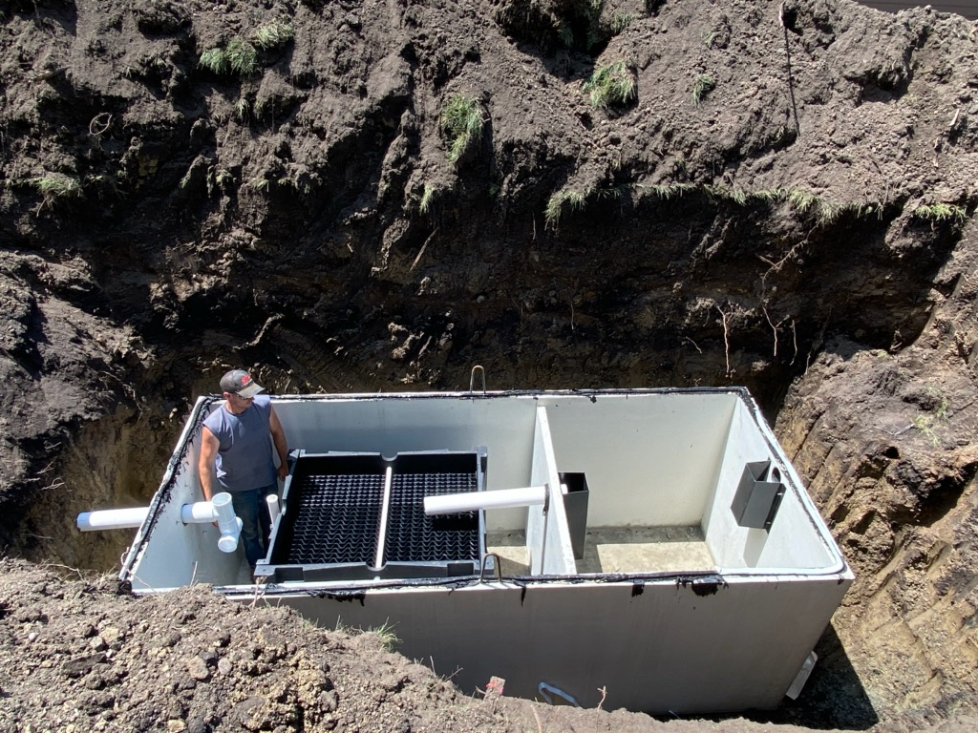
The E60 (600 gpd) Ecopod unit is roughly 2’ wide by 4’ long by 5’ tall and weighs about 165 lbs dry.
The unit typically stands on the tank floor.
Often the Ecopod unit is sent to the tank manufacturer for assembly, then the tank is delivered as a pre-assembled unit.
Otherwise you assemble it onsite.

Slide 11
The baffle wall pipe must bring effluent to inside top of unit, so the pipe is often level coming from the baffle wall.
The water level MUST be 2” above media, so the media must be 2” below the outlet invert.
The unit legs need to be cut to meet this specific height.
As such this custom tank requires a 2” drop from the inlet to the baffle wall, and another 2” drop to the outlet invert.

Slide 12
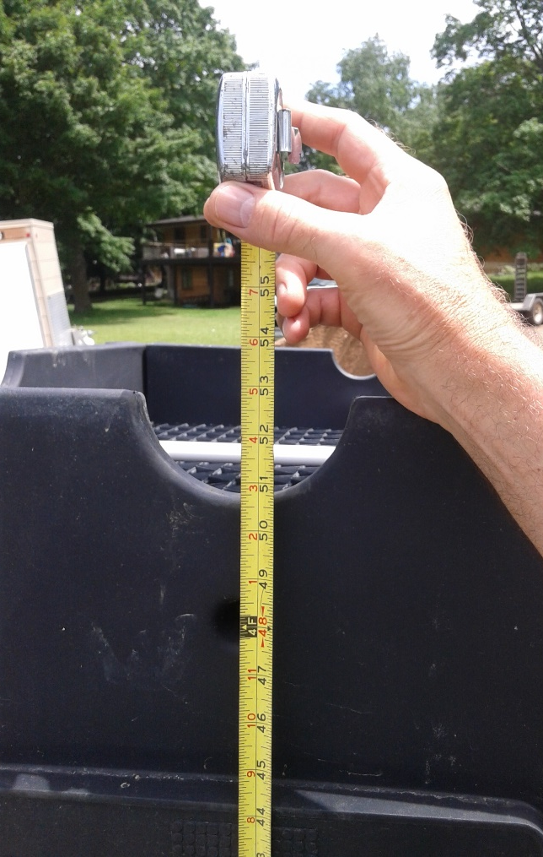
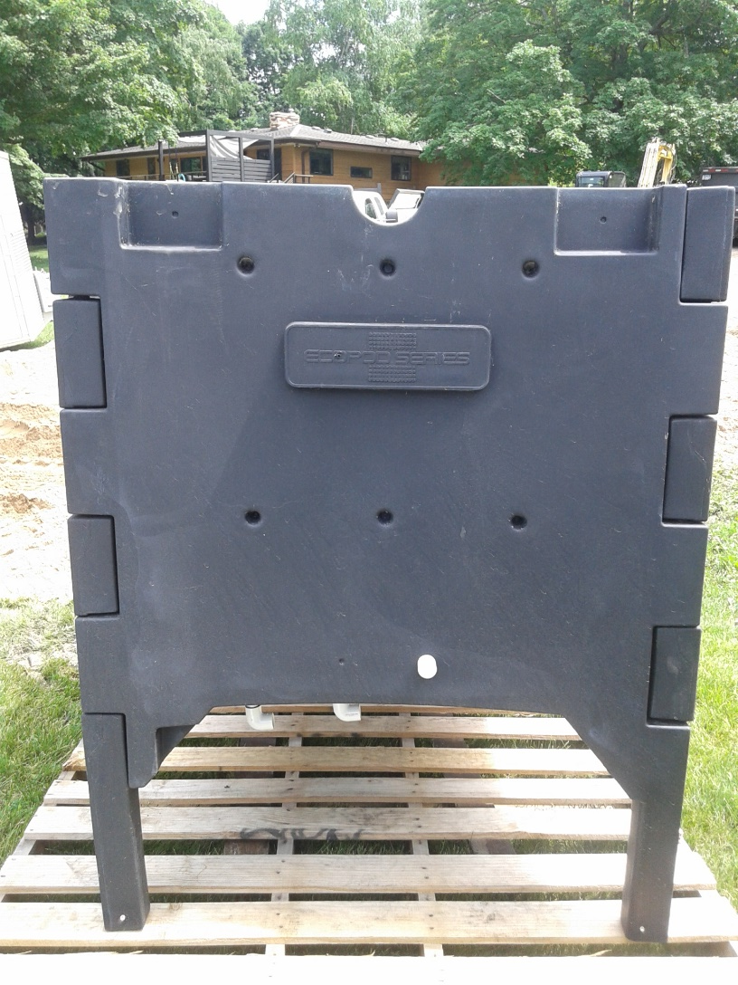
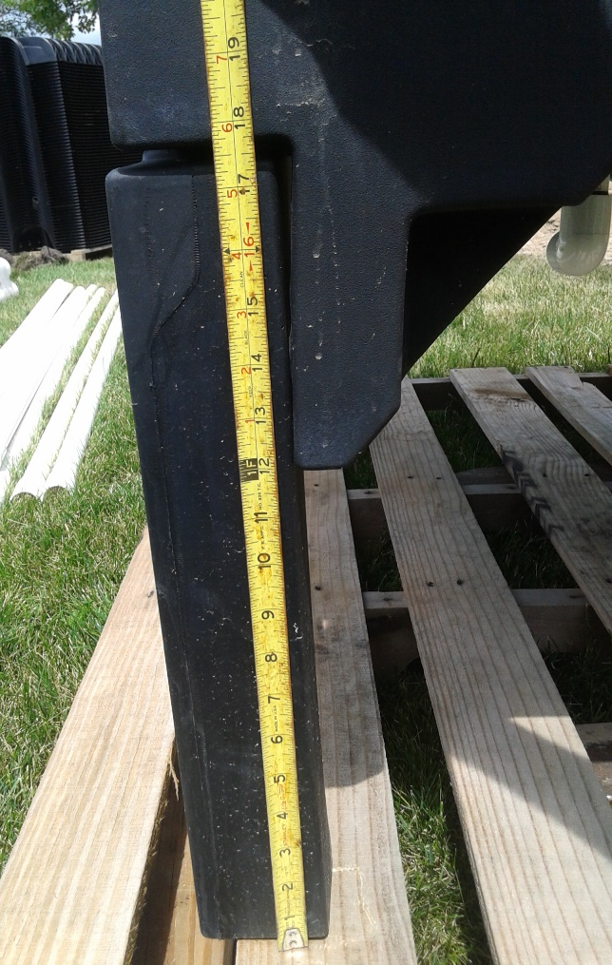
Cut legs as needed

Slide 13
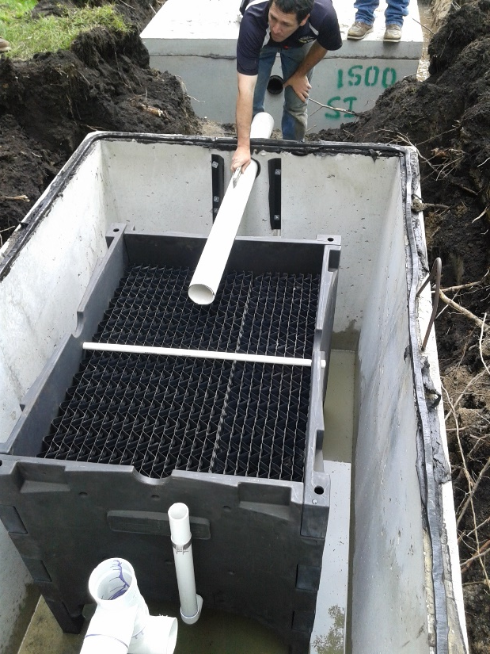
In the photo, the installer is holding the inlet pipe which places the effluent on the top of the media.
Looking at the outlet side of the tank, you see the 2” line that the blower will use to feed air to the bottom of the unit.
The air will rise and create a bubbling action as it comes up through the media as seen from the water surface.
This action circulates the effluent around the media and provides plenty of oxygen for the treatment “bugs”.

Slide 14
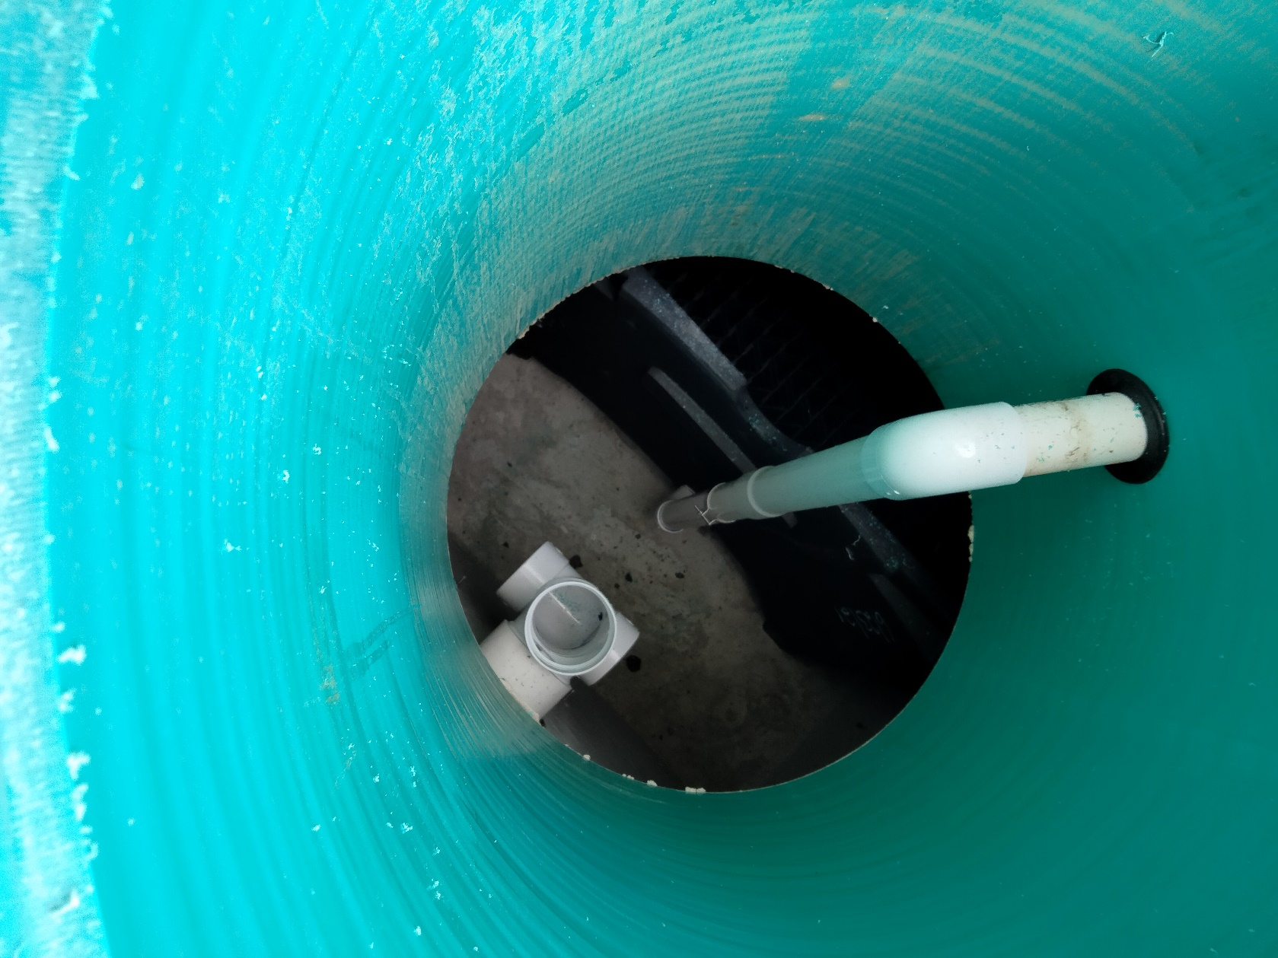
Air Supply Line in riser from blower to unit

Slide 15
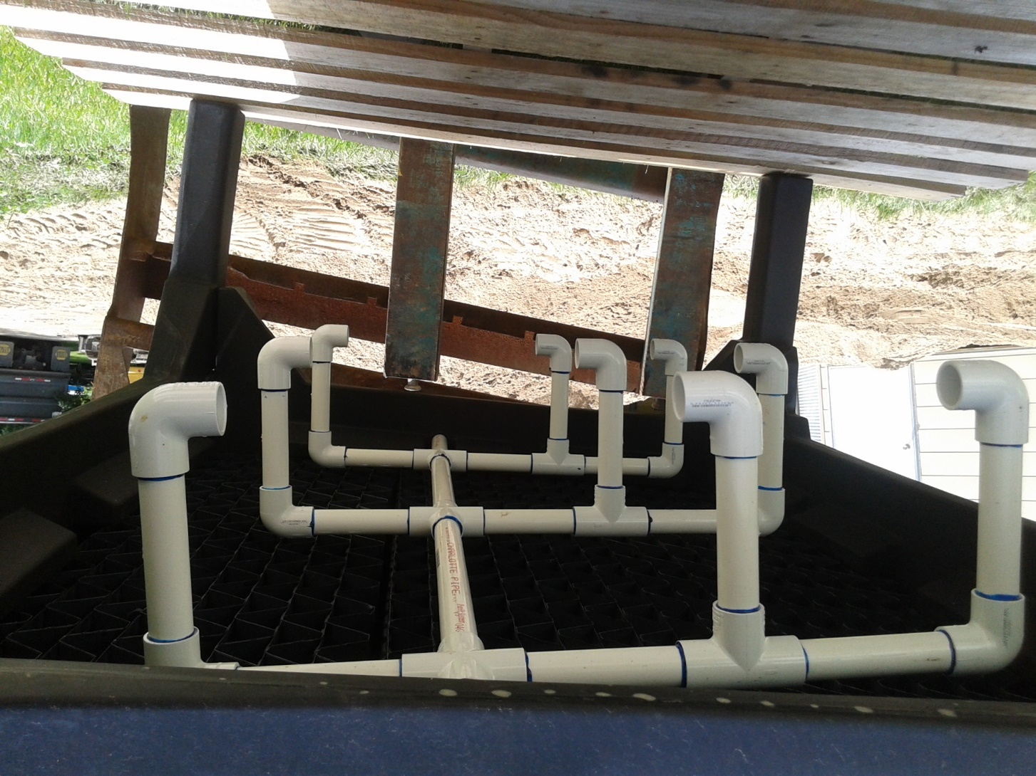
Air manifold on Underside of unit

Slide 16
The effluent then gravity flows out of the Treatment tank thru the sanitary “T” at the outlet of the tank.
Drain field
Gravity flow
to lift tank
Trash trap / treatment tank
UV lite
Lift tank

Slide 17
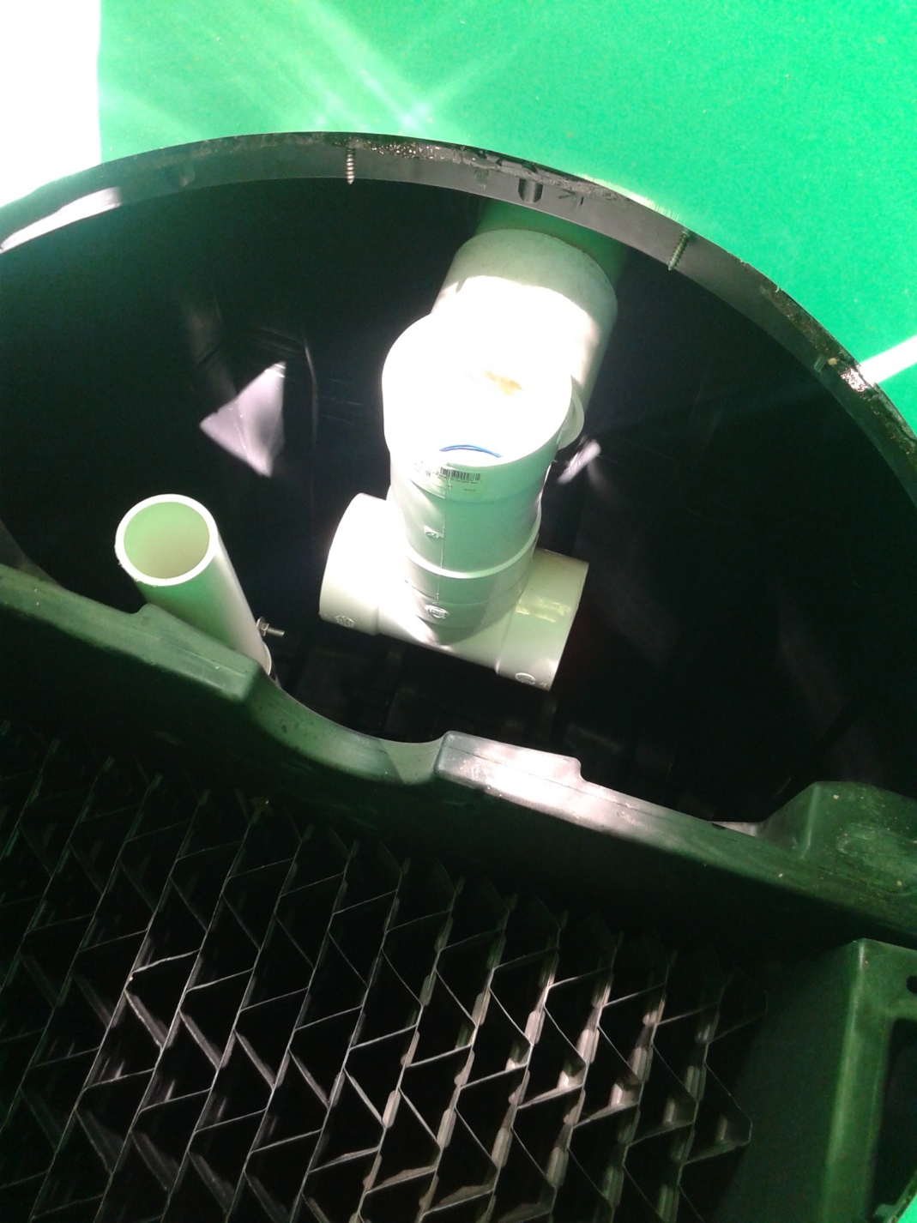
tank outlet sanitary T, with “a base T”
This helps to keep air bubbles from carrying solids up and out.

Slide 18
After the sanitary “T” the effluent then passes thru the UV light before entering the lift tank.
Drain field
Gravity flow
to lift tank
Trash trap / treatment tank
UV lite
Lift tank

Slide 19
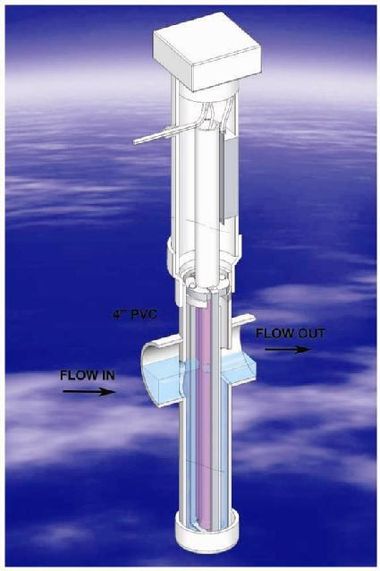
To meet MN treatment level “A” requirements, the Ecopod must be followed with a UV light.
The UV light is required to be inspected and cleaned twice a year.
The bulb is recommended to be replaced every 2 years.
MN7080 does not require lab sampling on any registered Type IV pretreatment system, but some local operating permits may require at least a fecal test to confirm treatment is occurring as intended.
Check with your local unit of
government for their specific
requirements.
Salcor UV lite

Slide 20
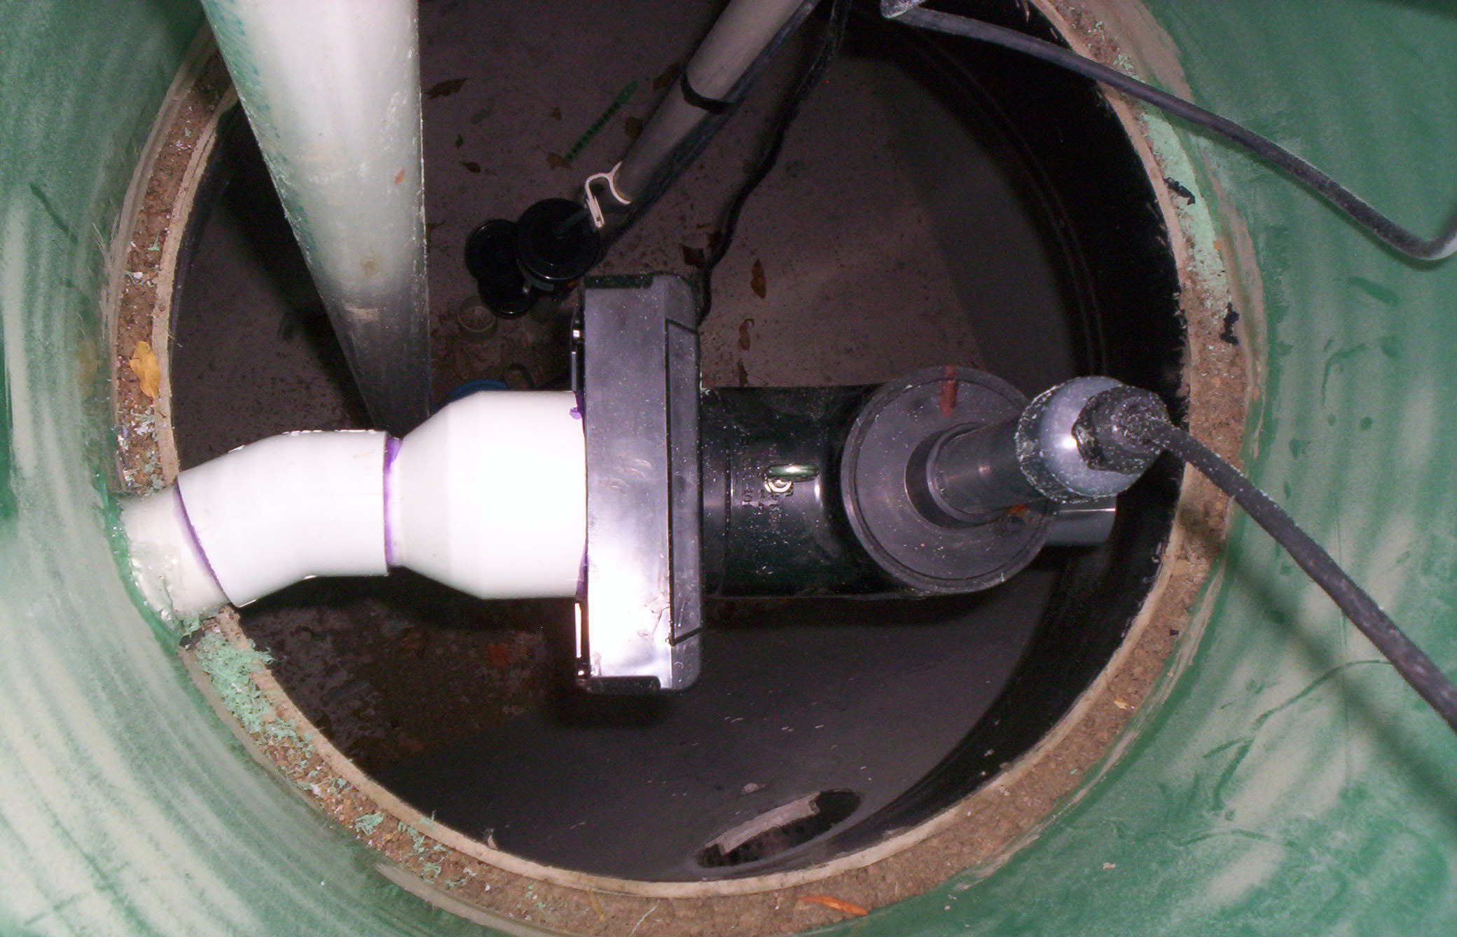
This is the riser to the lift tank. The UV lite is typically installed here and is shown with an angled pipe fitting. This helps makes room for the float tree and lift pump to all be installed in ONE riser.
Or you can put the UV lite in the 1st riser and the pump in the 2nd riser.

Slide 21
Install tips
Before getting started confirm the placement of the control panel and the route for the electrical wires.
The control panel can be placed in different locations depending on site conditions, but is often placed by the lift pump riser.
The panel will control:
- power to the blower motor
- the blower alarm (signaling a lack of air to the unit) (alarm #1)
- the lift pump in the dose tank (time dosed)
- the lift tank high level alarm (alarm #1)
- and power the UV lite & optional light fail alarm. (alarm #2)
Or the panel can control the pump out of the trash trap to the treatment tank (micro time dosed) then you would do a standard piggy back demand float for the lift pump to the drainfield, this second pump would require an additional power line as the panel does not have the ability to power it.
A single 12-2G power wire is typically used to power the panel.
Additionally a 2nd 12-2G can be run to isolate different components if desired.

Slide 22
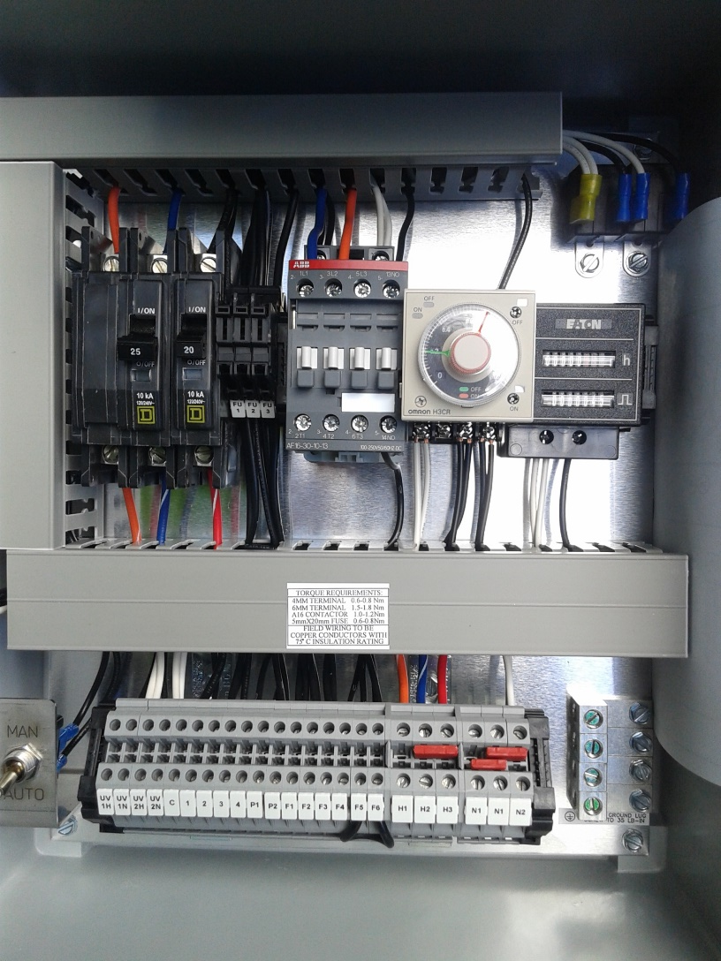
Control panel

Slide 23
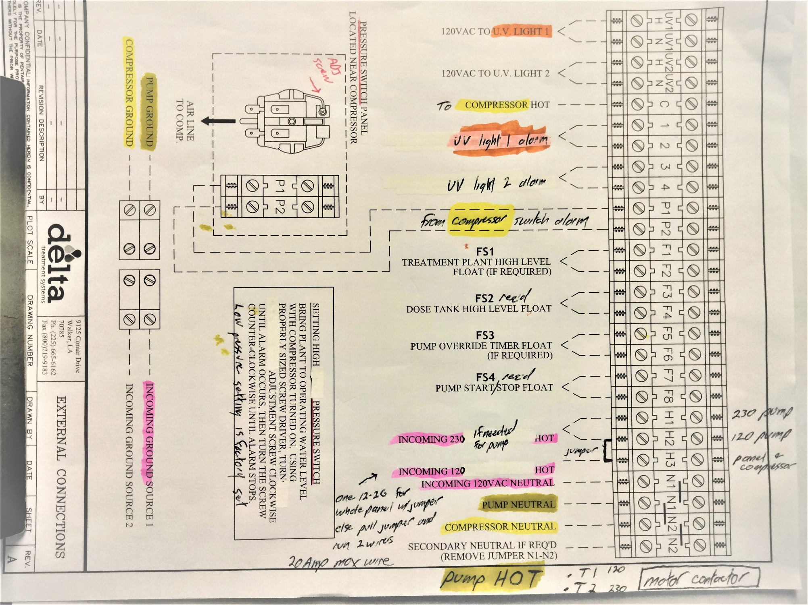
Control panel wiring diagram

Slide 24
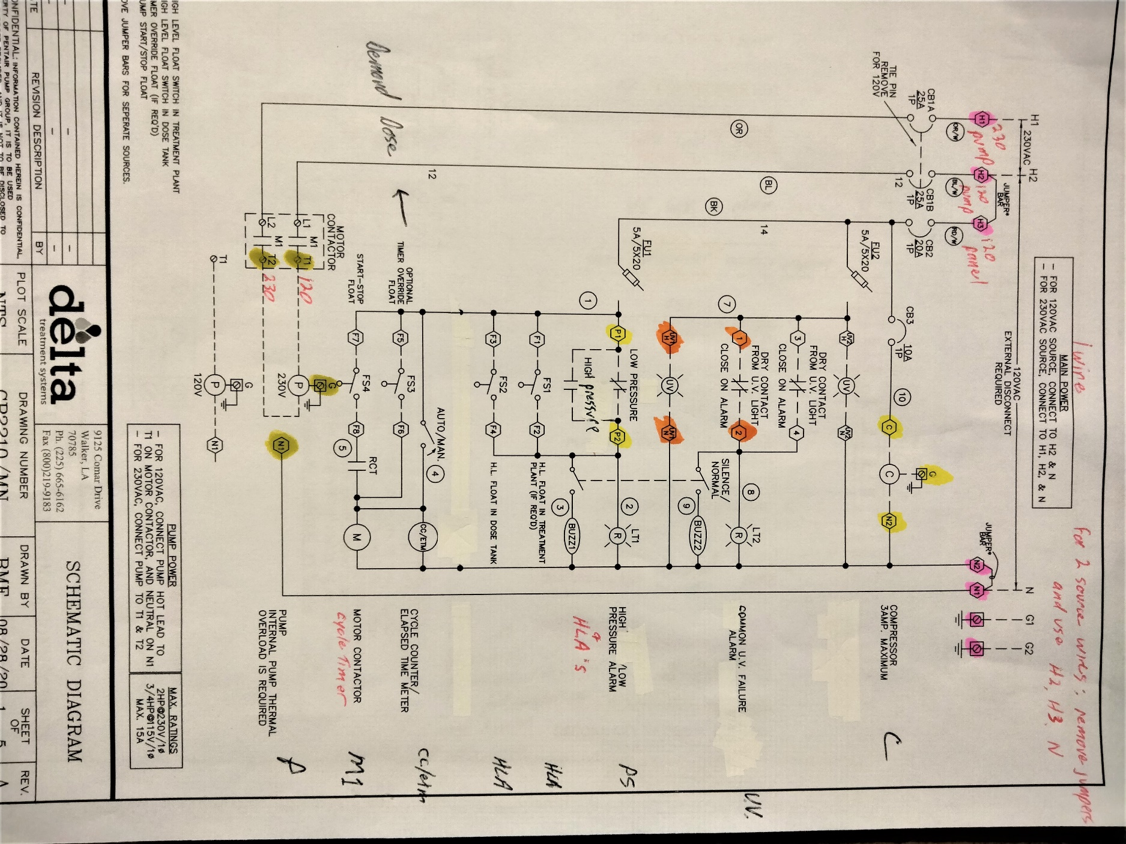
Control panel wiring schematic

Slide 25
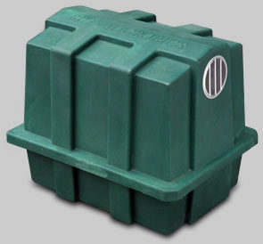
Also decide where to place the blower motor housing and exhaust vent outlet.
The blower air supply line should be 2” sch 40 and be less than 100’ long.
The exhaust vent pipe must be 3” minimum and should flow through it’s own designated vent line. It is NOT recommended to ONLY vent back through the home roof stack. A separate line out of the treatment or lift tank riser with a charcoal filter is often sufficient
The vent line must also provide for proper drainback.

Slide 26
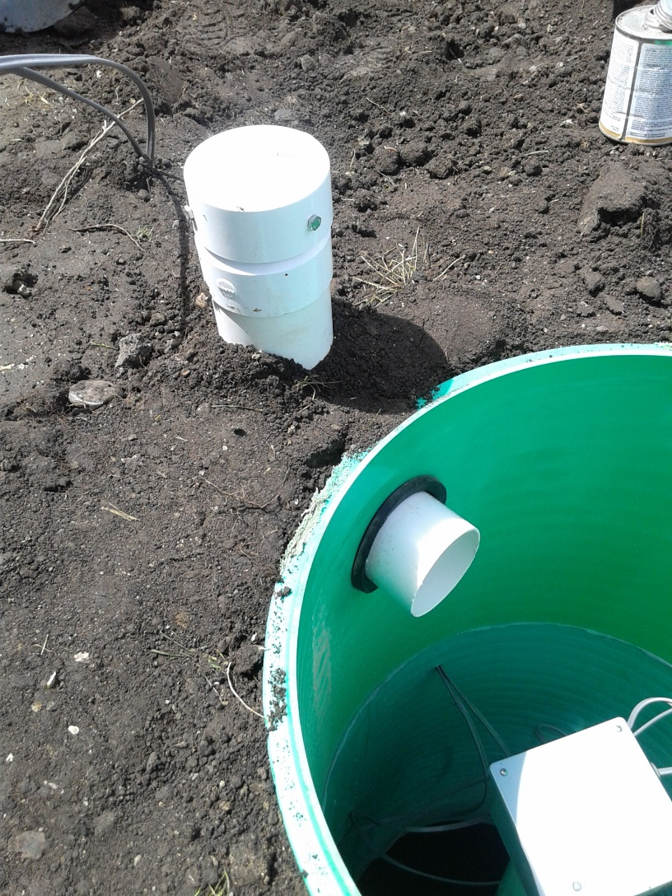
Venting through the treatment riser
Be aware of the placement of the exhaust vent in regard to potential odors.

Slide 27
The Blower typically lasts at least 5 years.
The blower motor and housing should sit on a 26” x 20” base, typically some brick pavers or a residential Air Conditioning unit type of pad.
Keep the blower inlet screen clean.
Test vent backpressure by holding your hand 8” from the vent outlet, if you feel no air draft this means it is properly sized. Cover the vent opening with #4 mesh screen (3/16” opening).

Slide 28
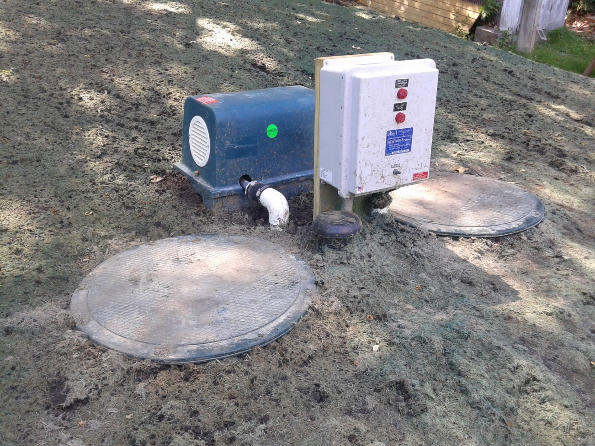
Control panel, 4” vent cap and Blower housing with 2” supply line
(vent should be a foot higher to be above winter snow)

Slide 29
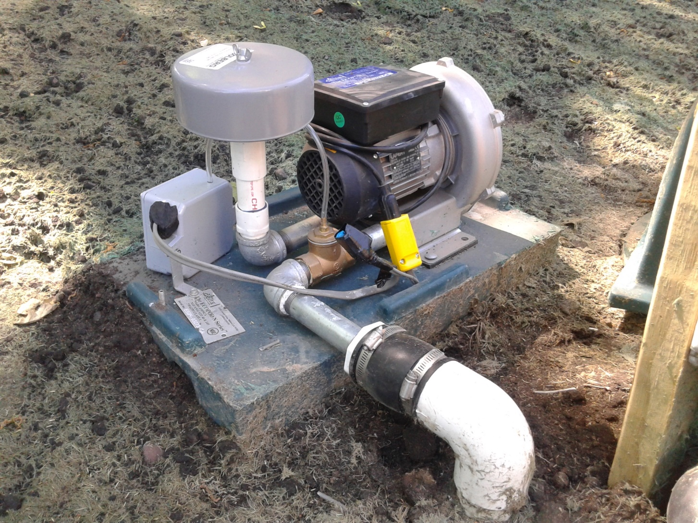
Blower with screened housing removed.
Air cleaner is inside along with brass air pressure switch that sends a signal to the panel if the blower fails.

Slide 30
Under normal residential use, start up and proper treatment will occur
within a week.
Under normal conditions there should be robust splashing seen on top of the media and the effluent should be clear to light brown
The unit should smell like compost , not rotten eggs.
Avoid grease and excessive water softener backwash.
The Ecopod requires maintenance twice a year.
Pump the tank when the sludge is within 4” of the bottom of the unit, or
about every 3 years.
When performing maintenance pumping, both the trash trap & treatment
tank should be pumped. The treatment tank should then be re-filled.
For seasonal use (gone longer than a month) just shut the blower off.

Slide 31
Design worksheet
When designing any system, the simplest method is to find the appropriate design worksheet at www.SepticResource.com and fill it in with the basic field data you obtained from your site evaluation. The design worksheet for a pretreatment system will still only take a couple of minutes to complete.
 | 2011 purple code |  |  | Ecopod & Pressure Bed |  |  |  |  |  |  |  |  | www.SepticResource.com (vers 14.2)
 |  | Property Owner: |  |  |  |  |  |  |  |  | Date:
 |  | Site Address: |  |  |  |  |  |  |  |  | PID:
 |  | Comments:
 |  | instructions: |  |  | = site specific input |  |  |  | = adjust if desired |  |  |  | = self-calculated (DO NOT ADJUST)
1) |  | ? | bedroom |  | Type | IV |  | Residential |  |  | System
2) |  | 0 | GPD design flow |  |  | (average flow should be < 70% of design flow)
 |  |  | PRETREATMENT: |  |  | (Residential strength to level A/B)
3) |  | 1000 | Gallon Trash trap/pump tank to Ecopod
4) |  | 500 | Gallon Ecopod unit |  |  |  | UV light req'd |  | Yes
 |  | 30 | gpm | 10 | ft head TREATMENT pump |  |  |  |  | 48 | doses per day |  |  | 0.0 | gal /dose (treatment)
5) |  | 10 | feet of |  | 2.0 | inch supply line |  |  | leads to | 2 | gallons of drainback volume
 |  |  |  |  |  |  |  |  |  | 2.0 | gallons total pump out volume

Slide 32
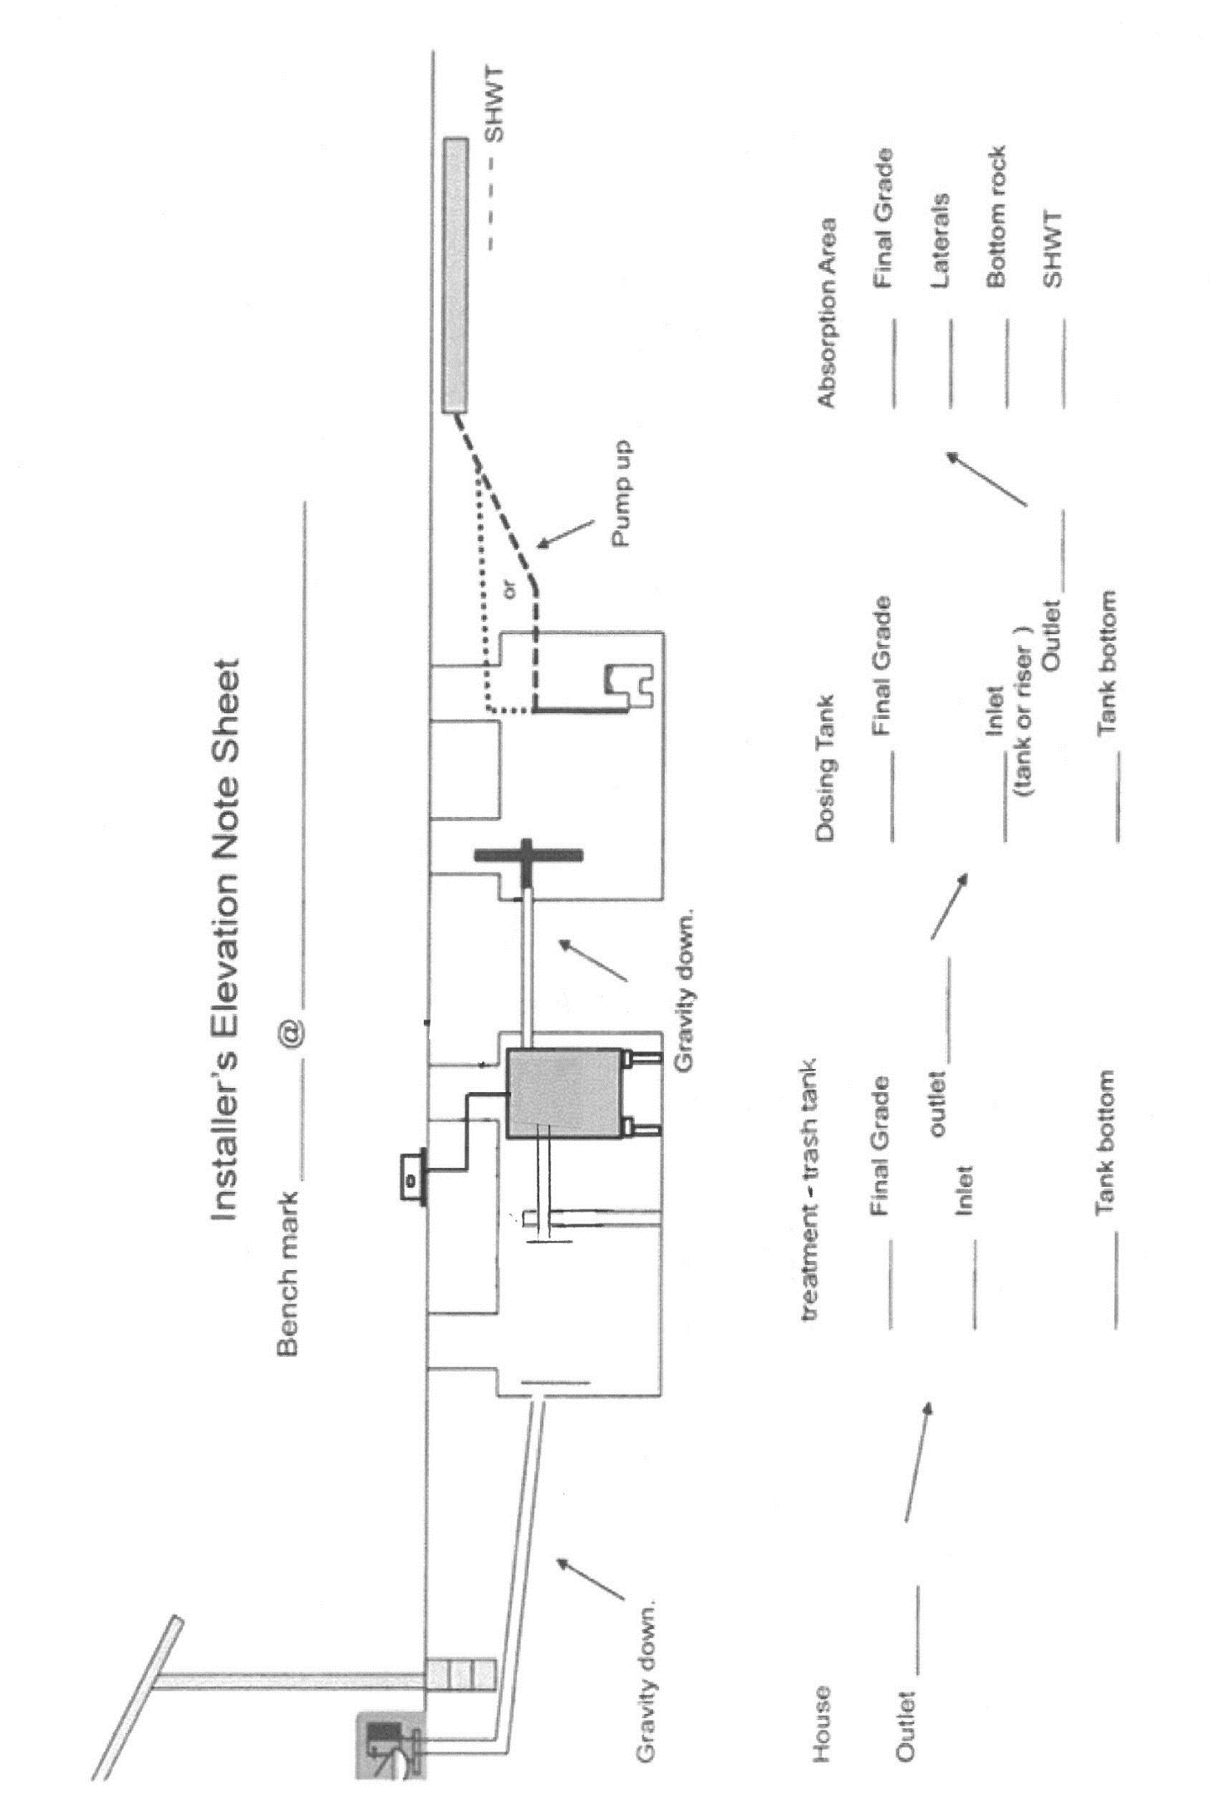
The design sheet will also produce a System elevation template

Slide 33
This concludes the basic Ecopod “need to know” training.
For further information contact your local distributor or the manufacturer at www.InfiltratorWater.com

