Slide 1
Basic “need-to-know” for
Advantex AX-20 pretreatment systems.
Specific requirements for MN applications.

Slide 2
Advantex Basics
The Advantex is a “recirculating“ treatment system similar to a recirculating sand filter.
Each Advantex AX-20 unit is Minnesota registered to 600 gpd with residential strength waste.
The unit will achieve treatment Level “A” with a UV lite.
Treatment level “A” only requires 12” of separation to the seasonal high water table and receives an average 25% reduction in the drainfield square footage requirement.
Check the “treatment level A” soil loading rates for your specific soil.
The Advantex system typically has a higher up front cost, but tends to cost less over time. This is due to a long lifespan of the equipment and the low monthly electrical bill. The power cost is often less than $3 dollars a month versus $25 or more for an ATU with a constantly running blower motor.
The manufacturer requires maintenance once a year.

Slide 3
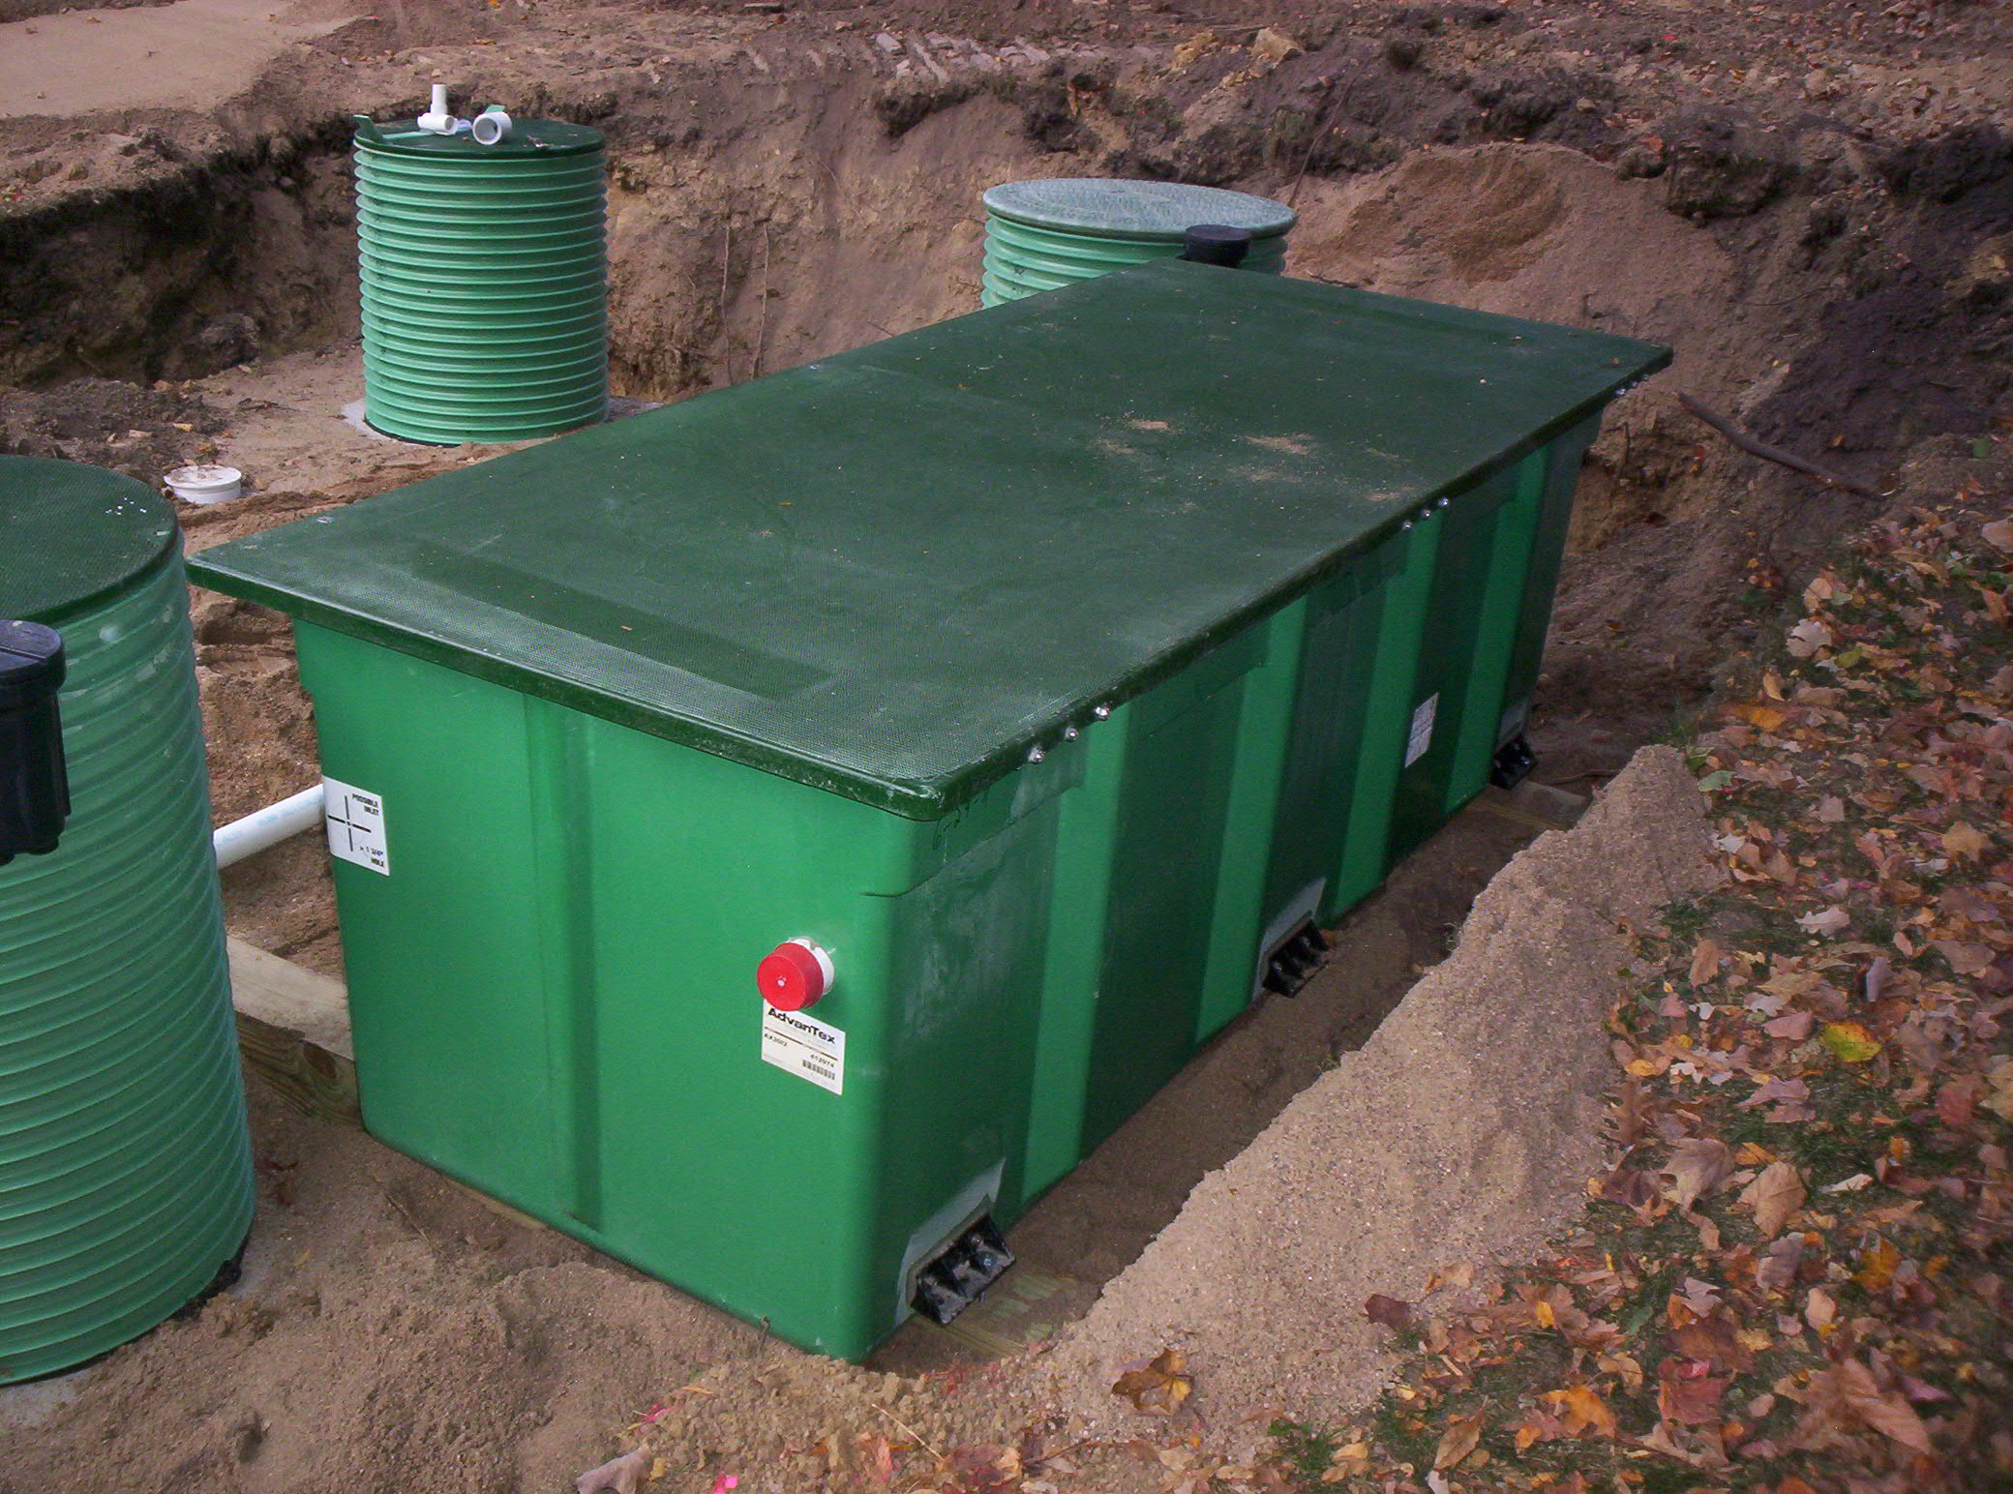
The Advantex filter is 7 ½ ’ long by 3’ wide by 2 ½ ’ tall.
It weighs about 350 lbs dry, and is typically set right on top of the recirc tank.

Slide 4
The basic layout of the Advantex system is the same as a recirculating sand filter, or any other recirculating treatment system.
To better understand the concept, start with a standard pressure bed layout.

Slide 5
Standard pressure bed layout
Drain field
Septic
Lift
Drawing #1

Slide 6
Now simply insert a recirc tank and the Advantex filter between the septic and lift tanks.

Slide 7
Additional pretreatment components
Advantex
Drain field
Recirc
Septic
Lift
Drawing #1

Slide 8
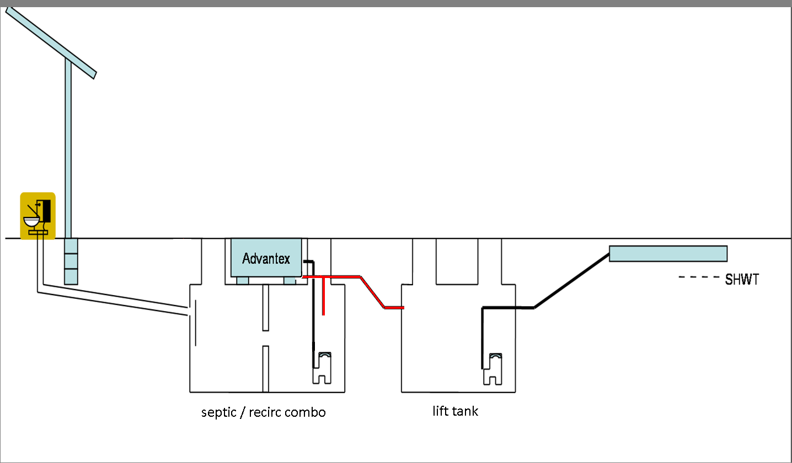
The septic and recirc tanks can be separate tanks, however it is often more efficient to use a combination septic/recirc tank (2000 gal combo works best).

Slide 9
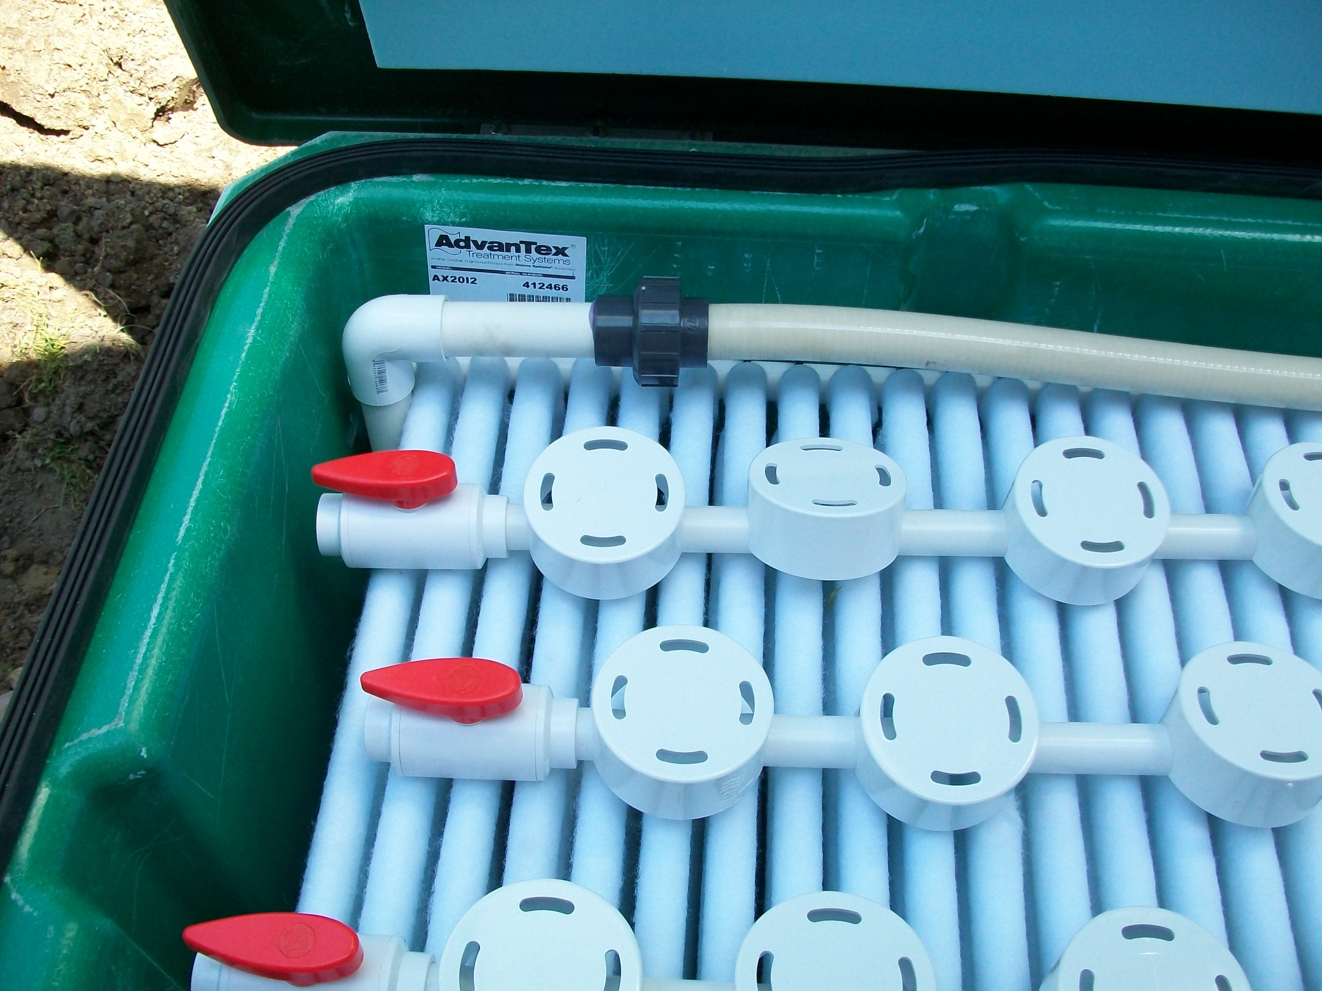
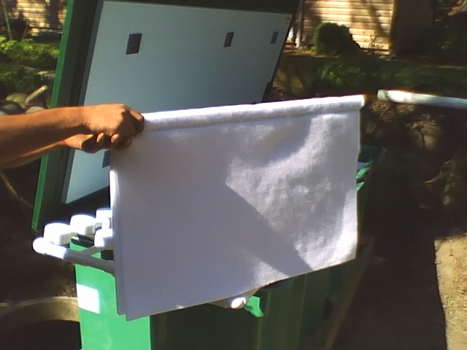
Treatment
The recirc pump doses the filter by spraying the effluent over the top of the hanging sheets using a miniature lateral network.
The effluent trickles down through the sheets to obtain treatment.
The effluent then drips off the bottom of the sheet and drains back to the recirc tank.
The Advantex unit is never full of water, nor does it maintain any level of water, it is simply a box full of dripping wet “towels” that has a drain pipe at the bottom.

Slide 10
Water flow
As the effluent drains back to the recirc tank, part of the water is diverted to the lift tank (drain line shown in red).

Slide 11
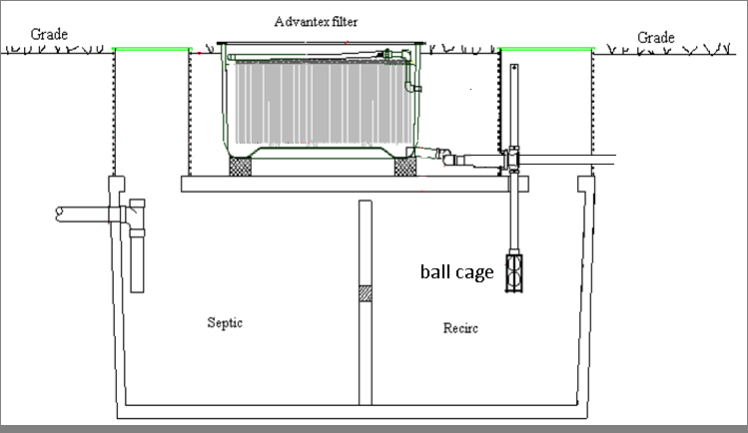
The “ball cage” is the component that diverts the flow and also provides for our recirculation, giving us our desired 3:1, 4:1 recirc ratios.

Slide 12
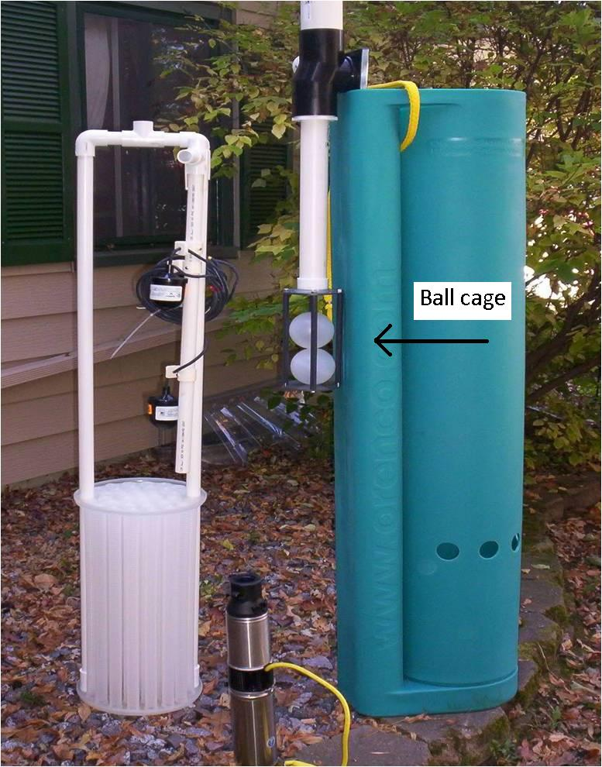
The ball cage assembly is shown
In the middle of the photo.

Slide 13
The “ball cage” assembly works similar to a trench drop box.
The effluent comes in one end of the “T” at the top of the ball cage, and when the water level in the recirc tank is high, the balls in the ball cage are up and seated, this causes the effluent to back up and flow out the other end of the “T” which leads to the lift tank.
Just like a trench drop box, when the first trench is full, it diverts the water to the next trench.
In this case, when the recirc tank is full it diverts the water to the lift tank.

Slide 14
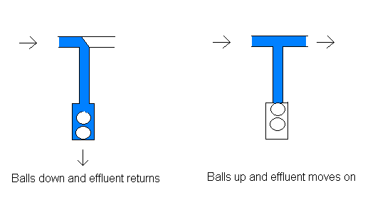
Low water level : High water level : water returns to the water moves on to recirc tank the lift tank

Slide 15
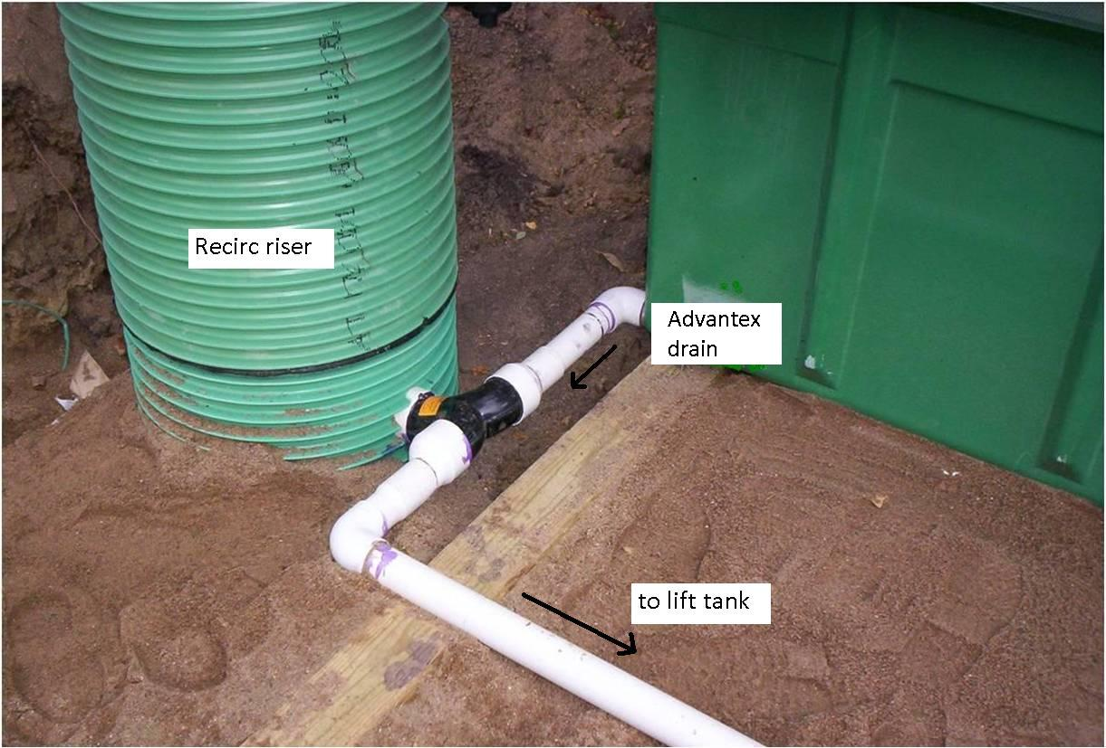
The component shown in black is the “T” at the top of the ball cage

Slide 16
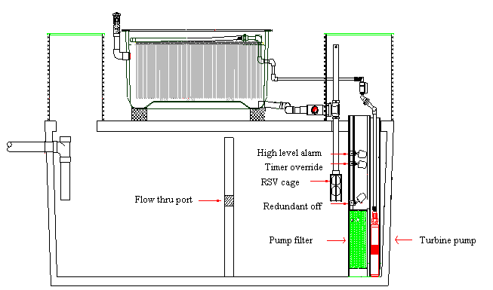
Inside the recirc tank there will also be a “pump vault” which contains the pump filter, floats, and a “well” style recirc pump (also shown is the RSV “ball cage”).
It takes at least 44” of water height for this stack of components, so low profile tanks won’t work. These components are also shown on the following page.

Slide 17
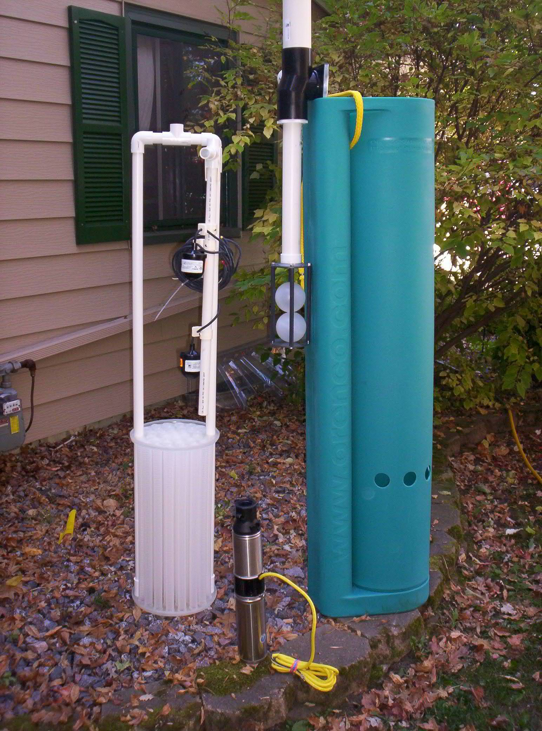

Slide 18
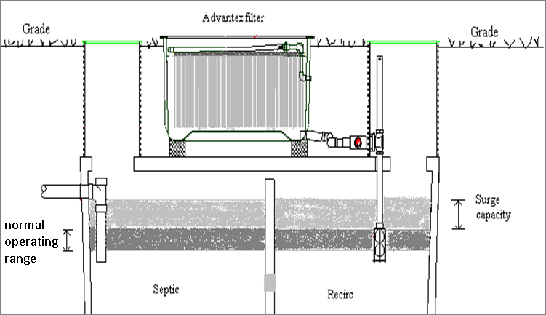
A recirculating system must time dose all effluent through the filter, so the recirc tank must also perform surge control (DO NOT UNDERSIZE IT) as such it does not have a fixed water level. Using a combo tank with a mole hole allows the septic to provide surge capacity as well.
The dark gray level shows the normal operating range.
The light gray level shows the surge capacity range.

Slide 19
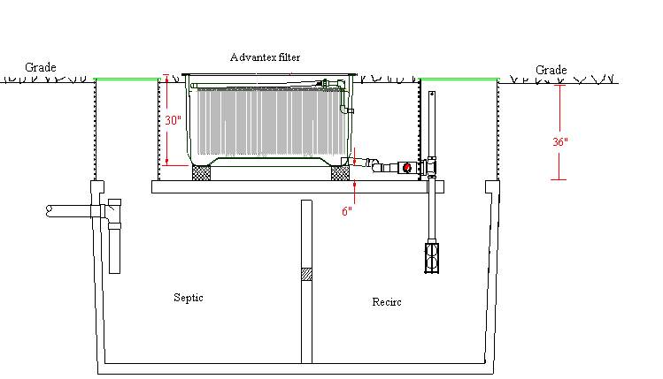
The “standard” design has 3’ of soil cover over the tank (and thus 3’ of tank riser).

Slide 20
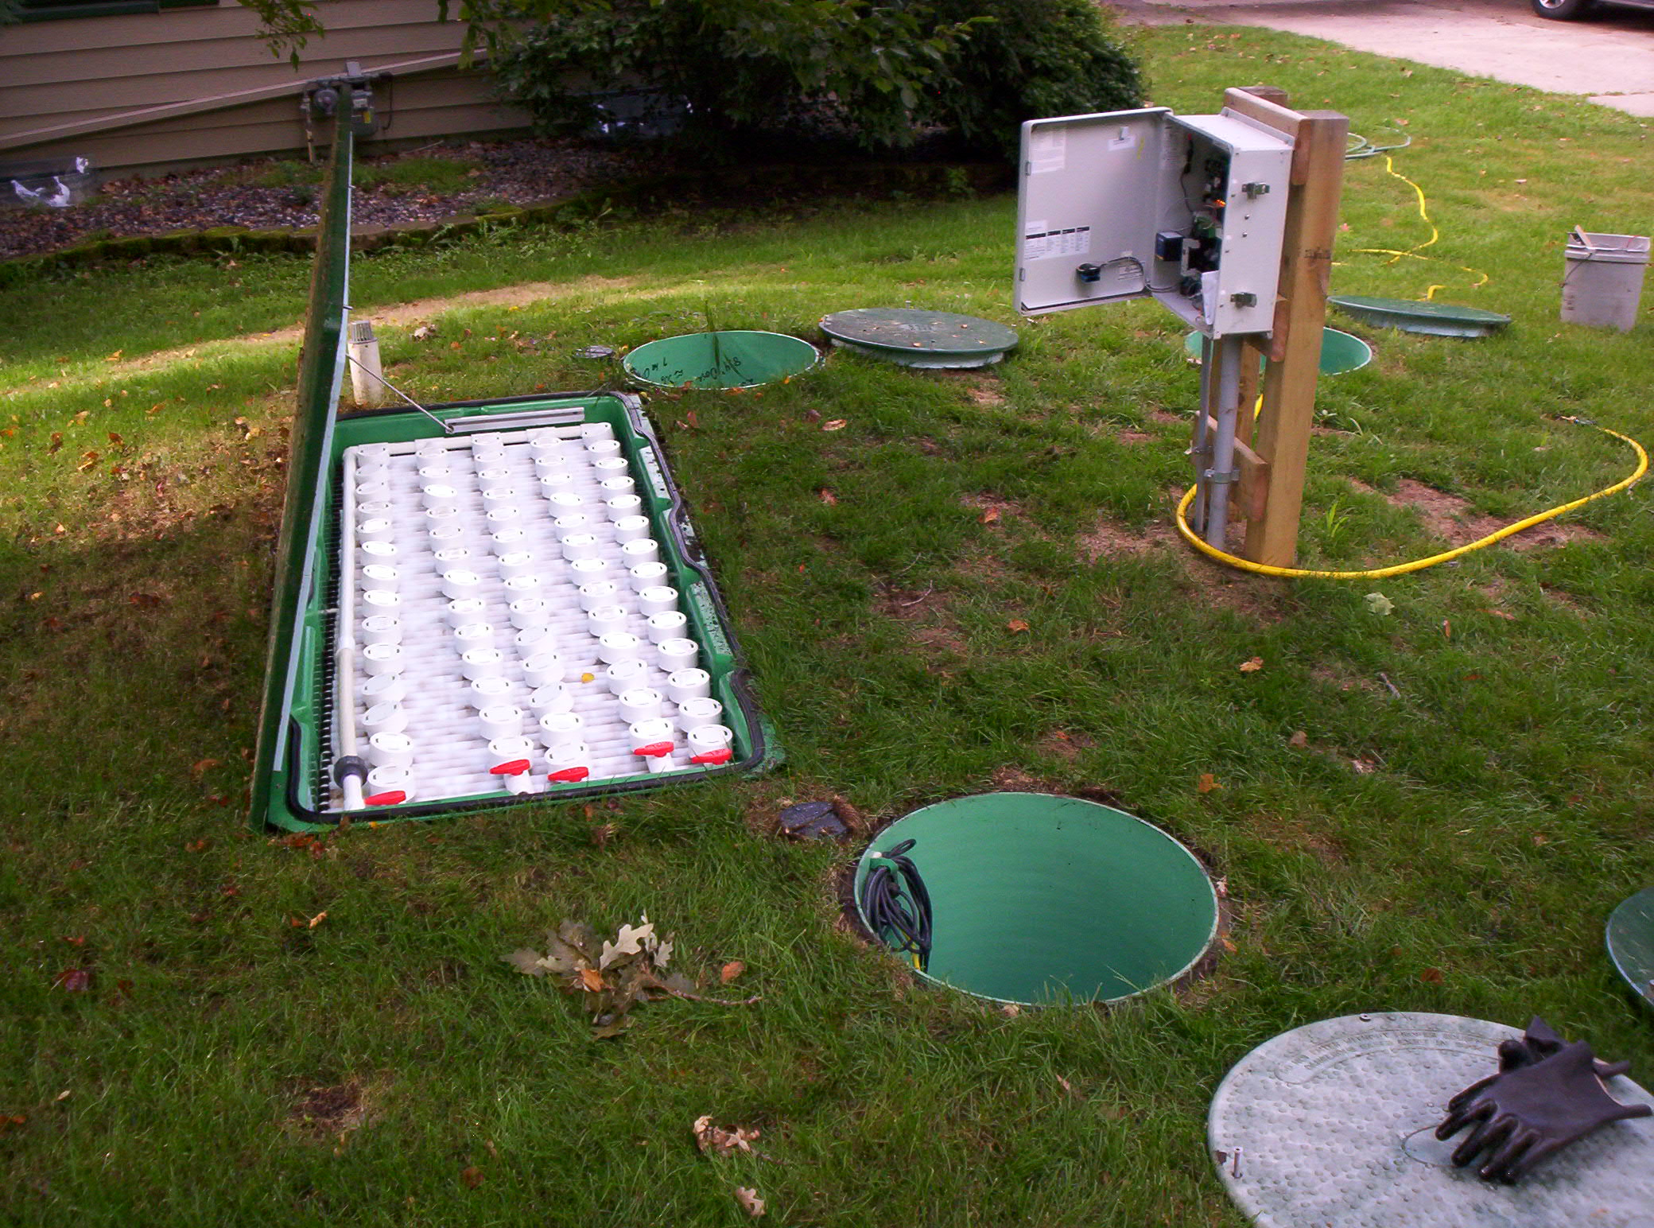
Each Advantex system is designed so that the top of the unit will be flush with final grade. This provides easy access to the unit for maintenance.

Slide 21
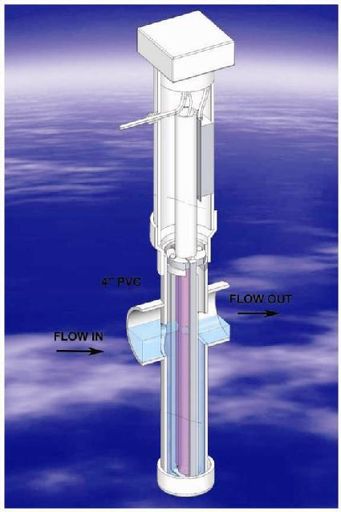
For treatment level “A”, the Advantex must be followed with a UV light.
The UV light is required to be inspected and cleaned twice a year.
The bulb is recommended to be replaced every 2 years.
MN7080 does not require lab sampling on any registered Type IV pretreatment system, but some local operating permits may require at least a fecal test to confirm treatment is occurring as intended.
Check with your local unit of
government for their specific
requirements.
Salcor UV lite

Slide 22
MN7080 requires “treatment level A” effluent to be:
- time dosed and
- uniformly distributed.
This typically results in using a standard pressure bed or pressure trenches.
You must be at least an Intermediate designer to design a residential strength Type IV pretreatment system < 2500 gpd.
An operating permit and a management plan are also required.

Slide 23
Install tips
During the installer site visit, it is a good time to confirm the placement of the control panel. It is best to place it near the risers which contain the recirc and lift pumps.
The UV light has a cord 20 feet long, this also needs to be considered when determining the placement of the control panel.
FYI: It will typically take one man 4 hours to assemble the various Advantex components.

Slide 24
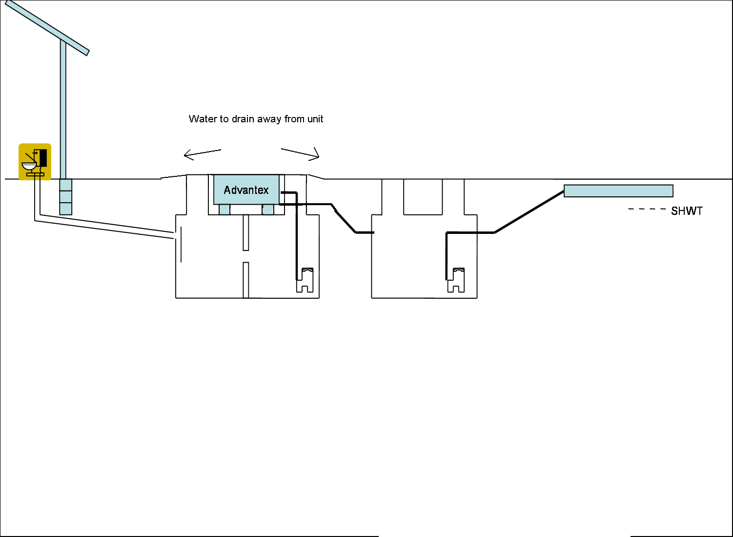
During back fill, keep a mild slope away from the unit lid and riser lids to avoid any future water runoff from getting into the unit or tanks.
Make sure the unit lid is bolted down prior to backfilling.

Slide 25
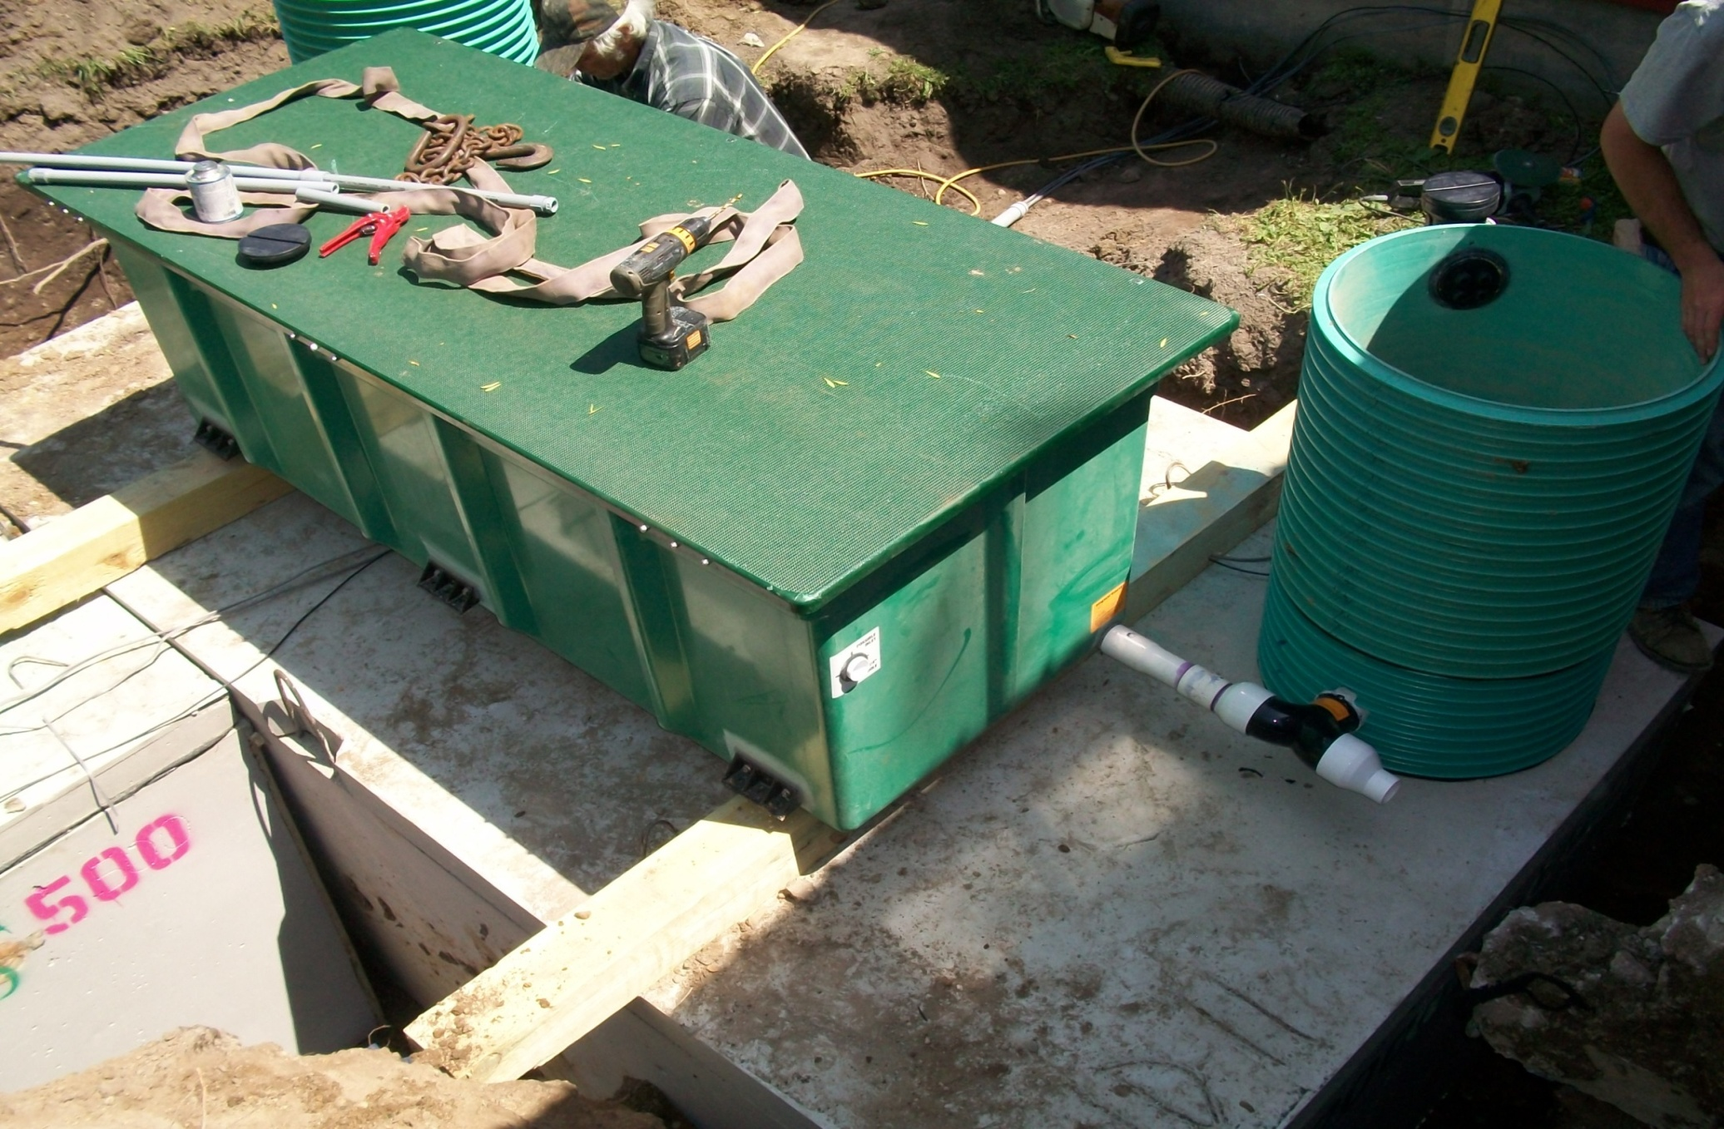
The unit is typically bolted to 6” Timbers perpendicular to the unit. This provides the proper height above the tank for pipe connections, and also provides anti-floatation measures. This unit is sitting on a 2000 gal combo tank with a mole hole.
Picture of unit parallel and perpendicular

Slide 26
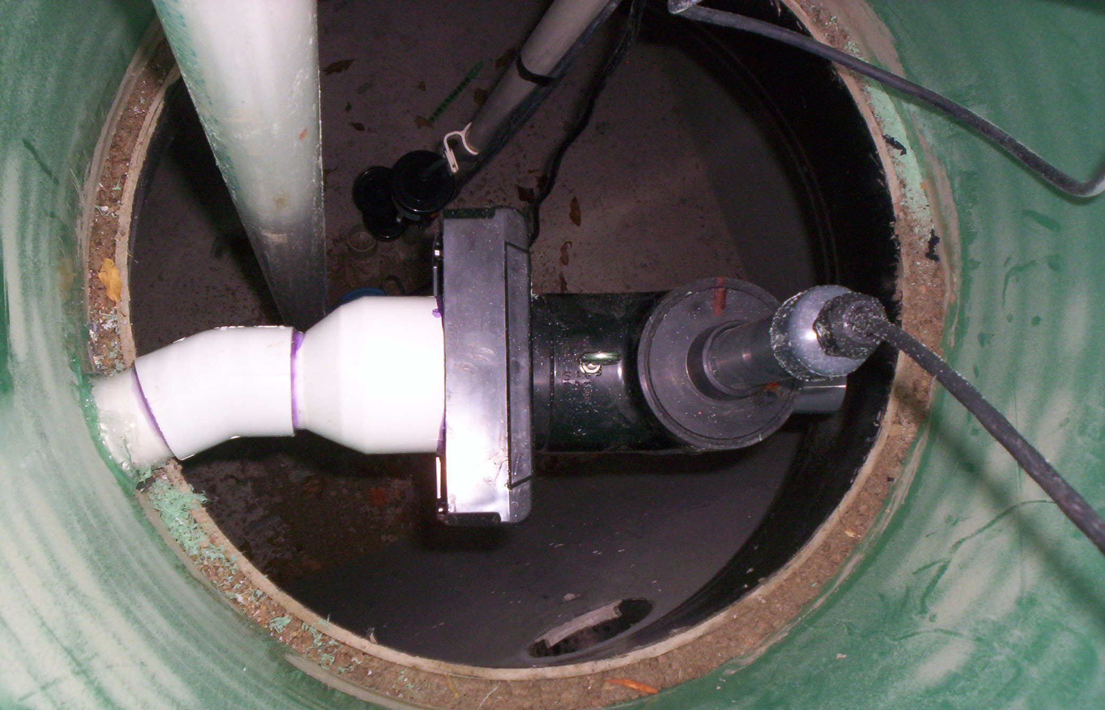
This is the riser to the lift tank. The UV lite is shown with an angled pipe fitting. This helps makes room for the float tree and lift pump.

Slide 27
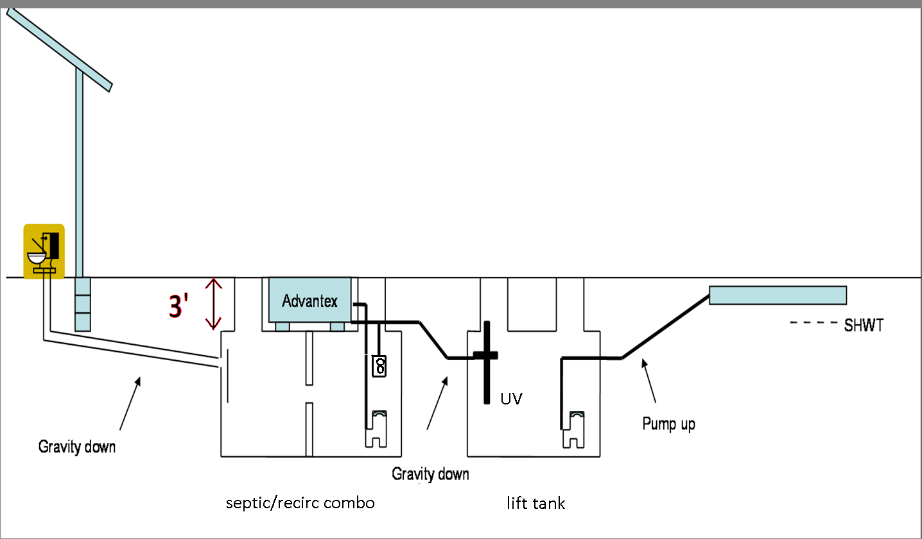
Review system flow
Sewage enters the septic/recirc combo. The effluent is pumped up to the Advantex filter. As it drains back to the recirc tank the “ball cage” will divert some of it toward the lift tank. The water goes through the UV light as it enters the lift tank. The lift pump then pumps the effluent to the drainfield.

Slide 28
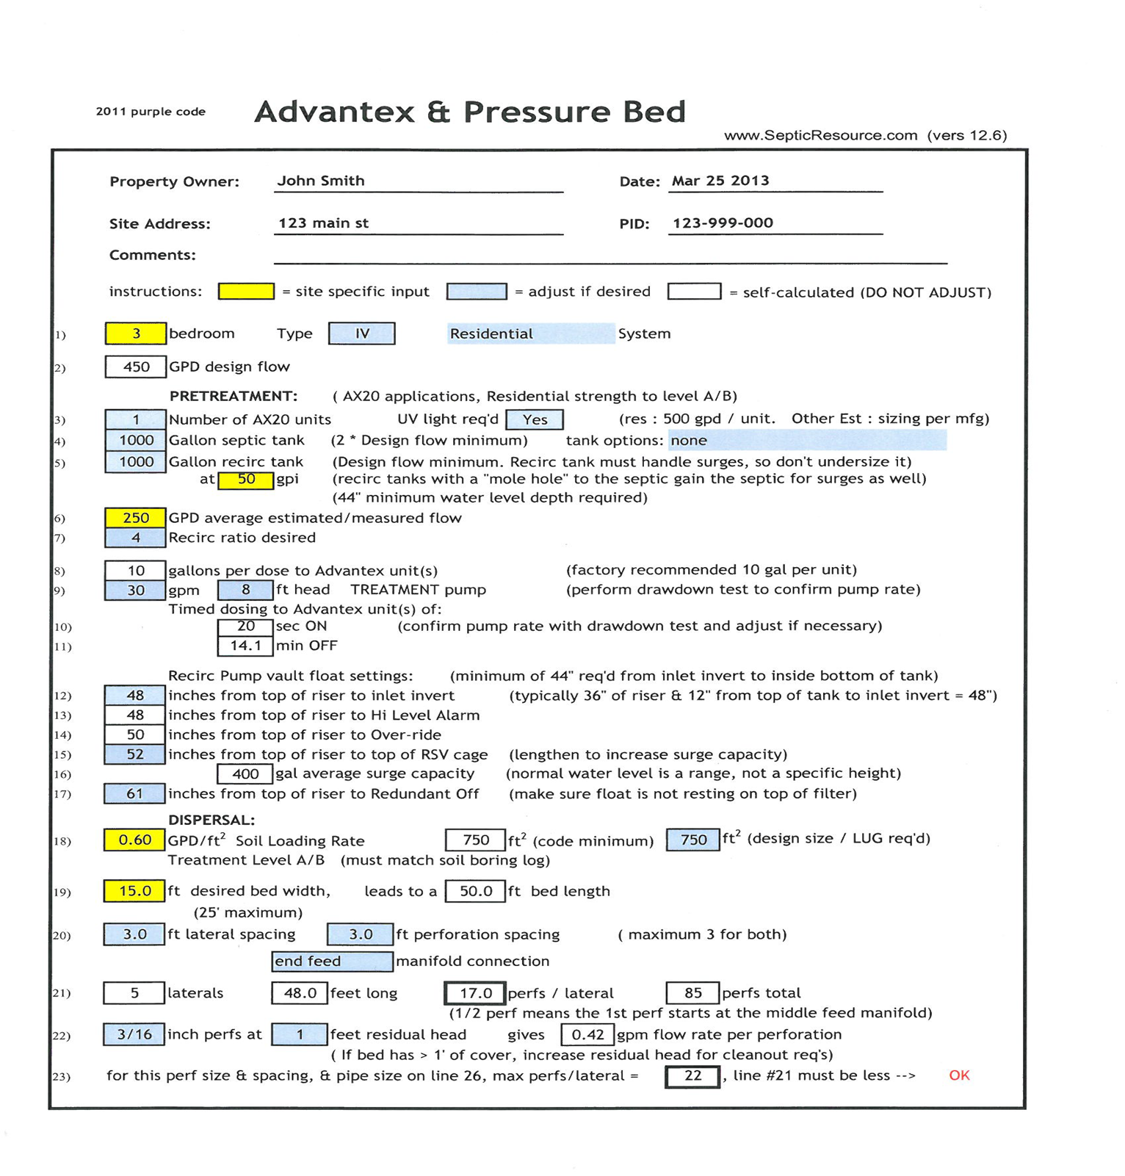
Design worksheet
When designing any system, the simplest method is to find the appropriate design worksheet at www.SepticResource.com and fill it in with the basic field data you obtained from your site evaluation. The design worksheet for a pretreatment system will still only take a couple of minutes to complete.

Slide 29
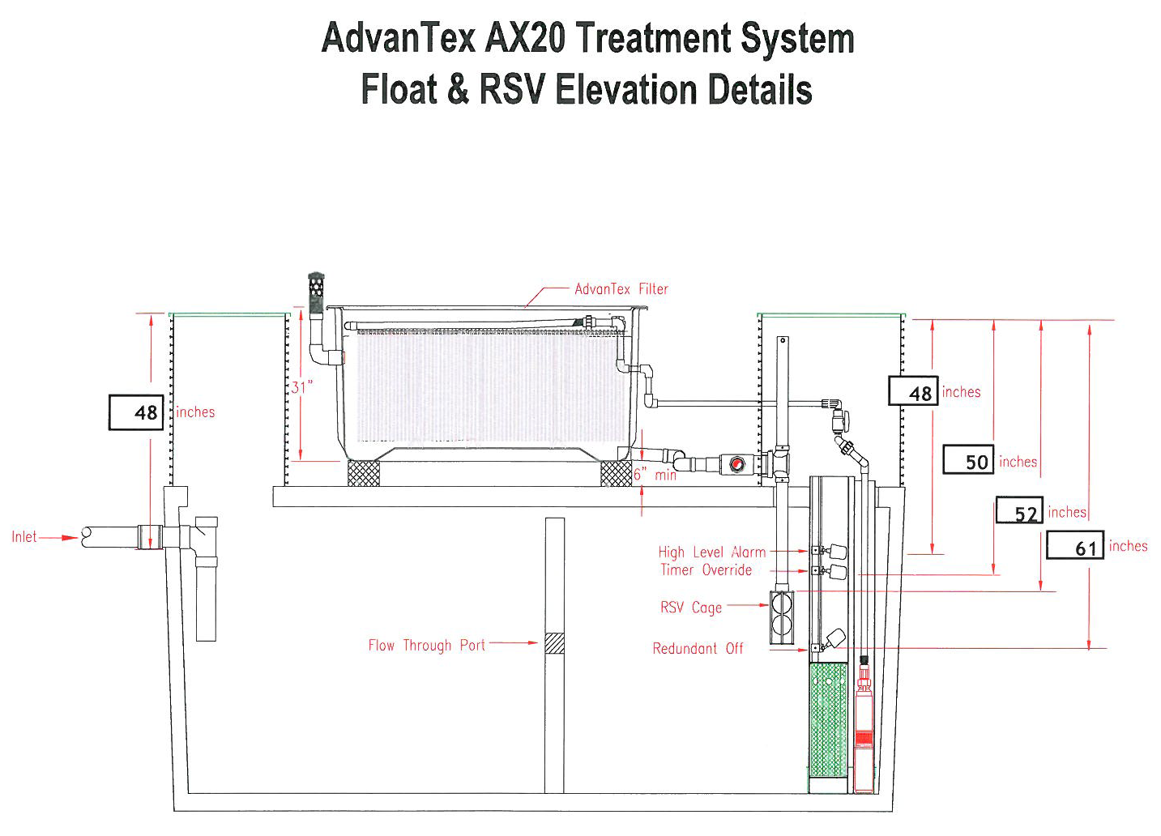
The design sheet will produce an installer summary list, a system elevation template, and a recirc & lift tank float setting document.
(Recirc tank float drawing - side view)

Slide 30
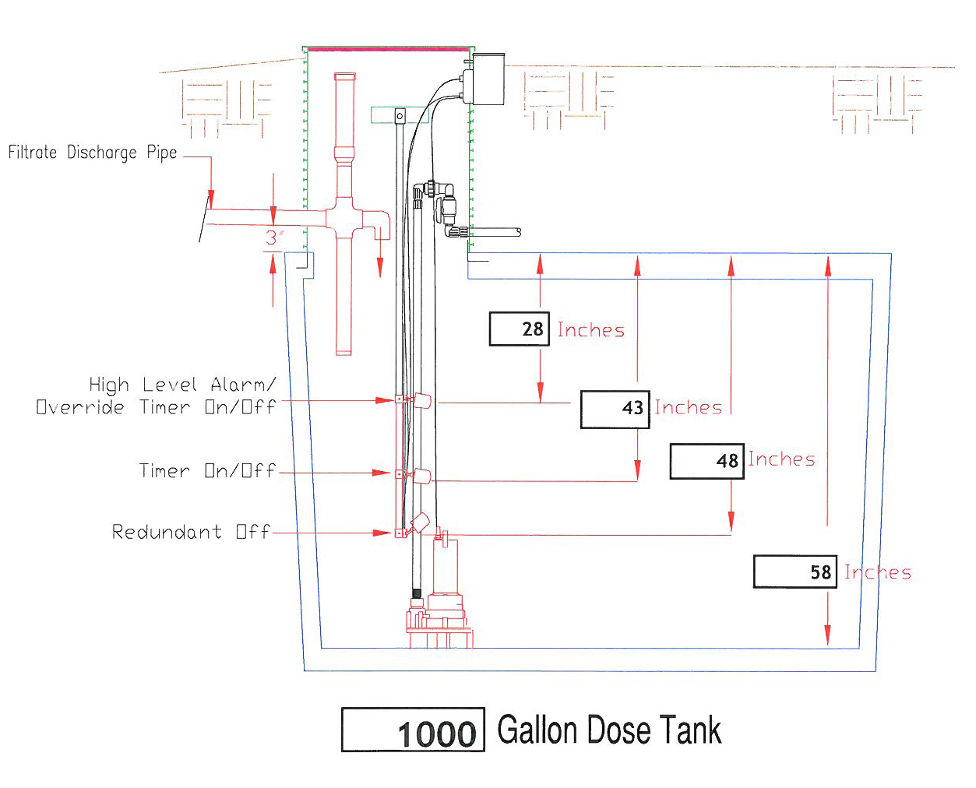
(Dose tank float drawing - side view)

Slide 31
System elevation template

Slide 32
System summary
- Each Advantex unit is registered at 600 gpd.
- The septic tank is sized at approximately 2 times design flow.
The recirc tank is sized for a minimum of 1 days design flow, with a minimum
water height of 44”.
- Recirc settings are based on estimated actual use.
- The Recirc pump doses approximately 10 gallons every 20 minutes,
depending on actual flow and the desired recirc ratio.
- Water must gravity flow from the ball cage “T” to the lift tank.
Floatation measures must be taken to keep the Advantex unit from lifting
out of the ground.

Slide 33
System summary - continued
The UV lite is typically set in the lift tank riser.
The system currently requires a phone landline for the onsite control panel.
The Maintainer will need an internet connection to set and adjust the alarm
settings and receive calls from the panel.
The recirc tank needs to be filled with water at system start-up.
The unit requires yearly maintenance: clean pump vault filter, check floats
and ball cage. Check synthetic sheets, verify tank scum & sludge levels, etc.
Avoid water softener backwash to the system.

Slide 34
Typical beneficial applications
Often a small lake lot does not have room for a standard system or even a down sized type III mound.
In this situation you may have around 18” to SHWT.
With a level “A” pretreatment system you can eliminate the need for a mound and reduce the size of the required drainfield footprint.
With 12” of soil for treatment and roughly 6” of distribution rock, the top of rock elevation is basically back to grade. When the additional 12” of cover above grade is blended in to the existing grade, you often can’t tell where the drainfield is. This can be achieved with a pressure bed or using pressure trenches down a slope.
With the Advantex unit over the combo tank, this and the lift tank do not require a lot of additional yard space. Since these components are all at grade, the owners often simply landscape around the lids.
The end result is a minimal impact to the yard which is quite a contrast to putting in a 3’ high (minimum) finished grade mound.
If you have room for a combo tank, a lift tank and a small drainfield, this system will work well.

Slide 35
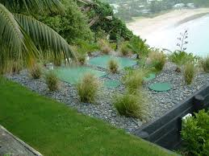
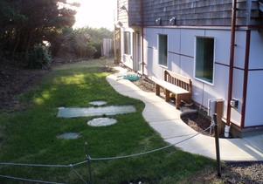
Components landscaped with rock and bushes, or flush with lawn

Slide 36
For detailed step by step instructions of the design or installation of an Advantex AX-20 system, review the training modules on the SepticResource.com website.
For further information contact your local distributor or the manufacturer at www.orenco.com
This concludes the basic Advantex “need to know” training.

